Slide 1

Programmable Accelerators
Jason Lowe-Power
powerjg@cs.wisc.edu
cs.wisc.edu/~powerjg

Slide 2
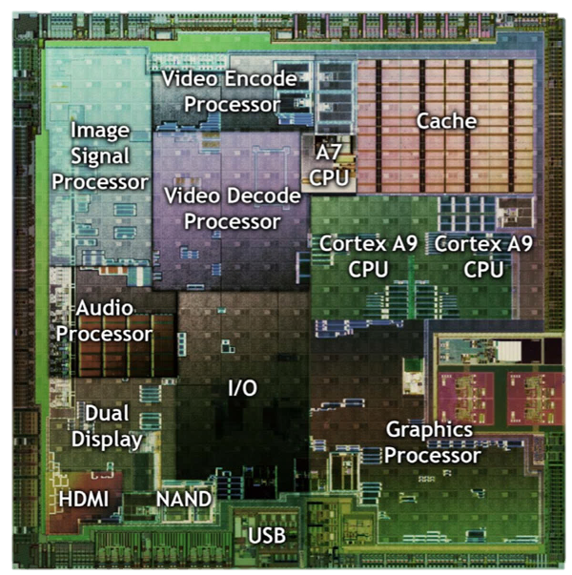
Increasing specialization
Need to program
these accelerators
Challenges
1. Consistent pointers
2. Data movement
3. Security (Fast)
This talk: GPGPUs
*NVIDIA via anandtech.com
Notes:
http://www.anandtech.com/show/4144/lg-optimus-2x-nvidia-tegra-2-review-the-first-dual-core-smartphone/3

Slide 3
Programming accelerators (baseline)
int main() {
int a[N], b[N], c[N];
init(a, b, c);
add(a, b, c);
return 0;
}
Accelerator-side code
CPU-Side code

Slide 4
Programming accelerators (baseline)
int main() {
int a[N], b[N], c[N];
init(a, b, c);
add(a, b, c);
return 0;
}
void add(int*a, int*b, int*c) {
for (int i = 0;
i < N;
i++)
{
c[i] = a[i] + b[i];
}
}
Accelerator-side code
CPU-Side code

Slide 5
Programming accelerators (GPU)
int main() {
int a[N], b[N], c[N];
init(a, b, c);
add(a, b, c);
return 0;
}
void add_gpu(int*a, int*b, int*c) {
for (int i = get_global_id(0);
i < N;
i += get_global_size(0))
{
c[i] = a[i] + b[i];
}
}
Accelerator-side code
CPU-Side code

Slide 6





Programming accelerators (GPU)
int main() {
int a[N], b[N], c[N];
int *d_a, *d_b, *d_c;
cudaMalloc(&d_a, N*sizeof(int));
cudaMalloc(&d_b, N*sizeof(int));
cudaMalloc(&d_c, N*sizeof(int));
init(a, b, c);
cudaMemcpy(d_a, a, N*sizeof(int),
cudaMemcpyHostToDevice);
cudaMemcpy(d_b, b, N*sizeof(int),
cudaMemcpyHostToDevice);
add_gpu(a, b, c);
cudaMemcpy(c, d_c, N*sizeof(int),
cudaMemcpyDeviceToHost);
cudaFree(d_a); cudaFree(d_b);
cudaFree(d_c);
return 0;
}
void add_gpu(int*a, int*b, int*c) {
for (int i = get_global_id(0);
i < N;
i += get_global_size(0))
{
c[i] = a[i] + b[i];
}
}
Accelerator-side code
CPU-Side code

Slide 7








Programming accelerators (GOAL)
int main() {
int a[N], b[N], c[N];
int *d_a, *d_b, *d_c;
cudaMalloc(&d_a, N*sizeof(int));
cudaMalloc(&d_b, N*sizeof(int));
cudaMalloc(&d_c, N*sizeof(int));
init(a, b, c);
cudaMemcpy(d_a, a, N*sizeof(int),
cudaMemcpyHostToDevice);
cudaMemcpy(d_b, b, N*sizeof(int),
cudaMemcpyHostToDevice);
add_gpu(a, b, c);
cudaMemcpy(c, d_c, N*sizeof(int),
cudaMemcpyDeviceToHost);
cudaFree(d_a); cudaFree(d_b);
cudaFree(d_c);
return 0;
}
void add_gpu(int*a, int*b, int*c) {
for (int i = get_global_id(0);
i < N;
i += get_global_size(0))
{
c[i] = a[i] + b[i];
}
}
Accelerator-side code
CPU-Side code

Slide 8
Programming accelerators (GOAL)
int main() {
int a[N], b[N], c[N];
init(a, b, c);
add_gpu(a, b, c);
return 0;
}
void add_gpu(int*a, int*b, int*c) {
for (int i = get_global_id(0);
i < N;
i += get_global_size(0))
{
c[i] = a[i] + b[i];
}
}
Accelerator-side code
CPU-Side code

Slide 9
Key challenges
CPU
a[i]
Virtual address
pointer
ld: 0x1000000
Cache
MMU
0x5000
Physical address
Memory

Slide 10
Key challenges
CPU
GPU
a[i]
Virtual address
pointer
Cache
ld: 0x1000000
MMU
Cache
?
MMU
0x5000
?
Consistent pointers
Data movement
Memory

Slide 11
Consistent pointers
Data movement

Slide 12
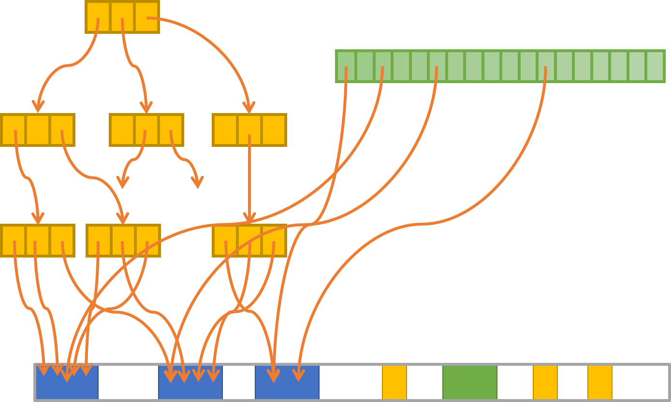
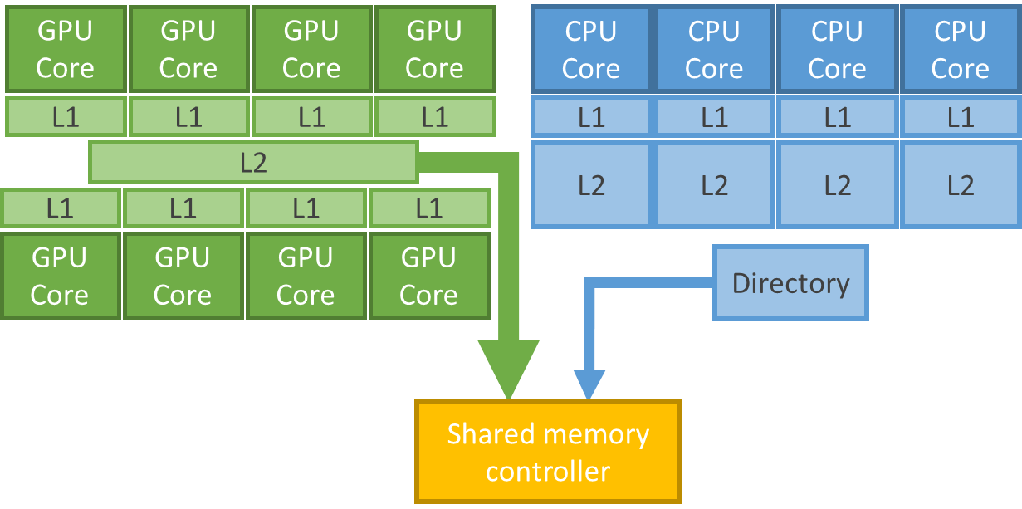
Consistent pointers
Supporting x86-64 Address
Translation for 100s of GPU Lanes
Data movement
Heterogeneous System Coherence
[HPCA 2014]
[MICRO 2014]
Notes:
High bandwidth address translation:
Note: Focus on proof-of-concept not highest possible performance
High bandwidth cache coherence

Slide 13
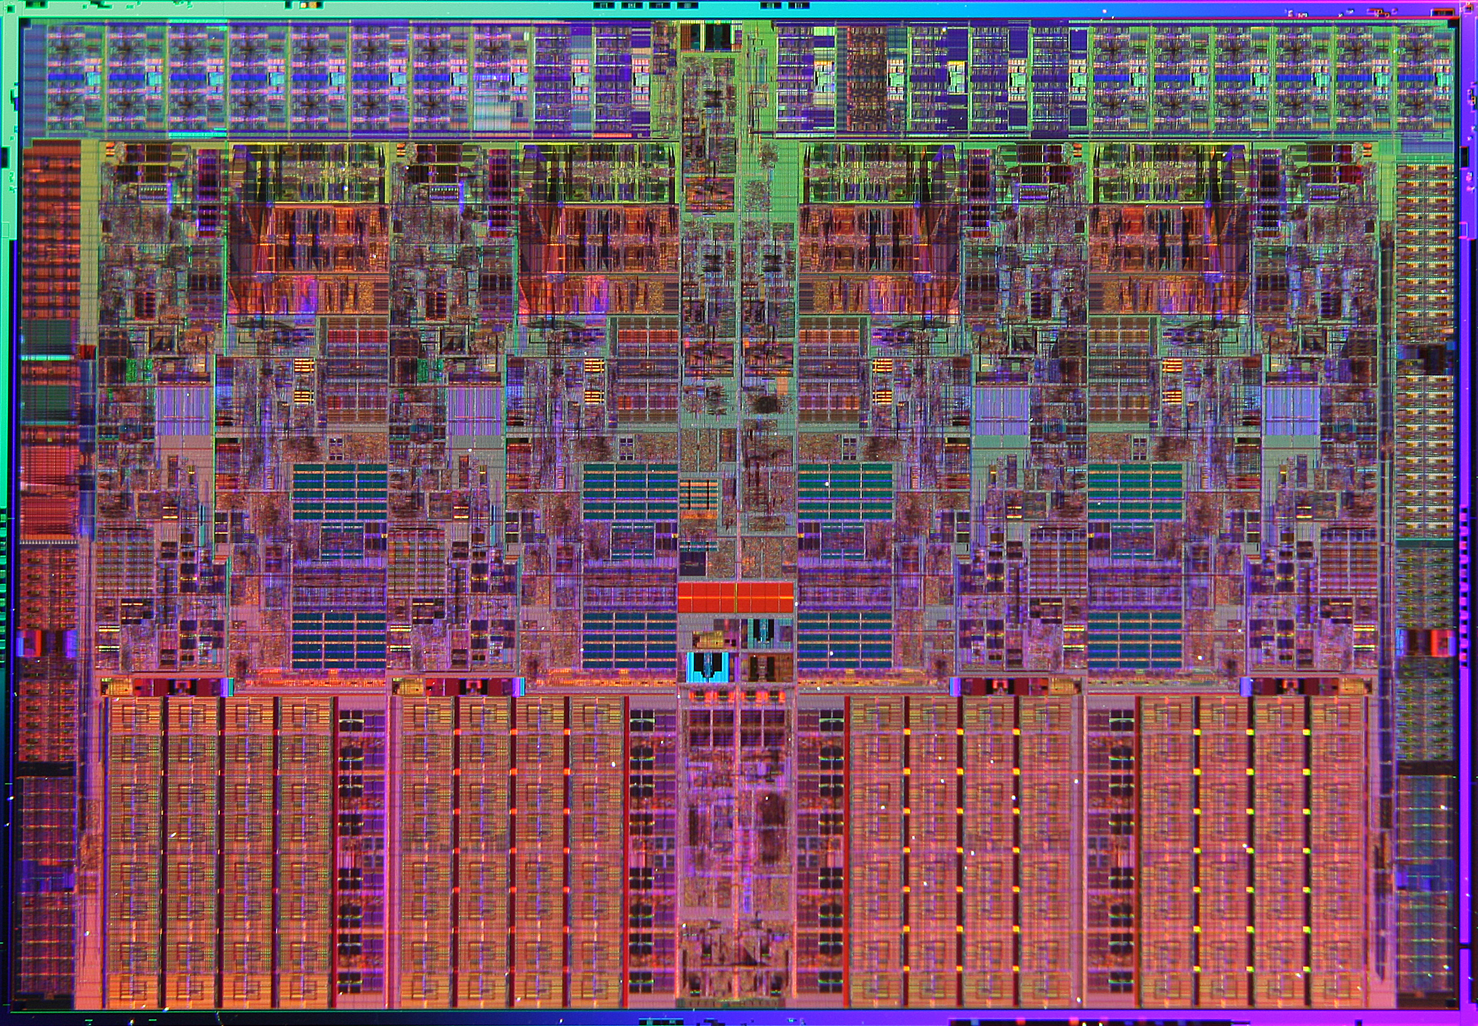
Heterogeneous System
GPU Core
GPU Core
GPU Core
GPU Core
CPU Core
CPU Core
CPU Core
CPU Core
L1
L1
L1
L1
L1
L1
L1
L1
L2
L2
L2
L2
L2
L1
L1
L1
L1
GPU Core
GPU Core
GPU Core
GPU Core
Directory
Shared memory controller
Notes:
The default for this is the old non-integrated programming model.
However, the tight physical integration gives us the chance for tight logical integration, which is what we’re looking at here.

Slide 14
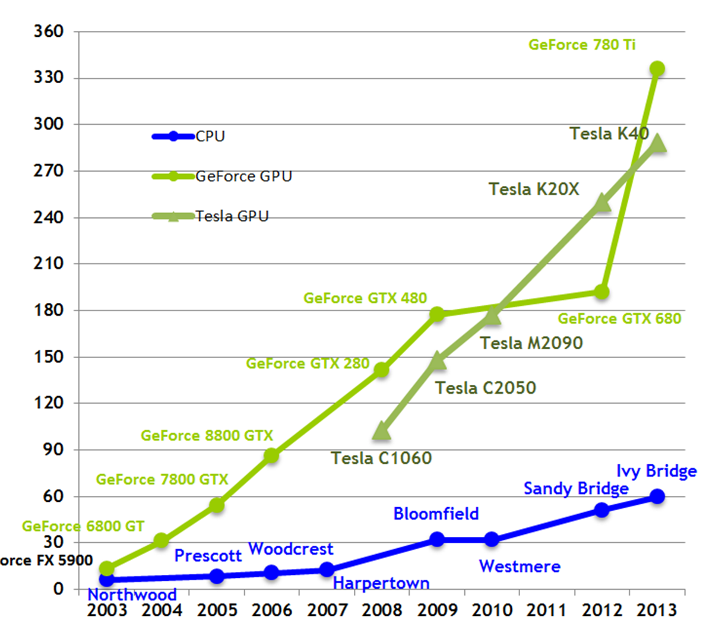
Why not CPU solutions?
Theoretical Memory Bandwidth
It’s all about bandwidth!
Translating 100s of addresses
500 GB/s at the directory
(many accesses per-cycle)
GB/s
*NVIDIA via anandtech.com

Slide 15
Consistent pointers
Supporting x86-64 Address
Translation for 100s of GPU Lanes
Data movement
Heterogeneous System Coherence
[HPCA 2014]
[MICRO 2014]
Notes:
High bandwidth address translation:
Note: Focus on proof-of-concept not highest possible performance
High bandwidth cache coherence

Slide 16
Why virtual addresses?
Virtual memory

Slide 17
Why virtual addresses?
Virtual memory
Simply copy data
Transform to new pointers
Transform to new pointers
GPU address space

Slide 18
Bandwidth problem
CPU
Virtual memory
requests
TLB
Physical memory
requests

Slide 19
Bandwidth problem
GPU Processing
Elements
(one GPU core)
Lane
Lane
Lane
Lane
Lane
Lane
Lane
Lane
Lane
Lane
Lane
Lane
Lane
Lane
Lane
Lane

Slide 20
Solution: Filtering
GPU Processing
Elements
(one GPU core)
Lane
Lane
Lane
Lane
Lane
Lane
Lane
Lane
Lane
Lane
Lane
Lane
Lane
Lane
Lane
Lane

Slide 21
Solution: Filtering
GPU Processing
Elements
(one GPU core)
Lane
Lane
Lane
Lane
Lane
Lane
Lane
Lane
Lane
Lane
Lane
Lane
Lane
Lane
Lane
Lane
1x
Shared Memory
(scratchpad)
0.45x

Slide 22
Solution: Filtering
GPU Processing
Elements
(one GPU core)
Lane
Lane
Lane
Lane
Lane
Lane
Lane
Lane
Lane
Lane
Lane
Lane
Lane
Lane
Lane
Lane
1x
Shared Memory
(scratchpad)
Coalescer
0.45x
0.06x
TLB

Slide 23
Design 1
Lane
Lane
Lane
Lane
Lane
Lane
Lane
Lane
Lane
Lane
Lane
Lane
Lane
Lane
Lane
Lane
Coalescer
Shared Memory
TLB
Shared page walk unit
Page table walker
TLB
Shared Memory
Coalescer
Lane
Lane
Lane
Lane
Lane
Lane
Lane
Lane
Lane
Lane
Lane
Lane
Lane
Lane
Lane
Lane

Slide 24
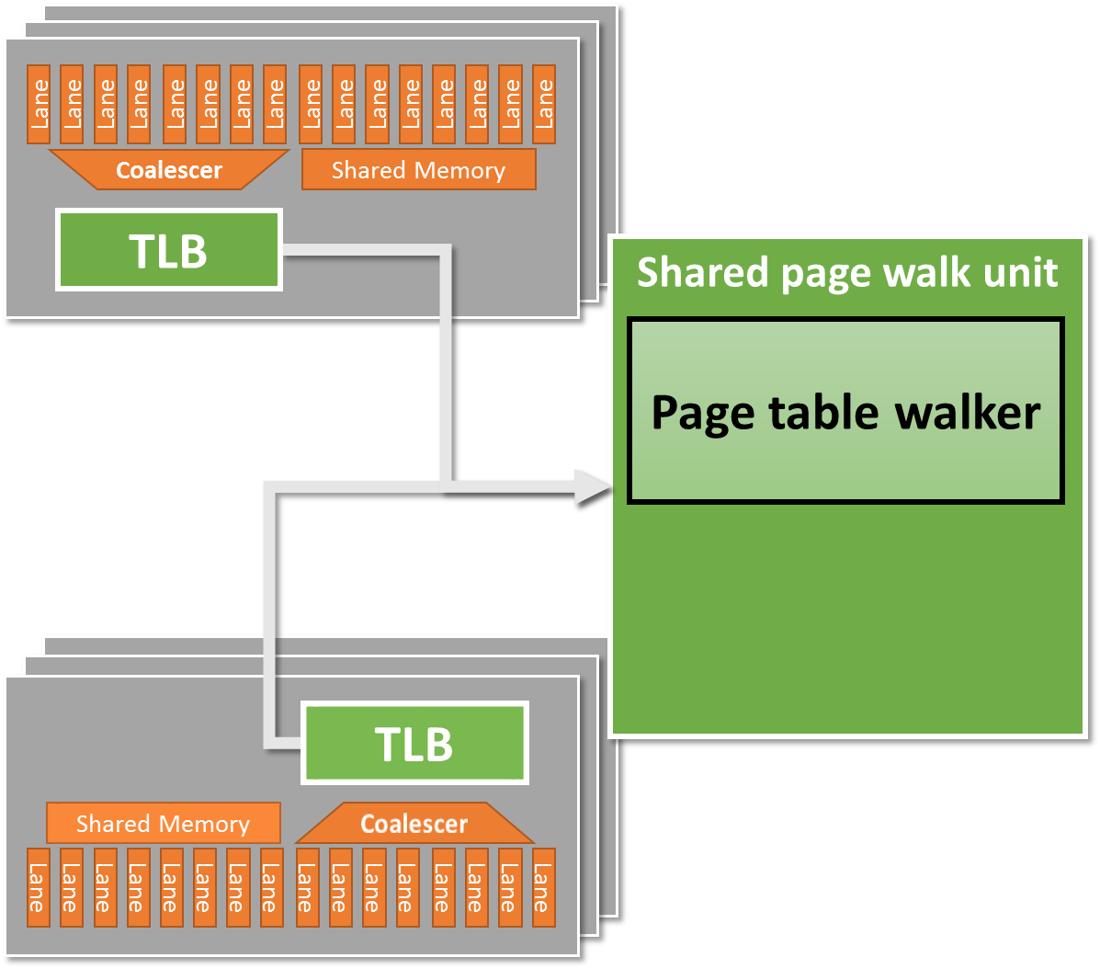
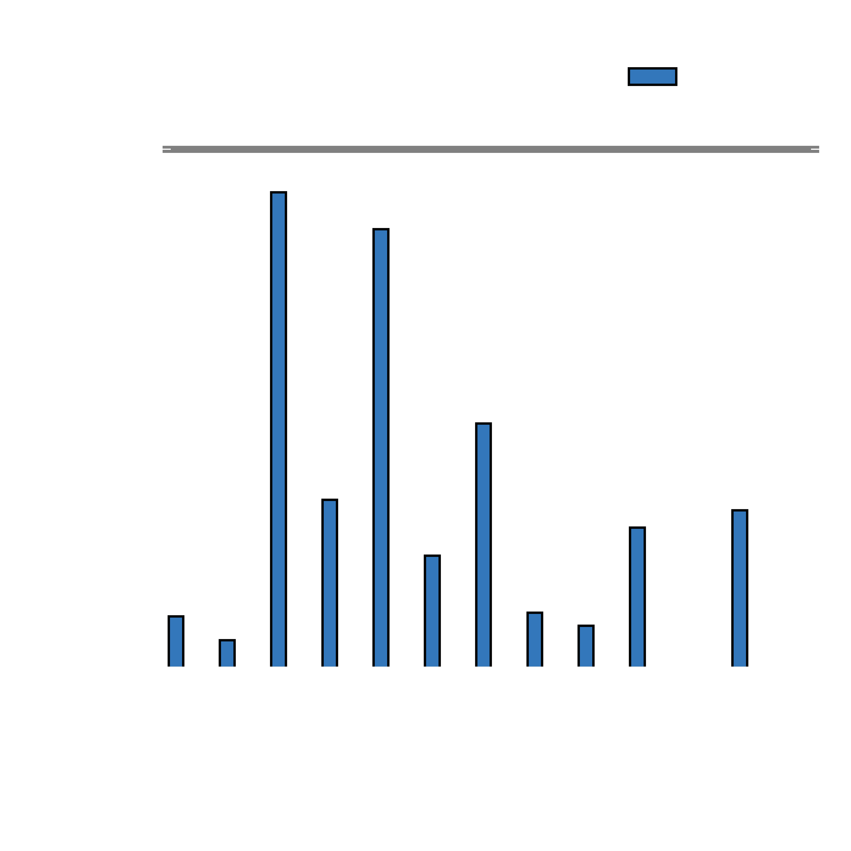

Poor performance
Average 3x slowdown

Slide 25
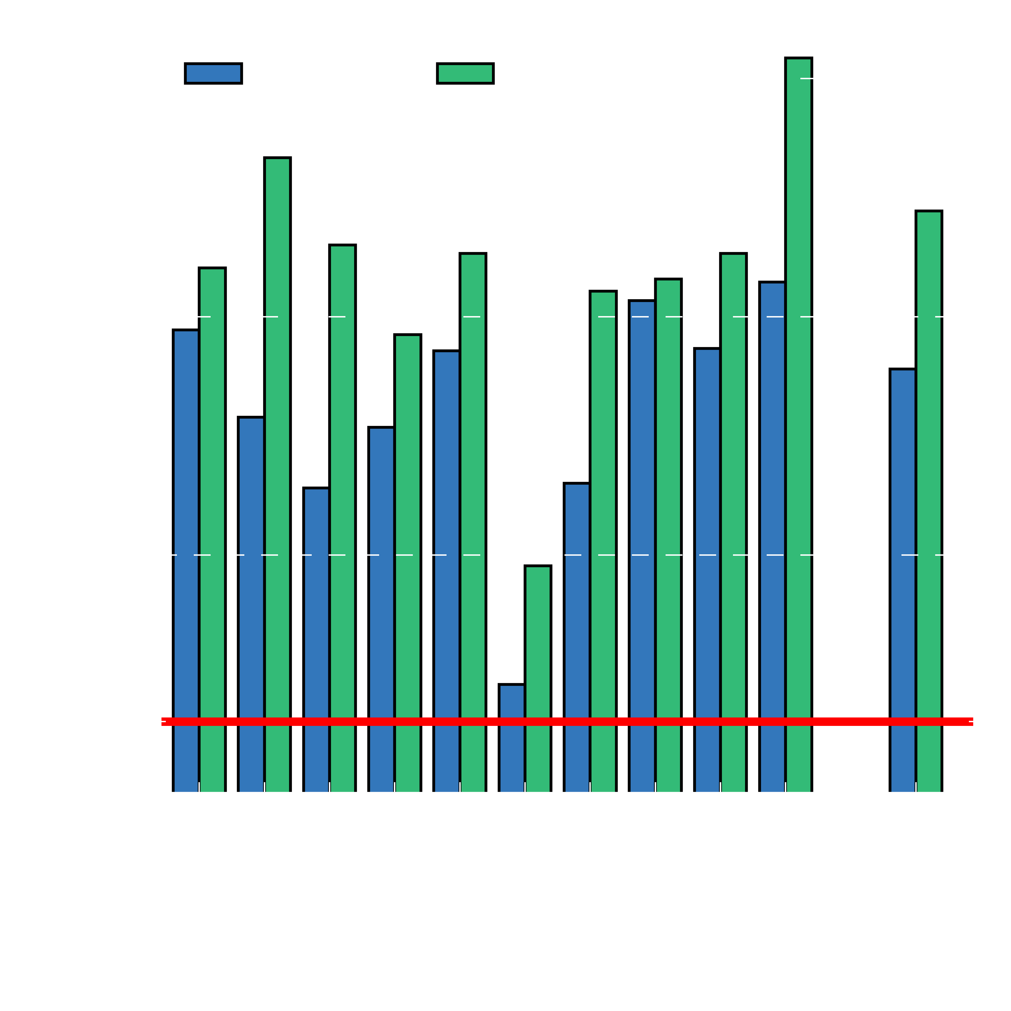



Bottleneck 1: Bursty TLB misses
Average: 60 outstanding requests
Max 140 requests
Huge queuing delays
Solution:
Highly-threaded pagetable walker
Notes:
The performance degradation comes from 2 things
1. many outstanding requests at the PTW hardware.
Solution: make it multithreaded

Slide 26
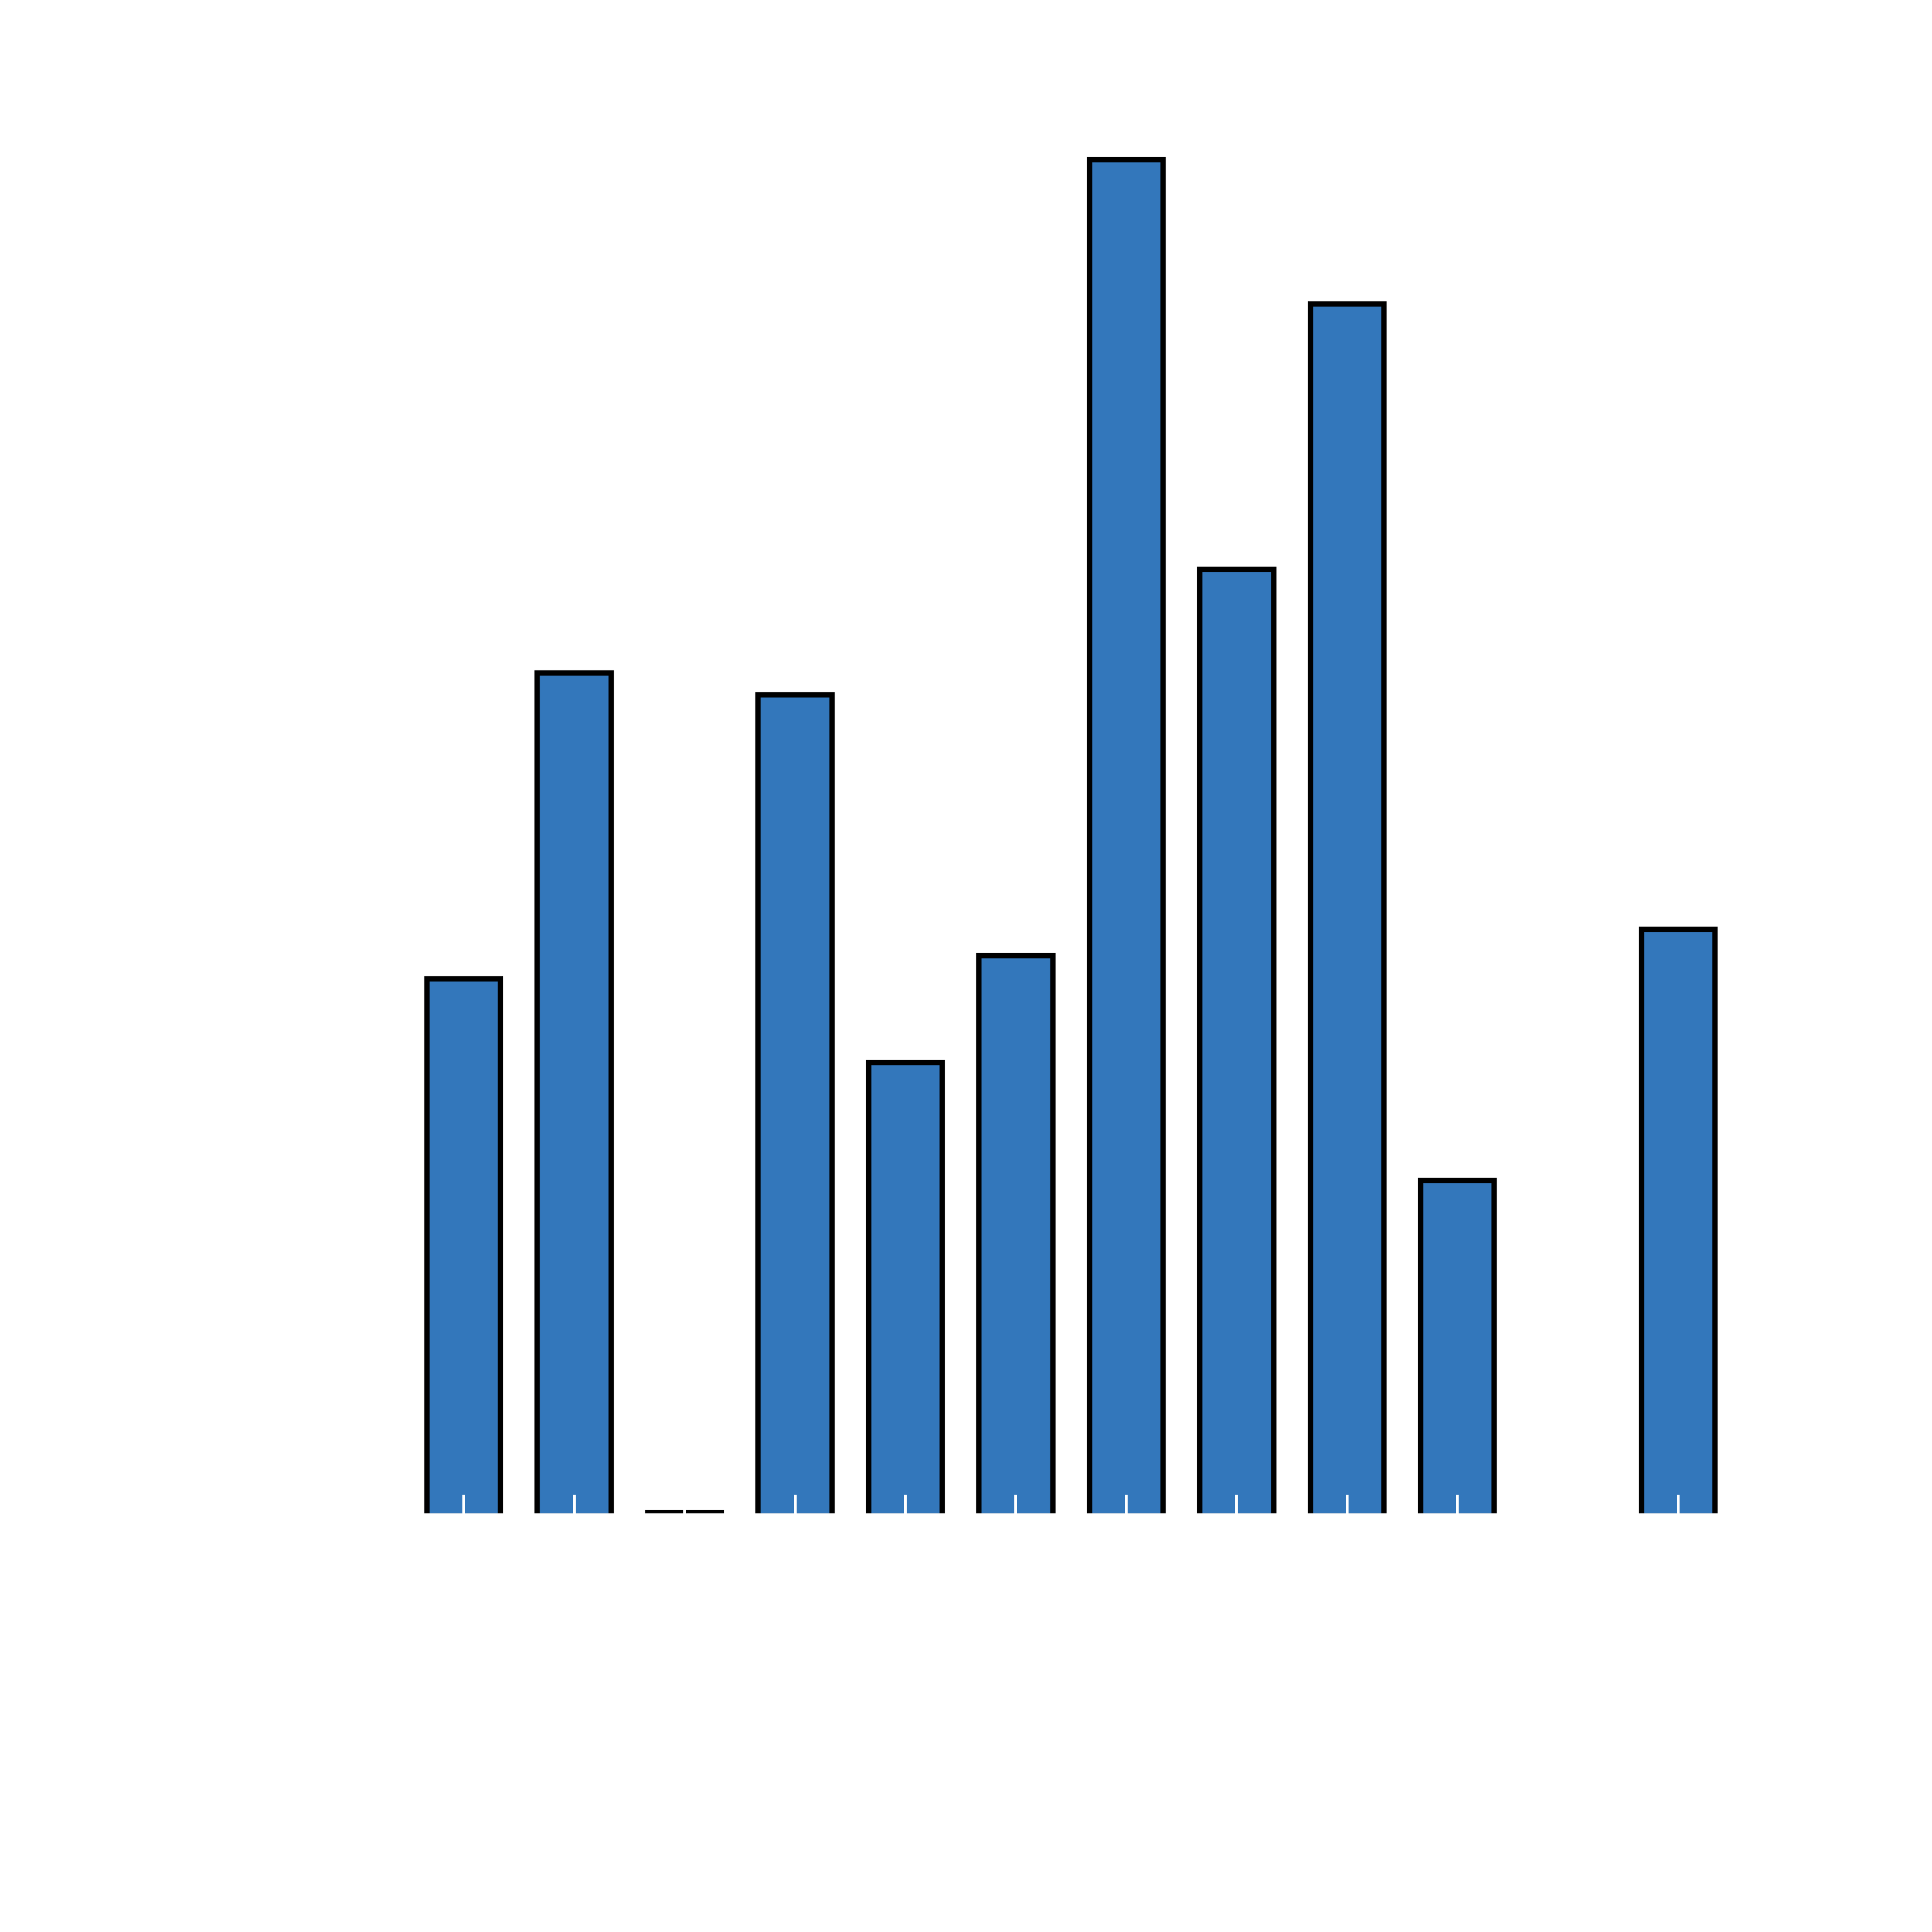
Bottleneck 2: High miss rate
Large 128 entry TLB doesn’t help
Many address streams
Need low latency
Solution:
Shared page-walk cache
Notes:
2. many misses no matter what you do
Solution: reduce miss latency with PWC

Slide 27
GPU MMU Design
Lane
Lane
Lane
Lane
Lane
Lane
Lane
Lane
Lane
Lane
Lane
Lane
Lane
Lane
Lane
Lane
Coalescer
Shared Memory
TLB
Shared page walk unit
Highly-threaded Page table walker
Page walk cache
TLB
Shared Memory
Coalescer
Lane
Lane
Lane
Lane
Lane
Lane
Lane
Lane
Lane
Lane
Lane
Lane
Lane
Lane
Lane
Lane

Slide 28
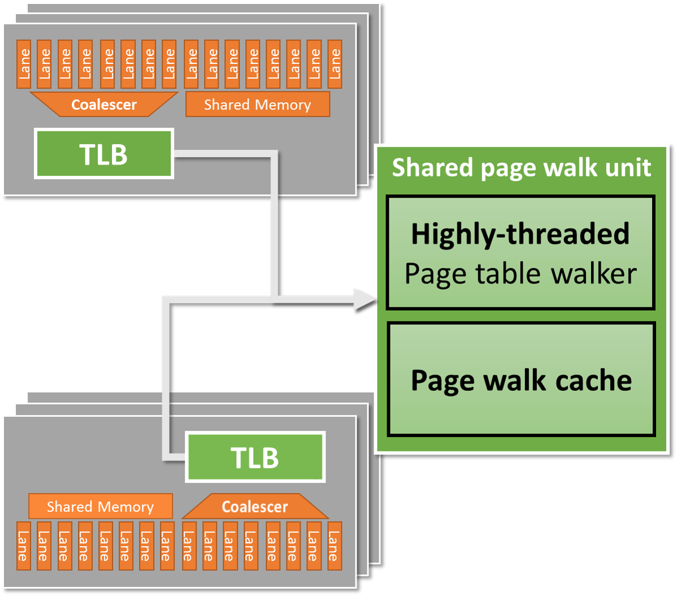
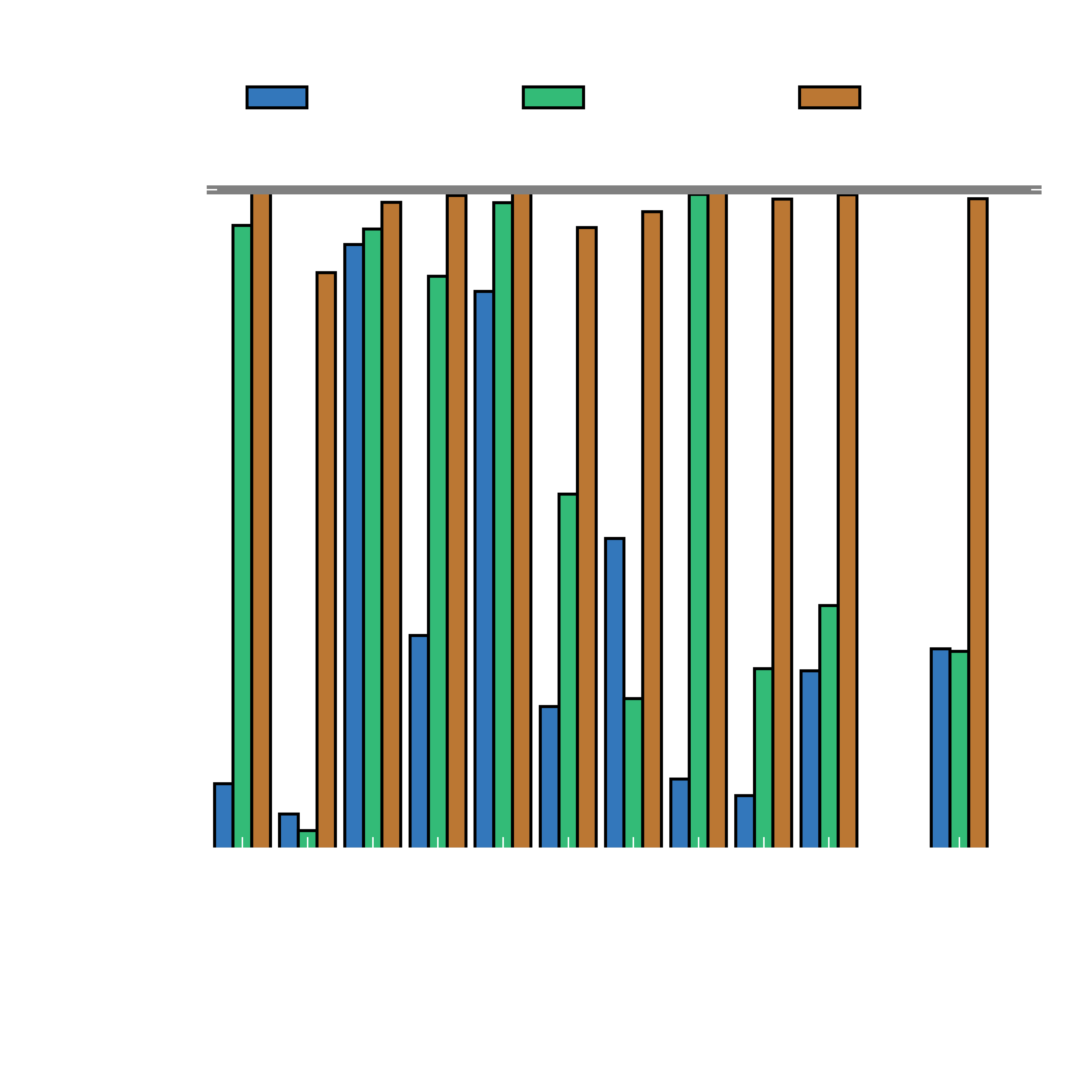





Performance: Low overhead
Average: Less than 2% slowdown
Worst case: 12% slowdown
28

Slide 29
Consistent pointers
Supporting x86-64 Address
Translation for 100s of GPU Lanes
Shared virtual memory is important
Non-exotic MMU design
  Post-coalescer L1 TLBs
  Highly-threaded page table walker
  Page walk cache
Full compatibility with minimal overhead
Still room to optimize
Notes:
High bandwidth address translation:
Note: Focus on proof-of-concept not highest possible performance
High bandwidth cache coherence

Slide 30
Consistent pointers
Supporting x86-64 Address
Translation for 100s of GPU Lanes
Data movement
Heterogeneous System Coherence
[HPCA 2014]
[MICRO 2014]
Notes:
High bandwidth address translation:
Note: Focus on proof-of-concept not highest possible performance
High bandwidth cache coherence

Slide 31











Legacy Interface
GPU Core
GPU Core
GPU Core
GPU Core
CPU Core
CPU Core
CPU Core
CPU Core
CPU writes memory
CPU initiates DMA
GPU direct access
High bandwidth
No directory access
L1
L1
L1
L1
L1
L1
L1
L1
L2
L2
L2
L2
L2
L1
L1
L1
L1
GPU Core
GPU Core
GPU Core
GPU Core
Directory
Inv
Memory

Slide 32




CC Interface
GPU Core
GPU Core
GPU Core
GPU Core
CPU Core
CPU Core
CPU Core
CPU Core
CPU writes memory
GPU access
Bottleneck: Directory
1. Access rate
2. Buffering
L1
L1
L1
L1
L1
L1
L1
L1
L2
L2
L2
L2
L2
L1
L1
L1
L1
GPU Core
GPU Core
GPU Core
GPU Core
Inv
Directory
Memory
Notes:
Key benefit: Use on-chip communication when possible. Copy time can be up to 98% of the runtime for a simple scan operation.

Slide 33


Directory Bottleneck 1: Access rate
Many requests per cycle
Difficult to design multi-ported directory

Slide 34
Directory Bottleneck 2: Buffering
Must track many outstanding requests
Huge queuing delays
Solution:
Reduce pressure on directory

Slide 35


HSC Design
GPU Core
GPU Core
GPU Core
GPU Core
CPU Core
CPU Core
CPU Core
CPU Core
Goal:
Direct access (B/W)
+ Cache coherence
Add:
Region Directory
Region Buffers
Decouples permission from access
Only permission traffic
L1
L1
L1
L1
L1
L1
L1
L1
L2
L2
L2
L2
L2
L1
L1
L1
L1
GPU Core
GPU Core
GPU Core
GPU Core
Region Buffer
Region Buffer
Region
Directory
Memory

Slide 36
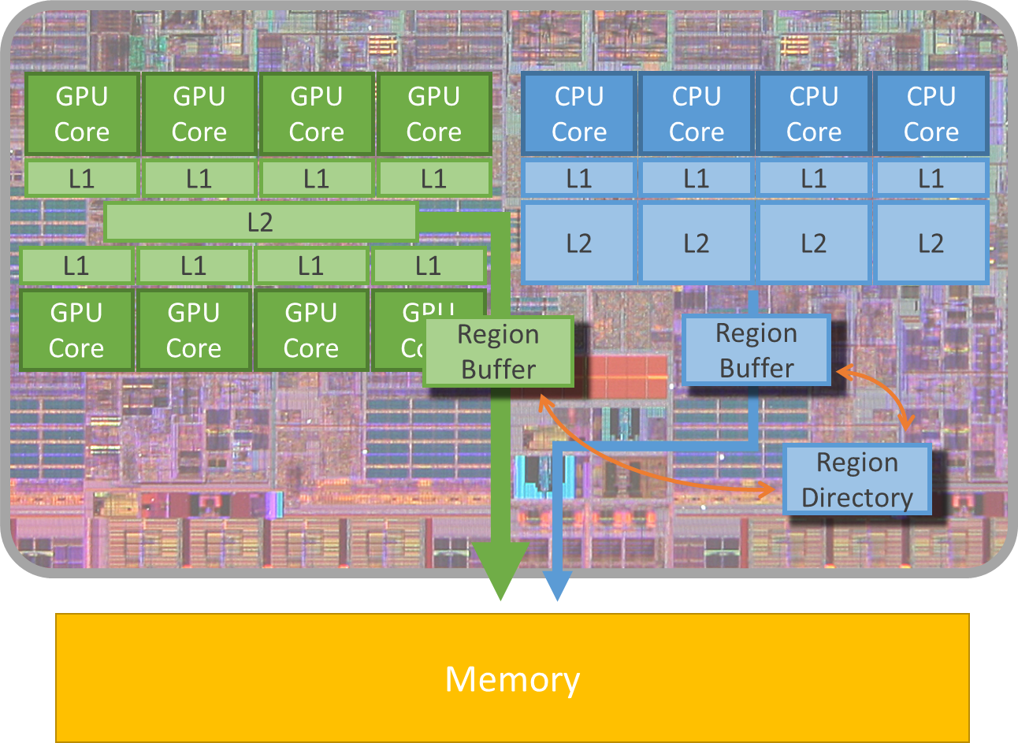
HSC: Performance Improvement

Slide 37
Data movement
Heterogeneous System Coherence
Want cache coherence without sacrificing bandwidth
Major bottlenecks in current coherence implementations
  1. High bandwidth difficult to support
  at directory
  2. Extreme resource requirements
Heterogeneous System Coherence
  Leverages spatial locality
  Reduces bandwidth and resource requirements by 95%
Notes:
High bandwidth address translation:
Note: Focus on proof-of-concept not highest possible performance
High bandwidth cache coherence

Slide 38
Increasing specialization
Need to program
these accelerators
Challenges
1. Consistent pointers
2. Data movement
3. Security (Fast)
This talk: GPGPUs
*NVIDIA via anandtech.com
Notes:
http://www.anandtech.com/show/4144/lg-optimus-2x-nvidia-tegra-2-review-the-first-dual-core-smartphone/3

Slide 39
Security & tightly-integrated accelerators
What if accelerators come from 3rd parties?
Untrusted!
All accesses via IOMMU
Safe
Low performance
Bypass IOMMU
High performance
Unsafe
Untrusted
Trusted
CPU Core
CPU Core
Accelerator
Accelerator
TLB
TLB
L1
L1
L1
L1
L2
L2
IOMMU
Process Data
Memory
OS (Protected) Data

Slide 40

Border control: sandboxing accelerators
[MICRO 2015]
Solution:
Border control
Key Idea: Decouple translation from safety
Safety + Performance
Untrusted
Trusted
CPU Core
CPU Core
Accelerator
Accelerator
TLB
TLB
L1
L1
L1
L1
L2
L2
Border Control
Border Control
IOMMU
Process Data
Memory
OS (Protected) Data
Notes:
Better because you only need 2 bits of data compared to 64 bits.

Slide 41
Conclusions
Challenges
1. Consistent addresses
GPU MMU Design
2. Data movement
Heterogeneous System Coherence
3. Security
Border Control
Goal: Enable programmers to use the whole chip

Slide 42


Consistent pointers
Supporting x86-64 Address
Translation for 100s of GPU Lanes
Jason Power, Mark D. Hill, David A. Wood
[HPCA 2014]
Data movement
Heterogeneous System Coherence
Jason Power, Arkaprava Basu*, Junli Gu*, Sooraj Puthoor*, Bradford M. Beckmann*, Mark D. Hill, Steven K. Reinhardt*, David A. Wood
*
[MICRO 2013]
Security
Border Control: Sandboxing Accelerators
Lena E. Olson, Jason Power, Mark D. Hill, David A. Wood
[MICRO 2015]
Jason Lowe-Power
powerjg@cs.wisc.edu
cs.wisc.edu/~powerjg
I’m on the job market this year!
Graduating in Spring
Contact:

Slide 43
Other work
Analytic database + Tightly-integrated GPUs
When to use 3D Die-Stacked
Memory for Bandwidth-Constrained
Big-Data Workloads
Jason Lowe-Power, Mark D. Hill, David A. Wood
[BPOE 2016]
Towards GPUs being mainstream
in analytic processing
Jason Power, Yinan Li, Mark D. Hill, Jignesh M. Patel, David A. Wood
[DaMoN 2015]
Implications of Emerging 3D GPU
Architecture on the Scan Primitive
Jason Power, Yinan Li, Mark D. Hill, Jignesh M. Patel, David A. Wood
[SIGMOD Rec. 2015]
Simulation Infrastructure
gem5-gpu: A Heterogeneous
CPU-GPU Simulator
Jason Power, Joel Hestness, Marc S. Orr, Mark D. Hill, David A. Wood
[CAL 2014]

Slide 44



Comparison to CAPI/OpenCAPI
 | Same virtual address space | Cache coherent | System safety from accelerator | Assumes on-chip accel. | Allows accel. physical caches | Allows pre-translation
CAPI | Yes | Yes | Yes | No | No | No
My work | Yes | Yes | Yes | Yes | Yes | Yes
Allows for high-performance
accelerator optimizations

Slide 45
Detailed HSC Performance

Slide 46
Lane
Lane
Lane
Lane
Lane
Lane
Lane
Lane
Lane
Lane
Lane
Lane
Lane
Lane
Lane
Lane
Coalescer
Shared Memory
TLB
Shared page walk unit
Highly-threaded Page table walker
Page walk cache
TLB
Shared Memory
Coalescer
Lane
Lane
Lane
Lane
Lane
Lane
Lane
Lane
Lane
Lane
Lane
Lane
Lane
Lane
Lane
Lane

Slide 47




Other accelerators
First step: CPU-GPU
What about other accelerators?
ISP, Always-on Sensors
Many emerging accelerators
Neuromorphic
Database
These also need a coherent and consistent view of memory!
Notes:
GPU is a stress test

Slide 48
Highly-thread PTW Design

