Slide 1
Persistent File Cache on Android Operating System
Robin Paul Prakash Prashant Saxena Prakhar Panwaria

Slide 2
Motivation
Why?
RAM– Faster access time, Non-persistent
Disk – Relatively slower access time, Persistent
Persistent File Cache – Best of both worlds!
Where?
Battery backed devices
Mobile devices are good candidate

Slide 3
Solution
Retain data in memory for longer duration
Batch write requests to disk
Provide extra protection to data while it resides in memory

Slide 4
Persistent File Cache
Synchronization between Memory and Disk can happen during:
Implicit sync: every 30 seconds
dirty_writeback_centisecs (default: 5 seconds)
dirty_expire_centiseconds (default: 30 seconds)
dirty_background_ratio (default: 10%)
Explicit sync
sync(), fsync()

Slide 5
Persistent File Cache
Our Implementation:
Intercept sync(), fsync() and fdatasync() system calls.
Implicit sync time increased to 2 minutes.
Switch between standard mode and custom mode of operation.
Modified kernel panic call stack to call sync()function before rebooting.

Slide 6
Memory Protection
Why?

Slide 7
Memory Protection
Why? - more time in memory
- Kernel bugs

Slide 8
Memory Protection
Why? - more time in memory
- Kernel bugs
Why not at File system level?

Slide 9
Memory Protection
Why? - more time in memory
- Kernel bugs
Why not at File system level?
How?

Slide 10
Memory Protection
Why? - more time in memory
- Kernel bugs
Why not at File system level?
How?
- modify page table entry
- write-enable before copying data

Slide 11
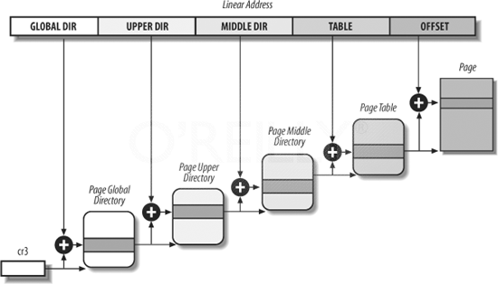
Kernel Page Tables
Figure 1: Kernel Page Tables

Slide 12
Page Table Protection
Write-enable only while copying data to page.
addr = (unsigned long)page_address(page);
pgd = pgd_offset_k(addr);
if (!pgd_none(*pgd))
{
pmd = pmd_offset(pud, addr);
if (!pmd_none(*pmd))
{
ptep = pte_offset_map(pmd, addr);
pte = pte_wrprotect(*ptep);
set_pte_at(&init_mm, addr, ptep, pte);
flush_tlb_kernel_page(addr);
}
}

Slide 13
Transcendent Memory
Not directly addressable by Kernel
Protects application data (in memory) from Kernel bugs
RAM
tmem API
(Cleancache)
get_page()
put_page()
invalidate_page()
Transcendent Memory (tmem)
Figure 2: Transcendent Memory

Slide 14
Cleancache (Linux 3.0+ Kernel)
Kernel
Page Cache
get_page()
put_page()
invalidate_page()
Cleancache
tmem
Figure 3: Cleancache (Linux 3.0 Kernel)

Slide 15
Changes in Cleancache
Kernel
Anonymous pages
File-backed pages
Page Cache
Cleancache
grab_page()
write_page()
tmem
Figure 4: Modified Cleancache

Slide 16
Changes in Cleancache
Two new calls
cleancache_grab_page()
Tries to get page from cleancache. If not present, get it from disk.
cleancache_write_page()
Write to a page in the cleancache at any particular offset within the page.

Slide 17
Changes in Android Kernel
Cleancache used for file-backed pages only
When application wants to
Read a page of file
Use cleancache_grab_page()
Write a page of file
Use cleancache_write_page()
Dirty pages written to disk when evicted from cleancache.

Slide 18
Optimization: zcache
Memory being a concern, file systems can use zcache drivers to store pages in cleancache in compressed format.
Benefit- Increase space for more pages in cleancache
Cost- Performance ( compression, decompression)

Slide 19
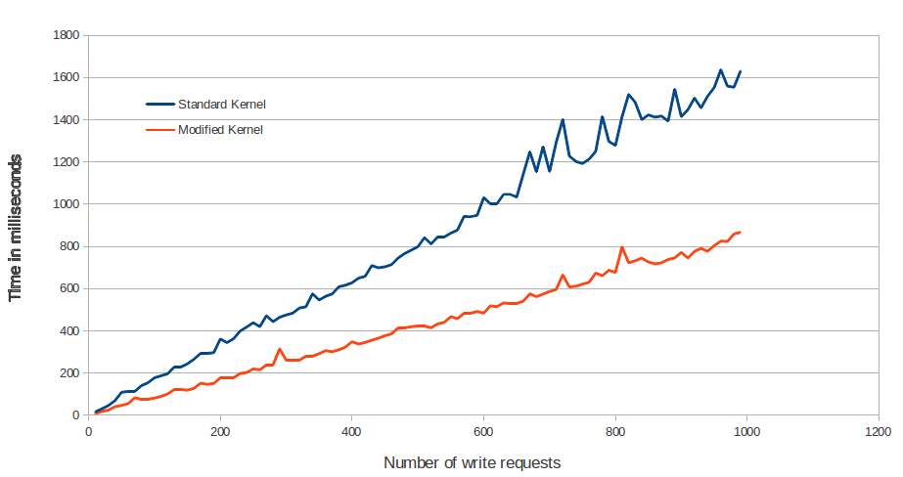
Performance Analysis
Figure 5: Performance Analysis

Slide 20
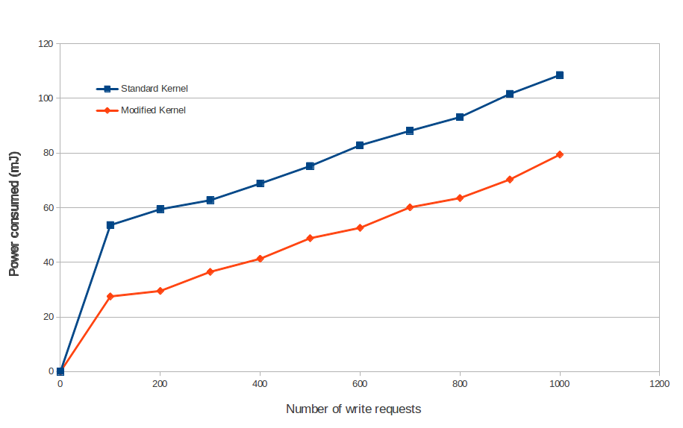
Power Analysis
Figure 5: Power Analysis

Slide 21
Questions?

Slide 22
References
[1] H. Volos, A. J. Tack, and M. M. Swift. Mnemosyne: Lightweight persistent memory. ASPLOS 11: Proceeding of the 16th international Conference on Architectural support for Programming Languages and Operating Systems, New York, NY, USA, 2011. ACM.
[2] Baker, M., Asami, S., Deprit, E., Ousterhout, J., and Seltzer, M. (1992). Non- Volatile Memory for Fast, Reliable File Systems. In Proceedings of the Fifth International Conference on Architectural Support for Programming Languages and Operating Systems (ASPLOS-V), pages 1022.
[3] Jorge Guerra, Leonardo Marmol, Daniel Galano, Raju Rangaswami, and Jinpeng Wei. Software persistent memory. FIU SCIS Technical Report TR-2010-12-01, 2010.
[4] Jason Gait. Phoenix: A Safe In-Memory File System. Communications of the ACM, 33(1):81-86, January 19, 1990.
[5] A.-I.A. Wang et al., Conquest: Better Performance through a Disk/Persistent-RAM Hybrid File System, Proc. 2002 USENIX Ann. Technical Conf., June 2002.
[6] P. M. Chen, W. T. Ng, S. Chandra, et al. The Rio File Cache: Surviving Operating System Crashes. In Proc. of the 7th Int'l. Conf. on ASPLOS, pages 74-83, 1996.

Slide 23
References
[7] Ng, N. T. and Chen, P. M. 2001. The design and verication of the Rio le cache. IEEE Trans. Comput. 50, 4, 322337.
[8] M. Baker and M. Sullivan. The recovery box: Using fast recovery to provide high availability in the UNIX environment. Proc. of the Summer USENIX Conf., June 1992.
[9] D. Magenheimer, C. Mason, D. Mccracken, K. Hackel, and O. Corporation, Transcendent memory: Re-inventing physical memory management in a virtualized environment, OSDI 08 WIP session, 2008, pp. 167-193.
[10] D. Magenheimer and O. Corp, Transcendent Memory on Xen, Xen Summit, 2009, pp. 1-3.
[11] Nitin Gupta. compcache: Compressed caching for linux. http://code.google.com/p/compcache/, 2010.
[12] Nitin Gupta, zcache: page cache compression support. http://lwn.net/Articles/396467/, 2010.
[13] Crispin Cowan, Calton Pu, Dave Maier, Heather Hinton, Jonathan Walpole, Peat Bakke,Steve Beattie, Aaron Grier, Perry Wagle, and Qian Zhang. Stackguard: Automatic adaptive detection and prevention of buer-overow attacks. In 7th USENIX Security Symposium, San Antonio, Texas, January 1998.

Slide 24
References
[14] Crispin Cowan, Perry Wagle, Calton Pu, Steve Beattie and Jonathan Walpole. Buer Overows: Attacks and Defenses for the Vulnerability of the Decade. DARPA Information Survivability Conference and Exposition. January 2000.
[15] David Wagner, Jerey S. Foster, Eric A. Brewer and Alexander Aiken. A First Step Towards Automated Detection of Buer Overrun Vulnerabilities. Network and Distributed System Security Symposium. February 2000.
[16] Get Involved | Android Open Source, Google, 2010. Web. <http://source.android.com/source/index.html>
[17] H. Kim, N. Agrawal, and C. Ungureanu, Examining storage performance on mobile devices, in Proceedings of the 3rd ACM SOSP Workshop on Networking, Systems, and Applications on Mobile Handhelds (MobiHeld), 2011.
[18] A. Carroll and G. Heiser. An analysis of power consumption in a smartphone. In USENIX, 2010.
[19] Z. Qian Z. Wang R. P. Dick Z. Mao L. Zhang, B. Tiwana and L. Yang. Accurate online power estimation and automatic battery behavior based power model generation for smartphones. In Proc. Int. Conf. Hardware/Software Codesign and System Synthesis, 2010.

Slide 25
Thanks!

