Slide 1
Deduplication - Reference counting with backpointers and bounded representation
Mitali Rawat, Sonu Agarwal, Sudarshan Avish Maru

Slide 2
Outline
Data deduplication mechanism
Approaches for handling leaking references
Current implementation in Ceph
Contributions
Our implementation
Simulated results

Slide 3
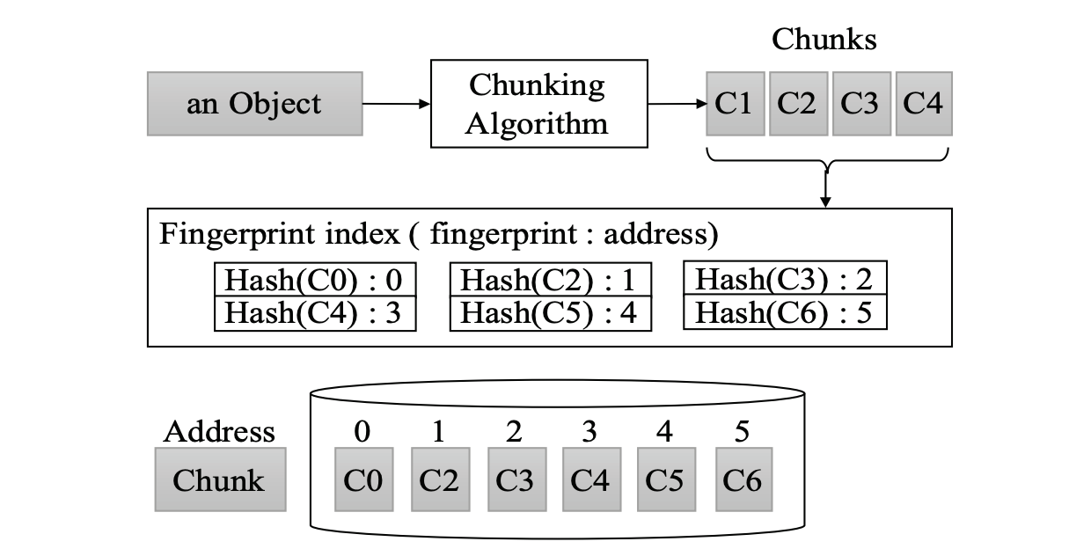
Data Deduplication Mechanism

Slide 4
Deduplication Mechanism Contd..
Traditional techniques divide an object into multiple chunks.
Each chunk is stored at a physical address that is calculated based on its contents.
This prevents duplicate storage of the chunk.

Slide 5
Approaches for handling leaking references
Each chunk can be referenced by multiple objects.
Need to keep track of references.

Slide 6
Approach 1
Store all the references explicitly.
However, in a large scale distributed system like ceph, a chunk may have millions of references.
Storing them explicitly causes huge space overheads.
Notes:
Eg some popular bytes or chunks

Slide 7
Approach 2
Instead of storing all references to a chunk explicitly, only keep their total count.
However, a lot of systems need explicit backpointers for garbage collection, consistency checks etc. (Ex: WiscKey)
Leaking references - crashes

Slide 8
Current Implementation in ceph
References to a chunk in ceph are stored explicitly.
They are captured by means of hobject_t object. It contains information such as Pool ID, Hash etc.
However, these references are currently stored in a set, which is unbounded.
Notes:
set<hobject_t> is unbounded; a popular sequence of bytes can be huge and the OSD will be sad.

Slide 9
Contributions
Fixed the CAS client to bring it to a working condition.
Added support for storing the reference count in addition to the actual backpointers.
Implemented an algorithm to create bounded representation of backpointers.
Unit tests to verify reference coalescing. These tests currently use scheme 3 but can be easily extended to other schemes.

Slide 10
Our Implementation
Hybrid of the two approaches. Stores explicit references as well as the count.
Each chunk has a vector of references, keyed by <poolid,hash prefix> where the hash prefix is some small number of bits
32 bits initially
When number of references reach a certain threshold, a coalescing mechanism is executed.
If n references are coalesced to one, the new coalesced vector contains n as the count.

Slide 11
Coalescing mechanism
Scheme 0: Coalesce two references if they have same Pool and 16 least significant bits of hash.
Scheme 1 and 2: Instead of 16 bits, use 8 and 4 bits of hash respectively.
Scheme 3: Coalesce based only on Pool.

Slide 12
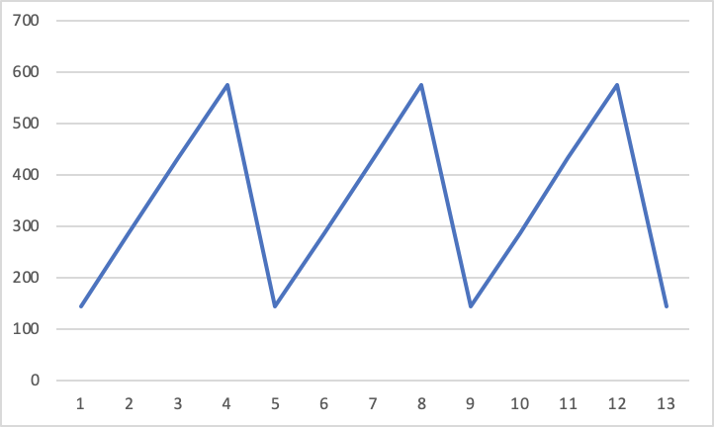
Simulated results
Approximate memory used by backpointers as more references are added to the same chunk
All references added from the same pool
Threshold on number of backpointers = 5
Memory used
(in Bytes)
Number of references added

Slide 13
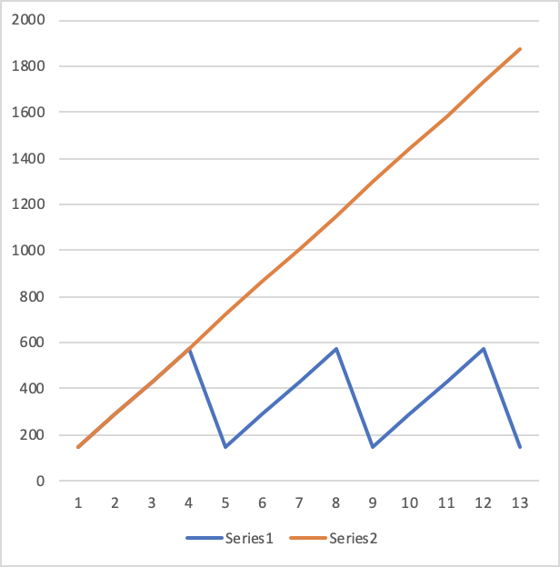
Approximate memory used by explicit and approximate backpointers as more references are added to the same chunk
All references added from the same pool
Threshold on number of backpointers = 5
Memory used
(in Bytes)
Number of references added

Slide 14
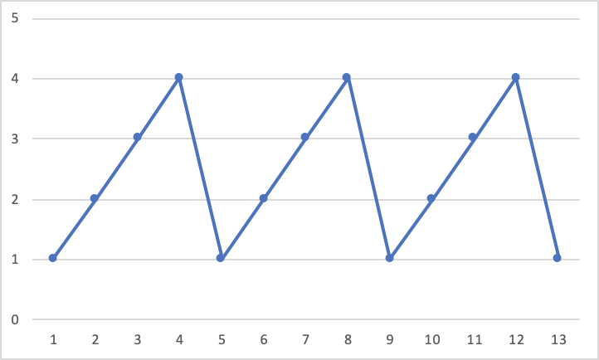
Number of backpointers stored as more references are added to the same chunks
Number of backpointers stored
Number of references added

Slide 15
Backpointers for an object when references are being added to it from two difference pools
 | Total number of reference | Total number of backpointers stored | Memory used by backpointers
Added from pool 1 | 1 | 1 | 144
Added from pool 2 | 2 | 2 | 288
Added from pool 1 | 3 | 3 | 432
Added from pool 1 | 4 | 4 | 576
Added from pool 2 | 5 | 2 | 288
Added from pool 2 | 6 | 3 | 432
Added from pool 1 | 7 | 4 | 576
Added from pool 1 | 8 | 2 | 288
Threshold on total number of backpointers = 5

Slide 16
Demo

Slide 17
Future Work
Fixes to dynamic switching between coalescing schemes
Delete path
Modifications to the scrubbing process

Slide 18
References
https://ceph.com/wp-content/uploads/2018/07/ICDCS_2018_mwoh.pdf
https://pad.ceph.com/p/deduplication_how_do_we_store_chunk

Slide 19
THANK YOU !!

Slide 20
QUESTIONS?

