Slide 1
Multi-Resource Packing for Cluster Schedulers
Tetris
Robert Grandl, Ganesh Ananthanarayanan,
Srikanth Kandula, Sriram Rao, Aditya Akella
Notes:
Thanks for the introduction, Rodrigo. Hello everyone. Today I am presenting Tetris, a new multi-Resource cluster scheduler which packs resources.
So, nowadays we have very powerful clusters, which worth millions of dollars. These clusters have a bunch of memory, cores, disk and network bandwidth, and are used to analyze large datasets by running jobs consisting of many tasks.
However, we cannot get the value for the money we pay.

Slide 2
Performance of cluster schedulers
We find that:
Resources are fragmented i.e. machines run below capacity
Even at 100% usage, goodput is smaller due to over-allocation
Pareto-efficient multi-resource fair schemes do not lead to good avg. performance
Tetris
Up to 40% improvement in makespan¹ and job completion time with near-perfect fairness
¹Time to finish a set of jobs
Notes:
For example, we observe that resources are fragmented, which means that machines are running below
capacity.
But even when at 100% usage, the actual goodput is much smaller, because some of the resources are over-allocated.
Also, even when pareto-efficient multi-resource fair schemes are used, they result in much lower performance.
Driven by these challenges, we propose Tetris, a new multi-resource cluster scheduler which is able to overcome these problems and provides
up to 40% improvements in makespan and job completion time with near-perfect fairness.

Slide 3
Findings from Bing and Facebook traces analysis
Applications have (very) diverse resource needs
Tasks need varying amounts of each resource
Multiple resources become tight
Demands for resources are weakly correlated
This matters, because no single bottleneck resource in the cluster:
E.g., enough cross-rack network bandwidth to use all cores
Upper bound on potential gains
Makespan reduces by ≈ 49%
Avg. job completion time reduces by ≈ 46%
Notes:
We analyzed Bing and Facebook traces, and we found that jobs of many applications coexist in these clusters and their tasks have diverse resource requirements.
For example, machine learning tasks are CPU-intensive, sort tasks are memory intensive, while tasks that aggregate data are network intensive.
Second, we observe that demands for different resources are weakly correlated due to the variety of specialized applications which have focused requirements, and hence overall their tasks have complementary demands. For example, a task may have high network and less memory demand, while others can be high memory and less network intensive.
As a consequence of the diversity of resource demands and weakly correlation between them, multiple resources can become tight, albeit at different machines and times.
And this matters, because in today’s clusters there is no single bottleneck resource. For example we have enough cross-rack bandwidth to use all the available CPU cores due to balanced machine specifications.
Actually, our analysis reveals that a scheduler that consider tasks with diverse multi-resource requirements and multiple resource bottlenecks, could reduce makespan and average job completion time by up to 49% and 46% respectively w.r.t to existing scheduling approaches.

Slide 4
Why so bad #1
Production schedulers neither pack tasks nor consider all their relevant resource demands
#1 Resource Fragmentation
#2 Over-allocation
Notes:
The reason is because they neither pack tasks nor consider all their relevant resource demands.
Hence, they suffer from two major problems: resource fragmentation and over-allocation of ignored resources during assignment process.
In the next slides, I will show some simple examples, which helps to clarify these problems.

Slide 5
Resource Fragmentation (RF)
Current Schedulers
T3: 4 GB
T3: 4 GB
Are not explicit about packing.
T2: 2 GB
T2: 2 GB
Avg. task compl.time = 1.33 t
Avg. task compl. time = 1 t
Time
Time
T1: 2 GB
T1: 2 GB
Allocate resources per slots, fairness.
STOP
RF increase with the number of resources being allocated !
Machine A
4 GB Memory
Machine B
4 GB Memory
Machine A
4 GB Memory
Machine B
4 GB Memory
Current Schedulers
“Packer” Scheduler
Notes:
So, resource fragmentation happens when during the resource assignment process some resources becomes fragmented,
and so being unable to be assigned to runnable tasks.
This happens, because none of the existing schemes pay attention to the set of runnable tasks, in a specific order, to minimize resource fragmentation.
Typically they allocate resources in terms of slots which logically represents some amount of memory and cores, and based on fairness considerations.
For example, consider a cluster with 2 machines available to schedule, each with 4 GB of available memory. And 3 tasks each with some memory requirement. Assuming each task has same duration t, a typical cluster scheduler “can” assign task 1 to machine 1, task 2 to machine 2 and such fragmenting the available memory on both machines, while task 3 is delayed until either t1 or t2 have finished.
On the other hand, a cluster scheduler that packs tasks to machines will assign both tasks 1 and 2 to machine A in order to maximize the resource usage on that machine, while task 2 can be executed in parallel on machine B.
In fact, theoretical analysis have shown that the resource fragmentation increases with the number of resources being allocated.

Slide 6
Over-Allocation
Current Schedulers
T3: 2 GB
Memory
T3: 2 GB
Memory
Not all of the resources are explicitly allocated
T2: 2 GB
Memory
20 MB/s Nw.
T2: 2 GB
Memory
20 MB/s Nw.
Avg. task compl.time= 2.33 t
Avg. task compl. time = 1.33 t
Time
Time
T1: 2 GB
Memory
20 MB/s Nw.
T1: 2 GB
Memory
20 MB/s Nw.
E.g.,disk and network can be over-allocated
STOP
20 MB/s Nw.
20 MB/s Nw.
Machine A
4 GB Memory; 20 MB/s Nw.
Machine A
4 GB Memory; 20 MB/s Nw.
Current Schedulers
“Packer” Scheduler
Notes:
But, even if we are able to avoid resource fragmentation and guarantee 100% resource usage, some other resources can be over-allocated.
This happens for example, when some tasks that are able to fully use some resource( for example disk bandwidth ) are assigned at the same time on the same machine, and such that resource becomes over-allocated.
Current cluster schedulers do not avoid over-allocation and this is because during the resource assignment process, some resources are ignored(such as disk and network) which could lead to their over-allocation.
For example, assume machine A has some amount of memory and network bandwidth available, and three runnable tasks, where t1 and t2 have both memory and network requirements.
Assuming each task has same duration t, a typical cluster scheduler which define slots based on memory, will assign both t1 and t2 simultaneously, although each of them is able to fully utilize the network, and hence will over-allocate the network, and double their completion time.
On the other hand, a cluster scheduler that packs and looks at all the relevant resources for a task, will assign t1 but not t2 at the same time, because the network is already a tight resource, and such t3 can be assigned as well.s
Now, assume that we are able to fully utilize the resources and avoid their over-allocations. Does that means we can get the best cluster efficiency and improvements in job completion time ?
And the answer is no, because , it is commonly to use fairness solutions to allocate job tasks appropriately based on “fairness” considerations, which do not strive to optimize job completion time, but to be fair.

Slide 7
Why so bad #2
Multi-resource Fairness Schemes do not solve the problem
Example in paper
Packer vs. DRF: makespan and avg. completion time improve by over 30%
Work Conserving != no fragmentation, over-allocation
Pareto¹ efficient != performant
Treat cluster as a big bag of resources
Hides the impact of resource fragmentation
Assume job has a fixed resource profile
Different tasks in the same job have different demands
How the job is scheduled impacts jobs’ current resource profiles
Can schedule to create complementarity
¹no job can increase its share without decreasing the share of another
Notes:
Remember, what is a packer scheduler here.
Although recent research has also defined fairness based on multiple resources, they do not help either.
In fact, we have an example in the paper that shows that a packer scheduler, can improve job completion time by 50% and makespan by 33% compared to Dominant Resource Fairness(DRF), which is the most recent work in context of multi-resource fair schemes.
The main reasons for lack of performance of production fairness schemes are the following:
first, they tend to be work conserving, and do not directly strive to reduce fragmentation or avoid over-allocation, and hence to improve job completion time and makespan.
Second, even when pareto efficient, they are not performant.
For example, they treats the cluster as one big bag of resources, which hides the impact of fragmentation which may occur on individual machines.
Also, they assume that each job has a fixed resource profiles. However, different tasks in the same job might have different resource demands.
For example, a task in its early stage can be network intensive as it is retrieving data, while later can be cpu/memory intensive by processing the data.
In addition, the scheduling procedure itself can impact jobs current resource demands and create complementary profiles. For example, it can arbitrate tasks scheduling such that network intensive tasks to be scheduled together with ones that are cpu/memory intensive.

Slide 8
Current Schedulers
1. Resource Fragmentation
2. Over-Allocation
3. Fair allocations sacrifice performance
Competing objectives
Cluster efficiency
vs.
Job completion time
vs.
Fairness
Notes:
Ok. So far, I have told you that state of the art schedulers allocate available resources in terms of slots based on fairness considerations which may lead to resource fragmentation and sacrifice performance, while over-allocating the resources ignored during the assignment process.
Driven by these problems, we want to improve cluster efficiency by avoiding resource fragmentation and over-allocation. At the same time, in practice there are also other important and competing objectives such as job completion time and achieving fairness.
In the rest of my talk, I will show you how we can achieve all of these simultaneous and competing goals, and how we combine them altogether.

Slide 9
Tetris
# 1
Pack tasks along multiple resources to improve cluster efficiency and reduce makespan
Notes:
So first of all, I am gonna tell you how we can pack tasks across their multiple dimensions such that to improve cluster efficiency while fragmentation and over-allocation are avoided.

Slide 10
Theory
Practice
Existing heuristics do not directly apply:
Multi-Resource Packing of Tasks
similar to
Multi-Dimensional Bin Packing
Assume balls of a fixed size
APX-Hard¹
Assume balls are known apriori
Avoiding fragmentation looks like:
vary with time / machine placed
elastic
Tight bin packing
Reduce # of bins → reduce makespan
cope with online arrival of jobs, dependencies, cluster activity
¹APX-Hard is a strict subset of NP-hard
Balls could be tasks
Bin could be machine, time
Notes:
<Analogy>
So there exists an analogy between the multi-resource packing of tasks and the multi-dimensional bin packing problem, where balls could be tasks and their sizes are resource requirements.
Now bins could be machine, time, as in machine discretized by time, because you can put the same ball on the same machine but at a different time.
So, why are they similar ?
The objective here is to pack the tasks/balls in the fewest number of bins, and such avoiding fragmentation by doing a tight bin packing.
So packing tasks in minimum number of machines, time means reducing makespan which is the goal we want to achieve.
<APX-Hard>
However, it turns out that bin packing problem is APX-hard, which is a strict subset of NP-hard.
<Heuristics>
But there exists some heuristics. However, they do not apply here:
For example, they assume balls of a fixed size, while in practice, the resource demands of tasks vary with time and based on the machine where they are placed at. Also, they are elastic, which means tasks can function with less than their peak demand.
Second, the existing heuristics assume all the balls are known a-priori, while in practice a cluster scheduler has to deal with online arrivals of jobs, dependencies among tasks, other cluster activity and so on.

Slide 11
Tetris
# 1
A packing heuristic
Fit
<
Tasks resources demand vector
Machine resource vector
Alignment score (A)
Packing heuristic
“A” works because:
1. Check for fit to ensure no over-allocation
Over-Allocation
2. Bigger balls get bigger scores
Resource Fragmentation
3. Abundant resources used first
Packing tasks to machines = Multi-Dimensional Bin Packing
Ball = Task resource demands vector
Bin = Machine available resource vector
Notes:
Driven by these challenges, we built an effective heuristic that can capture the complexities for tasks and gives you the goals we want: no fragmentation, no over-allocation.
Given a per runnable task, and a machine we compute a score, which denotes how good is to place this task at that machine for packing efficiency.
So, we take the task resources demand vector and the machine resource vector. We first check that task vector fits in the machine vector and then we compute an alignment score which is the dot product and this is what we call A. In the end, we pick the task with the highest score as the next task to assign to this machine.
This heuristic works because:
we check for fit, such that only tasks whose demands are satisfied are considered, and such over-allocation is avoided
The dot product ensures that bigger balls get bigger scores; which means that tasks that use more resources along every resource type get a higher score
And if the machine has network free then a task that uses the network will actually get a higher score than a task that don’t use the network, so abundant resources are used first
Together, this reduces resource fragmentation.
Also, it can helps in better spreading the load across machines and hence less likely to create performance bottlenecks.
The heuristic presented here is just a simple form. There are also other things, for example how to incorporate the task placement when computing the score, but I will point you to the paper for more details about it.

Slide 12
Tetris
# 2
Faster average job completion time
Notes:
So I have shown you how we pack tasks to improve cluster efficiency. Remember, that in practice another competing objective is to improve average job completion time, and I am gonna show you how we are able to do that as well.

Slide 13
Tetris
# 2
CHALLENGE
Q: What is the shortest “remaining time” ?
remaining # tasks
&
Job Completion Time Heuristic
“remaining work”
=
tasks’ resource demands
&
tasks’ durations
A job completion time heuristic
Gives a score P to every job
Extended SRTF to incorporate multiple resources
Shortest Remaining Time First¹ (SRTF)
schedules jobs in ascending order of their remaining time
¹SRTF – M. Harchol-Balter et al. Connection Scheduling in Web Servers [USITS’99]
Notes:
An useful starting point is the SRTF heuristic.
Intuitively, SRTF increases average job completion time the most , because the jobs with shortest remaining time runs first.
But, what means a job with the shortest remaining time ? It is the job with least remaining number of tasks , the job with smallest tasks durations,
or maybe the job with fewest resource demands ?
In fact, it is the job with least remaining work, where remaining work is the combination of all three of these.
So we have an heuristic which takes a job and gives it a score P which incorporates all three of these things. The details are in the paper, but essentially we’ve extended SRTF to the case of jobs with many tasks, multiple resources and different durations. Lower the score P, the more opportunity for the job to have tasks scheduled sooner.

Slide 14
Tetris
# 2
CHALLENGE
A: delays job completion time
?
Packing Efficiency
Completion Time
Job Completion Time Heuristic
P: loss in packing efficiency
Combine A and P scores !
1: among J runnable jobs
2: score (j) = A(t, R)+ε P(j)
3: max task t in j, demand(t) ≤ R (resources free)
4: pick j*, t* = argmax score(j)
Notes:
So I have just told you about our packing efficiency heuristic, which favor big tasks to be scheduled first, but nonetheless it might delay average job completion time. And now we also have a job completion time heuristic, but which can do bad things to the packing heuristic and hence hurt packing efficiency.
So, how we can achieve the best from these 2 competing objectives: efficiency and job completion time ?
We have to combine the two scores A and P using a weighted sum.
So, among all runnable jobs, we compute a score as a combination of both packing efficiency and job completion time scores,
and pick the job with the highest score to be scheduled next, and the task which generated this score as the next task to be assigned.

Slide 15
Tetris
# 3
Achieve performance and fairness
Notes:
Alright. So I have told you so far about how we can get better performance; we pack to avoid over-allocation and fragmentation and we also have a way of figuring out which are shortest jobs and preferring them.
What about fairness ?

Slide 16
Tetris
Performance and fairness do not mix well in general
# 3
But ….
We can get “perfect fairness” and much better performance
Fairness Heuristic
Packer says: “task T should go next to improve packing efficiency”
SRTF says: “schedule job J to improve avg. completion time”
Fairness says: “this set of jobs should be scheduled next”
Possible to satisfy all three
In fact, happens often in practice
Notes:
In general, we cannot get both performance and fairness at the same time. If you have to get fairness you have to give up on someone’s performance.
But I am gonna try to convince you that in the context of cluster scheduler we can achieve so called perfect fairness and
good performance.
By perfect fairness I mean do exactly what perfect allocations would have done, exactly half the cluster or exactly dominant resource fairness.
So, howe can you do that ?
Our cluster packing heuristic says: hey, pick tasks i to put on this machine because it packs well here.
Our shortest job heuristic says: oh, pick this job as it has only few work to be done and average job completion time improve.
Now, what would fairness say: every fairness scheme gives the next set of resources to jobs that are under-allocated.
(CS does this, Fair scheduling does this, DRF does this. Even the more complex schemes that were newly proposed proportional fairness and bottleneck fairness. Even they do the same thing. As in an online fashion, give the next resources to a job that is currently most unfair by some measure of unfairness. )
But, all of these three things might be simultaneously satisfiable. There might exist some job, among the jobs that are unfair, there might be a lot of tasks pending.
So you might find some tasks among the jobs which are most unfair that will pack well.
In fact, we found in practice that it is common to find this to simultaneously hold.
(In fact, what we found in practice is that it is common to find this to simultaneously hold,
because you have two administrative groups so you have two sets of jobs. It is very unlikely that even the best packing task to fall in the wrong set, but it’s possible to find a reasonable good packing task even in the other sets that is most unfair by now. )

Slide 17
Tetris
# 3
Fairness is not a tight constraint
Lose a bit of fairness for a lot of gains in performance
Long term fairness not short term fairness
Fairness Heuristic
Heuristic
Fairness Knob, F ∈ [0, 1)
Pick the best-for-perf. task from among
⎡1-F⎤ fraction of jobs furthest from fair share
Most unfair
Most efficient scheduling
Close to perfect fairness
F = 0
F → 1
Notes:
In fact, we can do better. Our cluster operators tell us that fairness is not a tight constraint. It helps to makes things more predictable,
but it is okay to lose a bit of fairness if you could get a lot of performance.
In fact, if the fairness happens on coarse grain timescale, such as job completion time then it’s good. You don’t need to be always fair or
instantaneously fair.
So we introduced a fairness knob where 0 means most unfair but efficient scheduling and close to 1 means perfect fairness.
And the way we use it is pick the best for performance task from among the 1-F fraction of jobs that are most unfair.
So we are giving a bit of room here: the less stringent fairness constraint is, the more jobs we can look for better performance.
But even if it’s more stringent, we still look for better performance for that one job.
Driven by these observations, even if performance and fairness do not often mix well together, we are able to do a little bit better.
We see that fairness is not a tight constraint and it does not really matter at very short timescales. You probably want fairness at coarse timescales, such as job completion time timescales.
So even if you loose fairness a bit, who will gonna come and shout if you can get a lot of performance gains for a little gap in fairness.
So in Tetris, we introduce a fairness knob F to trade-off a bit of fairness for a lot of gains in performance.
The knob takes values in the range [0, 1) and setting f = 0 results in the most efficient scheduling choice, whereas f -> 1 leads to perfect fairness.
So, having the knob what we do with it: we pick the best for performance task from among fairness constraint subset of jobs, i.e. (1-F) fraction of jobs which are furthest from the fair share.

Slide 18
Putting it all together
We saw:
Packing efficiency
Prefer small remaining work
Job Manager₁
Node Manager₁
Allocations
Multi-resource asks; barrier hint
Offers
Track resource usage; enforce allocations
Fairness knob
Asks
Resource
availability reports
Cluster-wide Resource Manager
Other things in the paper:
New logic to match tasks to machines (+packing, +SRTF, +fairness)
Estimate task demands
Deal with inaccuracies, barriers
Yarn architecture
Other cluster activities
Changes to add Tetris(shown in orange)
Notes:
So what did I tell you so far.
We have a packing score to deal with packing efficiency.
We have a heuristic which prefer jobs with smallest remaining work, and a fairness knob to trade-off a bit of fairness for a lot of performance gains.
What I did not tell you about is how we estimate task demands, their dependencies or
how we deal with other cluster activities such as ingestion or evacuation. But they are all covered in the paper, so I am gonna point you to that for more details.
We believe that these ideas from Tetris can be implemented in most cluster schedulers, but for purpose of this project we have implemented it in Yarn.
And here is what yarn architecture looks like. There is a cluster wide resource manager. Per server there is a node manager and per job there is a job manager. The job manager asks the resource manager for requests; the node manager tells the resource manager when nodes are free and the resource manager marries the two.
In orange you can see the changes we added to implement Tetris. We modified the ask from job manager to incorporate multiple resource demands. However this demands are not exact bounds, as the placement dictates the actual resource usage, but we have a way of massaging that, described in the paper.
The node manager also reports resource usage which we use to estimate our resource demands, also looks at who is using the cluster so much, how much background work is happening, and it also enforces allocations.
The main logic is in the resource manager, which given the expanded resource asks and the node manager resource profiles, it implements the heuristics I have mentioned before in order to achieve packing efficiency, improve average job completion time and provide fairness.

Slide 19
Evaluation
Implemented in Yarn 2.4
250 machine cluster deployment
Bing and Facebook workload
Notes:
We implemented Tetris atop Yarn 2.4 framework and evaluate it over a 250 machine cluster deployment using a synthetic workload of over 100 jobs generated by Gridmix.
We also did trace-driven simulations using Bing and Facebook traces.

Slide 20
Efficiency
Tetris
Single Resource Scheduler
200
Over-allocation
150
Utilization (%)
100
50
0
0
5000
10000
15000
Time (s)
Low value → high fragmentation
Tetris vs.
Makespan
Avg. Job Compl. Time
Gains from
Single Resource Scheduler
29 %
30 %
avoiding fragmentation
avoiding over-allocation
Multi-resource Scheduler
28 %
35%
Notes:
Naturally, the two things we should discuss. Accounted resource utilization.
We evaluated two widely used metrics in cluster schedulers: makespan which represents the time to finish a set of jobs which starts at the same time, and average job completion time.
Our evaluation shows that Tetris improves these metrics by around 30% against the two most popular cluster schedulers implemented in Hadoop and used in production, Capacity Scheduler and Fair Scheduler and by the same number against DRF.
As we expected, most of the gains comes from avoiding resource fragmentation by doing better packing of tasks by exploiting tasks complementarity demands and from avoiding over-allocation.
For example, in the figure X axis represents time, while Y axis is the expected resource utilization. The red dotted line marks 100% resource
usage. Everything above is over-allocated while below means under-utilization and lower the value the higher the resource fragmentation.
Now I am showing to you the expected resource usage for both Tetris and Capacity Scheduler for one of our experiment.
For Tetris, you can observe that during the whole experiment at least one resource is tight, while the others have values over 60% almost all the time, which means it is able to reduce fragmentation and such pack many more tasks.
Also note that, none of the resources are over-allocated and such task completion time is not delayed.
On the other hand, for Capacity Scheduler the resource utilization has high fluctuation which means there is a lot of fragmentation. Worse, resources such as storage or CPU are very often over-allocated. This is mainly because Capacity Scheduler assign slots defined on memory only.
Over-fragmentation avoidance:
at any point in time, a resource is used up to 100%
Many resources have high value over the entire duration of the experiment
And such many more tasks are able to be allocated, so more jobs can finish faster– as we can see in the paper another figure
Exploit complementary demands:
Observe how memory become tight around time 10000 s, and such tetris is able to do better packing
To minimize fragmentation and keep all the resources high
Over-allocation avoidance:
None of the resources are over-allocated and such task completion time is not delayed

Slide 21
Fairness
Fairness Knob
quantifies the extent to which Tetris adheres to fair allocation
Makespan
Job Compl.
Time
Avg. Slowdown
[over impacted jobs]
No Fairness
F = 0
50 %
40 %
25 %
Full Fairness
F → 1
10 %
23 %
2 %
F = 0.25
25 %
35 %
5 %
Notes:
When fairness is completely ignored, Tetris is able to improve makespan and job completion time on average by 50% and 40% respectively with less than 25% of the jobs slow down.
When Fairness Knob is into play, it is surprising that even at complete fairness (f = 1), Tetris is still able to offer sizable gains with no more than 2% of the jobs being delayed compared to a fair allocation. This is because even when restricted to the subset of allocations that are fair, there are many choices to schedule; by picking a suitable task from the constrained set of jobs, Tetris improves efficiency while being fair.
However, knob values between 0.25 and 0.5 achieve most of the gains, whereas less than 5% of the jobs are delayed by no more than 5% compared to a fair allocation, which is reasonable compared with the perfect fairness case.

Slide 22
Tetris
Pack efficiently along multiple resources
Prefer jobs with less “remaining work”
Incorporate Fairness
Combine heuristics that improve packing efficiency with those that lower average job completion time
Achieving desired amounts of fairness can coexist with improving cluster performance
We are working towards a Yarn check-in
http://research.microsoft.com/en-us/UM/redmond/projects/tetris/
Implemented inside YARN; deployment and trace-driven simulations show encouraging initial results
Notes:
We presented Tetris, a multi-resource cluster scheduler that pack tasks to machines.
We show how to combine heuristics that improve packing efficiency with those that lower average job completion time
Although performance and fairness are often unachievable together, we show that in the context of cluster schedulers, much better performance can be achieved with just a little unfairness and expose the trade-off with a knob
We implemented Tetris inside Yarn framework. Our trace driven simulation and deployment results show encouraging results.
We are in the process of open-sourcing the code, so please stay tuned on this link for news about it.
With that, I conclude my talk and I am happy to take questions.

Slide 23
Backup slides

Slide 24
Estimating Resource Demands
Estimating resource requirements
We estimate peak usage from
inputs size/location of tasks
finished tasks in the same phase
collecting statistics from recurring jobs
Placement impacts usages of network and disk.
Observe usage and backfill
Resource Tracker
reports resource usages of tasks and other cluster activity e.g., evacuation
Notes:
In Tetris, each task has resource demands in terms of cpu, memory, disk and network.
Per resource, Tetris has to estimate peak demands, following certain ideas:
based on size and location of input tasks
From finished tasks in the same phase, since tasks in a phase perform the same computation on different partitions of data,
so their resource use is statistically similar.
and from collecting statistics from recurring jobs which are fairly common in clusters
Tetris over-estimates task demands and is using peak usage demands at the time of scheduling. While over-estimating is better than under-estimation and is not slowing down tasks, resources can remain idle. For example, assume a task whose in network peak demand is described by the red dotted line is assigned to machine 1, but in reality it is able to use only the amount described by the orange shape. Hence, Tetris is able to allocate only the top portion of free network resource to other tasks.
In order to overcome under-utilization, Tetries relies on a Resource Tracker to report unused resources and allocated them to new tasks. In addition the Resource Tracker is aware of other cluster activities such as ingestion and evacuation, and takes care that their resource demands are accounted, during the cluster scheduling process.

Slide 25
Incorporating task placement
1. Disk and network demands depend on task placement
2. Remote resources cannot directly be included in dot-product
Resource vectors increase with the number of machines in the cluster
Can prefer remote placement!
Sensitivity Analysis
Compute packing score on local resources; use a fractional penalty to reduce use of remote resources
Makespan & completion time change little for remote penalty
∈ [6%, 15%]

Slide 26
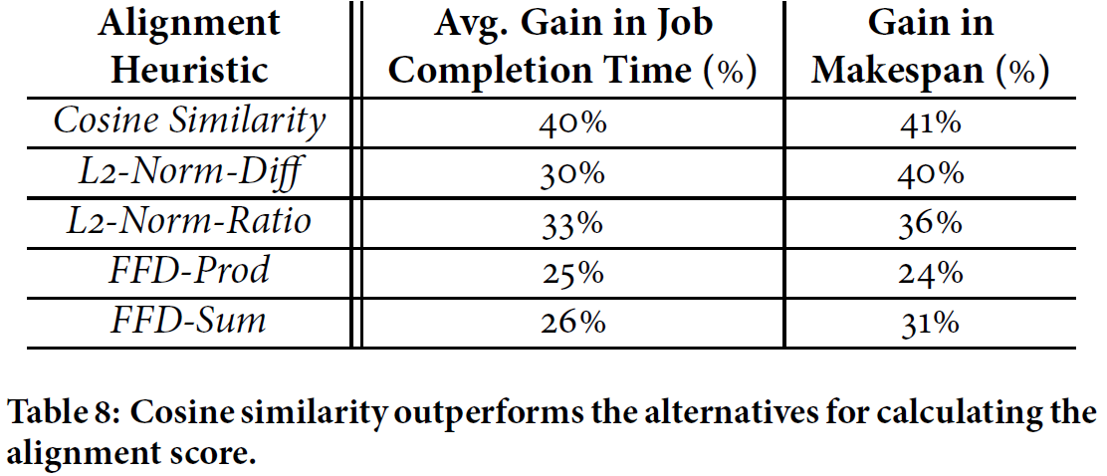
Alternative Packing Heuristics
d_{i} – task demand along dimens. i
a_{i} – avail. res. along dimens. i

Slide 27
Virtual Machine Packing != Tetris
Virtual Machine Packing
Consolidating VMs, with multi-dimensional resource requirements, on to the fewest number of servers
But focus on different challenges and not task packing:
balance load across servers
ensure VM availability inspite of failures
allow for quick software and hardware updates
NO corresponding entity to a job and hence job completion time is inexpressible
Explicit resource requirements (e.g. small VM) makes VM packing simpler
Notes:
VMs last for a while longer than tasks; hence their demands probably change with time a fair bit.
Tasks make it easier to figure out and limit demands.
With VM placement, the goals to achieve are some sort of topological closeness or fault tolerance; ours are makespan and
job completion time.
Why different from Grid computing work ?
Which work: We are not aware of any work which tries to achieve all the objectives I have mentioned to you, altogether: cluster efficiency, job completion time and fairness.
So as far as can tell, jobs in grid typically are bottlenecked on a resource, so packing is less important. Second, it is hard for us to compare our work against grid, as we have real system implementation and not access at any such grid to evaluate against.
Also, in general grid jobs takes longer than in context or current cluster, and such packing can be simpler, but may lead to more errors in case if it does bad scheduling.

Slide 28
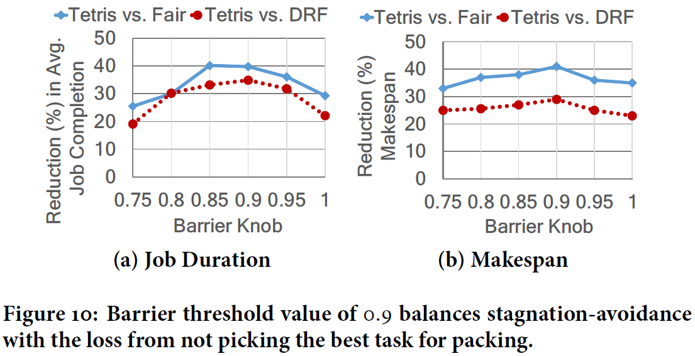
Barrier knob, b ∈ [0, 1)
b = 1 no tasks preferentially treated
Tetris gives preference for last tasks in a stage
Offer resources to tasks in a stage preceding a barrier, where b fraction of tasks have finished

Slide 29
Weighting Alignment vs. SRTF
1: among J runnable jobs
2: score (j) = A(t, R) + ε P(j)
3: max task t in j, demand(t) ≤ R (resources free)
4: pick j*, t* = argmax score(j)
While the best choice of ε depends on the workload, we found that:
gains from packing efficiency are only moderate sensitive to ε
improving avg. job compl. time requires ε > 0, though gains stabilize quickly
$$\text{Tetris}\text{: }\text{ε}=\frac{\overline{A}}{\overline{P}}$$
Sensitivity Analysis
$$\text{Gains} \text{in} \text{Makespan}$$
$$\text{Gains} \text{in} \text{job} \text{completion} \text{time}$$
$$\text{Do} \text{not} \text{improve}$$
$$\text{m}\text{ = }\text{ε}\frac{\overline{P}}{\overline{A}}$$
$$\text{Drop} \text{by}\text{ 10\%}$$
$$\text{> 8\%}$$
$$\text{Do} \text{not} \text{drop}$$
$$\text{m}\text{ = }0$$
$$\text{m}\text{ = .5}$$
$$\text{m}\text{ = 1.5}$$

Slide 30
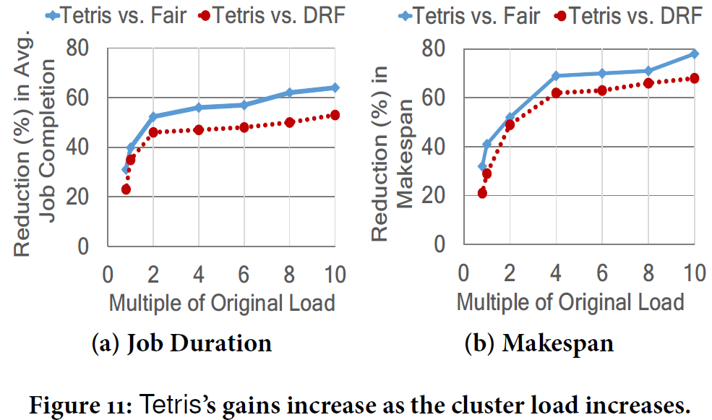
Cluster load vs. Tetris performance

Slide 31
Starvation Prevention
It could take a long time to accommodate large tasks
Working on a more principled solution
But …
most tasks have demands within one order of magnitude
Free resources become available in “large clumps”
periodic availability reports
scheduler learns about resources freed up by all tasks that finish in the preceding period in one shot

Slide 32
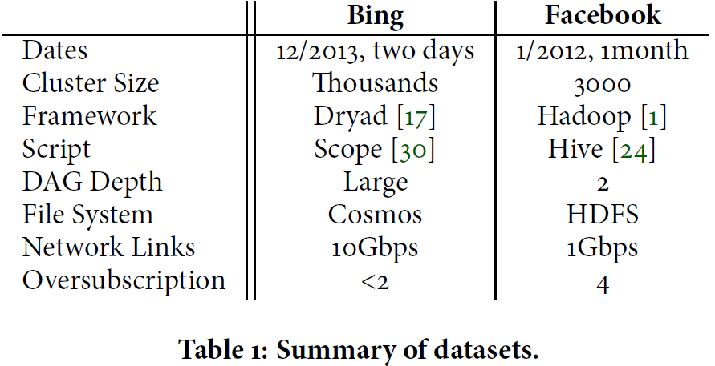
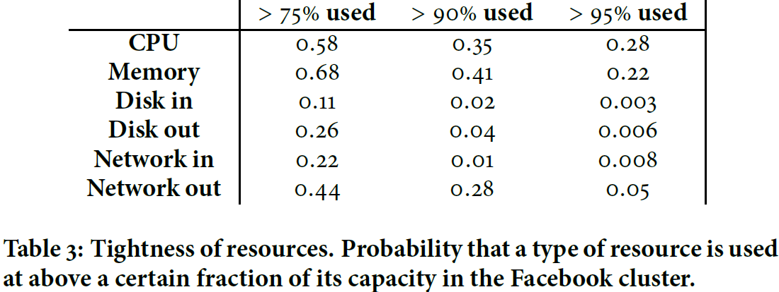
Workload analysis

Slide 33
Ingestion / evacuation
Other cluster activities which produce background traffic
ingestion = storing incoming data for later analytics
E.g., some clusters reports volumes of up to 10 TB per hour
evacuation = data evacuated and re-replicated before
maintenance operations
E.g., rack decommission for machines re-imaging
Resource Tracker reports, used by Tetris to avoid contention between its tasks and these activities

Slide 34
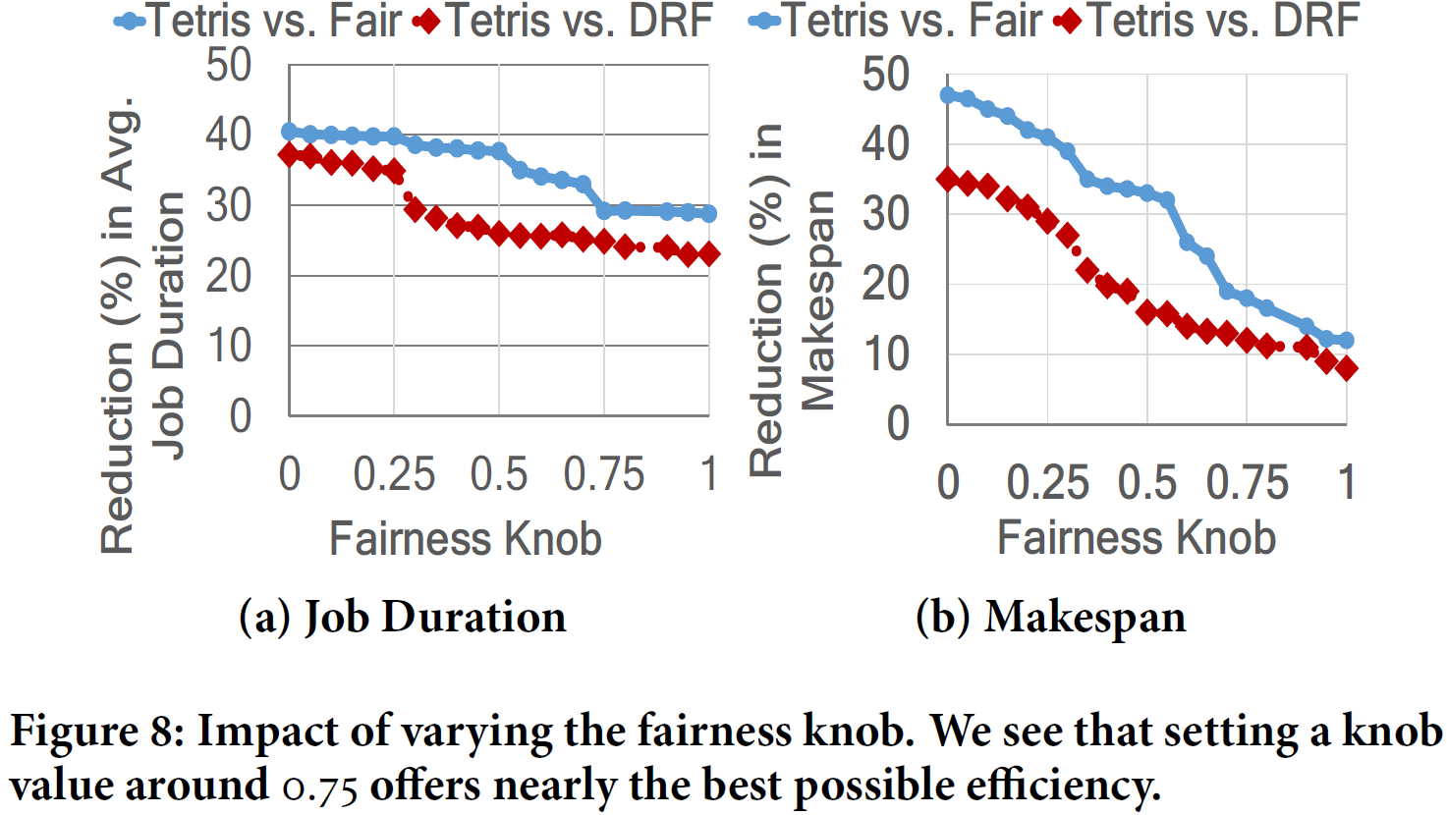
Fairness vs. Efficiency

Slide 35
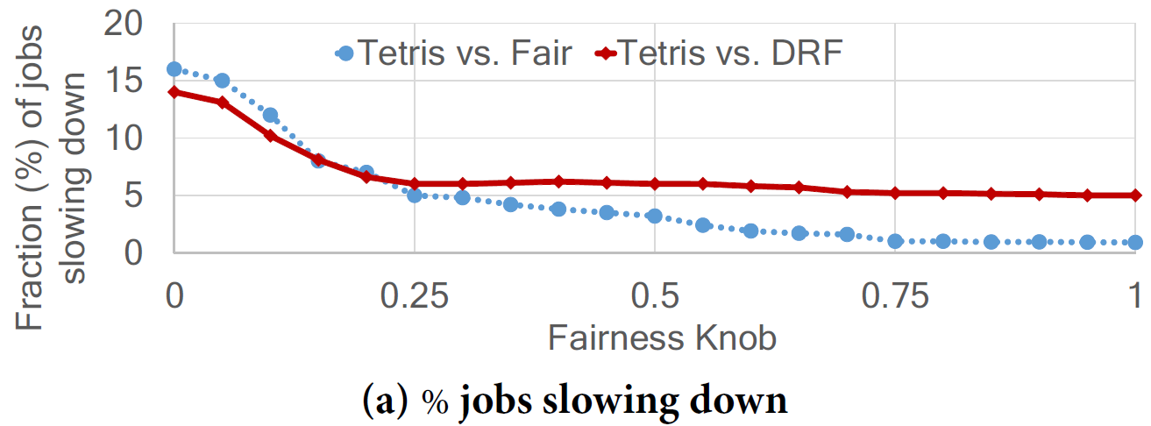
Fairness vs. Efficiency

Slide 36
Packer Scheduler vs. DRF
A
6 tasks
6 tasks
6 tasks
A
18 tasks
B
2 tasks
2 tasks
2 tasks
B
0 tasks
6 tasks
C
2 tasks
2 tasks
2 tasks
C
0 tasks
0 tasks
6 tasks
t
2t
3t
t
2t
3t
Job Schedule
Job Schedule
18 cores
18 cores
18 cores
18 cores
18 cores
18 cores
16 GB
16 GB
16 GB
36 GB
6 GB
6 GB
Resources used
Resources used
DRF Scheduler
Packer Schedulers
Dominant Resource Fairness (DRF)
Durations:
Durations:
Cluster [18 Cores, 36 GB Memory] Job: [Task Prof.], # tasks
A | [1 Core, 2 GB], 18
B | [3 Cores, 1 GB], 6
C | [3 Cores, 1 GB], 6
computes the dominant share (DS) of every user and seeks to maximize the minimum DS across all users
A: 3t
A: t
B: 3t
33% improvement
max ($qA$, $qB$, $qC$) (Maximize allocations)
$qA+3qB+3qC$ $≤18$ (CPU constraint)
2q_{A} + 1q_{B} + 1q_{C} $≤$ 36 (Memory constraint)
$$\frac{qA}{18}=\frac{qB}{6}=\frac{qC}{6} (Equalize DS)$$
B: 2t
C: 3t
C: 3t
DS = $\frac{1}{3}$
Notes:
The second reason why current schedulers do not pack is because they allocate slots to
tasks, purely on “fairness consideration”.
A commonly used scheduling approach is to pick tasks from the job that is farthest from its fair share.
Although recent research has also defined fairness based on multiple resources, even when pareto efficient and work conserving, do not yield the best job completion time and makespan. We will explain this using a simple example of Dominant Resource Fairness(DRF) allocation.
In a nutshell, DRF will compute the dominant share of every user and seeks to maximize the minimum dominant share across all users.
Consider a cluster with 18 cores and 36 GB memory available, and 3 jobs to schedule, each from a different user A, B and C with the task profiles and number of tasks mentioned in the table, where every task has same duration t.
Solving the following set of constraints, DRF will compute a DS of 1/3, which means for every task of job B or C, 3 tasks of A are assigned. Hence, DRF will schedule 6 tasks of A and 2 tasks of B and C at a time, leading to an average job duration of 3t. Such an allocation, however, leaves 20 GB of memory idle in the cluster for the whole duration of
the jobs.
On the other hand, a scheduler that packs the tasks, schedules all tasks of job A initially because they use up all the cores and memory in the cluster, followed by tasks of job B and then job C. This leads to an average job duration of 2t and 33% improvement over DRF.

Slide 37
Packing efficiency does not achieve everything
Achieving packing efficiency does not necessarily improve job completion time
Pack
No Pack
Durations:
2 tasks
2 tasks
2 tasks
2 tasks
A: 3t
2 tasks
2 tasks
2 tasks
2 tasks
B: 4t
Machine 1,2: [2 Cores, 4 GB] Job: [Task Prof.], # tasks
A | [2 Cores, 3 GB], 6
B | [1 Core, 2 GB], 2
t
2t
3t
4t
t
2t
3t
4t
Job Schedule
Job Schedule
29% improvement
2 cores
4 cores
4 cores
4 cores
4 cores
4 cores
4 cores
2 cores
Durations:
A: 4t
6 GB
6 GB
6 GB
4 GB
B: t
4 GB
6 GB
6 GB
6 GB
Resources used
Resources used
¹Time to finish a set of jobs
Notes:
However, achieving packing efficiency does not necessarily improve job completion time.
For example, consider a cluster of 2 machines with 2 cores and 4 GB memory available each, and 2 jobs with the resource demands per task and number of tasks described in the table.
Assuming each task has same duration t, the packing heuristic we just described will assign tasks of job A first because they are able to fragment resources less, then tasks of job B, leading to an average job duration of 3.5t.
On the other hand, a scheduler which strives for faster job completion time, can assign job B tasks first then tasks of A, leading to an average job duration of 2.5 t and 29% improvement comparing with the packing heuristic.

Slide 38
Notes:
So, main takeaways from this work are:
Packing is important considering diversity in resource requirements, so schedulers should strive to achieve packing efficiency in order to maximize cluster usage.
Second, even for small jobs where packing might not be so important, but we improve job completion time.
Third, existing multi-resource fairness schemes do not consider jobs multi-resource requirements and do not necessarily strives to improve performance. But we show a way you can achieve both performance and fairness.
What if you have jobs with smaller resource requirements. How important is packing ?
This is a good question, but packing is important even in this case. If there was only one resource bottleneck then indeed, packing was not important. For example if machine has 100 units resource, and a task requires 1, you can at most loose 1 unit.
However, when tasks have requirements across multiple dimensions, without a packing solution, the fragmentation will increase on some dimensions.
As I have mentioned before in the talk, the theoretical analysis reveals that resource fragmentation increase with the number of resources being allocated.

