Slide 1
An Information-Aware QoE-Centric Mobile Video Cache
Shan-Hsiang Shen, Aditya Akella
University of Wisconsin-Madison

Slide 2
Observations
Mobile and wireless traffic will exceed wired traffic by 2016
Consumer video traffic will be 69% of all consumer traffic in 2017 (57% in 2012)
Cisco Visual Networking Index: Global Mobile Data Traffic Forecast Update, 2012–2017
Quality of experience (QoE) becomes more important, because growing expectation of video quality
Notes:
According to Cisco forecast, because smartphone and tablet become popular these years, mobile and wireless traffic will be more than wired traffic by 2016. In addition, video traffic will become 69% of all consumer traffic. It is critically major part of all traffic. So, it is why my research wants to focus on video traffic, especially in wireless area. When people are using wireless traffic, they want to get the data and service they want as fast as possible. Which means we need to provide than higher goodput transmission. The goodput here is defined as valid bytes divide by transmission time. That excludes control and re-transmission bytes. Because video traffic is growing, the other focus of my research is on video service. We want to give client better experience during video playback. However, different clients may care about different criteria, but I will focus on general ones, that are start up latency, video buffering time, and video quality. Video quality is in terms of bit rate.

Slide 3
Quality of Experience
QoE is reflected in user engagement
User engagement:
Watching time of each video view
The number of video watch for each viewer
The key factors determine user engagement:
Join time
Buffering rate
Bit rate

Slide 4
Design requirements
A video proxy system: iProxy
Efficient cache
Remove redundant videos
Save storage space
Increase hit rate
Good QoE
Better user engagement

Slide 5
Cache Design
Use cache storage efficiently
Problem in conventional proxy:
Youtube
Dailymotion
Are they the same data?
YES
NO
Challenge 1:
How to look into the content of videos
iProxy
Conventional proxy
Use URLs to identify videos
Notes:
Here is an example why we want a new caching scheme. There are two videos with the same content, but one of them is from Youtube and the other is from Dailymotion. So, their URLs will be different, but in client point of view, they the same. If we ask a question “are they the same data?”. A conventional proxy will say no, because it identify video using URLs, so the conventional proxy cache both of copies. This waste the proxy storage. But iproxy should say yes, because it look into the content of videos. So, the first challenge of iproxy is how to look into the content of videos.

Slide 6
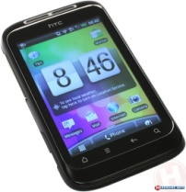
Diversity
Channel diversity
Wiscape[Sen’11] shows the performance of wireless networks vary with location and time
Client diversity
Challenge 2:
How to deal with channel and client diversities
Notes:
In wireless networks, some diversity make smooth video difficult. The first one is channel diversity. The channel performance such as throughput vary a lot with location and time. This figure is five throughput measurement on cellular networks in different locations. Some location can get the throughput as high as 6000 Kbps, but some location only get 1000 kbps. And we can see the throughput is unstable. The second diversity is client diversity. Client may use different kinds of devices. For example, some people use smartphone, others may use tablet. The devices have different screen resolutions and different computational power, one version of video cannot satisfy all users. Tablet users expect higher resolution videos, but if we send high resolution videos to smartphone, they need to lower the resolution to play it. It is a waste of bandwidth, because higher resolution videos tend to be larger. The video decoders in user devices are also different.

Slide 7
iProxy Components
Use cache storage efficiently
Better quality of experience (QoE)
Video identification module
Linear bit rate adapter module
Notes:
To achieve our two major goals and overcome the challenge mentioned above, iproxy include two modules. The first one is used to identify videos to avoid redundant caching. The second module is to provide linear bit rate according to the available bandwidth and clients’ devices.

Slide 8
Efficient Cache: Video Identification
Compare URLs
Compare video files byte by byte
Only can do exactly match
Fuzzy match: the same video may be in different formats, bit rates, and served by different providers
0010010111101000010001000011110010
0110001111100001000110000100000100

Slide 9
Efficient Cache: Video Identification
Information-bound referencing (IBR)
Linear to what frames look like
DCT
Sampling
Raw frames
Frequency domain
IBR

Slide 10
Efficient Cache: the IBR Table
iProxy keeps a IBR table that map URLs to IBR values
Each entry maps to exactly one video file (keep higher quality video only)
IBR_1 | URL_A, URL_B, URL_C
IBR_2 | URL_D
IBR_3 | URL_E, URL_F
Video_1
Video_2
Video_3
Notes:
To compare and match the video content, iproxy keeps an IBR table, this table maps URLs to IBRs. Multiple URLs associating with the same content videos maps into one IBR. So, only one copy of videos is cached for each IBR. Compared to conventional proxy, iproxy can cover more URLs. It means iproxy can potentially satisfy more requests that request video using URLs.

Slide 11
Efficient Cache: Video Matching
Request (a URL)
Streaming
IBR_1 | URL_A, URL_B, URL_C
IBR_2 | URL_D
IBR_3 | URL_E, URL_F
URL look up
Hit
Dynamic video encoder
Miss
Video Downloader
Update IBR table
Replacement policy
Hit
DCT
IBR look up
Miss
Add an entry to IBR table
Notes:
Here is the flow of video request. As conventional proxy, clients also use URLs to request videos. When iproxy get a request, it check its IBR table if the URL is already in the table. If the lookup is hit, then the video have already been cached. So, iProxy send the video to the client. However, if the look up is miss. iProxy download the video from original video providers. Then, calculate it IBR value. iProxy compares this IBR value with other IBR values in IBR table, if lookup is hit, the video is already in cache. So, the one with higher quality will be kept. If the lookup is miss, a new entry is added for this new video. However, if cache is full, we need a replacement policy to decide which entry to replace.

Slide 12
Better QoE: Join Time
Shorter join time can improve user engagement
High bit rate videos → longer delay to pre-processing videos and fill buffer
Transcoding

Slide 13
Better QoE: Video Transcoding
Channel diversity
Bit rate adapting
Use Out Bandwidth
Bit Rate Adapting
Bit rate
Bandwidth
Bit rate
Waste Bandwidth
Time

Slide 14
Better QoE : Video Transcoding
Possible solution: pre-encode multiple versions with different bit rate, resolution, and format
MPEG DASH
Performance Cliff Problem
Version 1
Storage consuming
Version 2
Version 3

Slide 15
Better QoE : Video Transcoding
DCT
Sampling
Retrieving IBR
Frequency domain
Frequency domain
Dynamic video encoder
To Provide linear bit rate adapting
User device information
(screen resolution, video format support)
Available bandwidth

Slide 16
Better QoE : Bandwidth Estimation
To determine bit rate in a cheaper way
Use in-context information [Gember‘12] as baseline bit rate
Location
Time
Refine the bit rate according to TCP feedback
To make bit rate adapt smooth, iProxy uses an exponentially-weighted moving average (EWMA)
Notes:
To decide the bit rate the dynamic video encoder should use, we need to do some estimations. The first method we use is in-context information. For example, we can know the location of the device according to the cellular sector the device connect to. We briefly get a base-line bit rate. The dynamic video encoder start from this base-line bit rate and adjust its bit rate according to TCP feedback.

Slide 17
Evaluation: Cache Efficiency
We implement real working system
Use a three-day real trace file to the cache module of iProxy
Hit rate improvement:
iProxy | A conventional proxy
71% | 65%

Slide 18
Evaluation: Setup to Test QoE
A Cellular Network
Internet
Android phone
10 s buffer
Proxy

Slide 19
Evaluation: Start Up Latency
Improvement in video start up latency:
Compare to statistic video service
We use a smartphone with 480 X 800 screen resolution
VGA video | XGA video | .asf format video
0s | 13s | ∞
Notes:
We also evaluate start up latency improvement. We use a smartphone with 480 X 800 resolution screen and the smartphone cannot decode .asf files. The smartphone requests three different videos. iProxy don’t change the format of the VGA video, so we cannot see any improvement compared to statistic video service. The resolution of XGA video is higher than screen resolution, so iProxy will lower than resolution before sending to a client. So, a client player needs more time to pre-process the high resolution videos and fill up buffer. So we can see 13 second improvement. Finally, iProxy can change the encoding format of .ash video, so client can decode and play the video. So I mark infinite for the improvement.

Slide 20
Evaluation: Setup to Test Video Quality
Rate limited to 1.5 Mbps
2.54 Mbps
PSNR: 31dB
A Cellular Network
Internet
Android phone
10 s buffer
Proxy

Slide 21
Evaluation: Video Quality
PSNR test
Notes:
PSNR is a popular metrics to measure video quality. We compare iProxy with other video delivery methods. The original video is encoded as 31 dB. Because of unstable channel quality, iProxy lower down bit rate if necessary, so the PSNR is a little bit drop. Then, if we use very low bit rate to avoid using out bandwidth, PSNR will drop a lot because of lower video quality. If we send original video from conventional proxy, because of frame loss, PSNR significantly drops that is lower than 30% of original video. Finally, if we don’t use proxy, because of extra delay from original provider, PSNR further drop.

Slide 22
Evaluation: Video Quality
Dynamic video adapter
500 Kbps in average
430 Kbps in average
Notes:
We compare linear adapter with MPEG DASH. I use net filter to limit available bandwidth and I change the available bandwidth during video playback. The red line is available bandwidth and the blue line is bit rate
Linear adapter can change the bit rate according to available bandwidth and MPEGE DASH also can do it, but it can choose among limited version of video. In this evaluation, it has four versions.
The result shows that linear adapter can get high average bit rate than MPEG DASH, because it can use bandwidth more efficiently. Higher bit rate means better video quality.

Slide 23
Conclusion
We propose a system to provide better video watching experience
Efficient cache
Identify videos by content
Serve more requests with limited storage space
Better QoE
Linear bit rate adapter
Shorter join time
Better video quality

Slide 24
Thank you
Q & A

Slide 25
Backup slides

Slide 26
CC_WEB_VIDEO: Near-Duplicate Web Video Dataset
Queries |  |  | Near-Duplicate
ID | Query | # | # | %
1 | The lion sleeps tonight | 792 | 334 | 42 %
2 | Evolution of dance | 483 | 122 | 25 %
3 | Fold shirt | 436 | 183 | 42 %
4 | Cat massage | 344 | 161 | 47 %
5 | Ok go here it goes again | 396 | 89 | 22 %
6 | Urban ninja | 771 | 45 | 6 %
7 | Real life Simpsons | 365 | 154 | 42 %
8 | Free hugs | 539 | 37 | 7 %
9 | Where the hell is Matt | 235 | 23 | 10 %
10 | U2 and green day | 297 | 52 | 18 %
11 | Little superstar | 377 | 59 | 16 %
12 | Napoleon dynamite dance | 881 | 146 | 17 %
13 | I will survive Jesus | 416 | 387 | 93 %
14 | Ronaldinho ping pong | 107 | 72 | 67 %
15 | White and Nerdy | 1771 | 696 | 39 %
16 | Korean karaoke | 205 | 20 | 10 %
17 | Panic at the disco I write sins not tragedies | 647 | 201 | 31 %
18 | Bus uncle (巴士阿叔) | 488 | 80 | 16 %
19 | Sony Bravia | 566 | 202 | 36 %
20 | Changes Tupac | 194 | 72 | 37 %
21 | Afternoon delight | 449 | 54 | 12 %
22 | Numa Gary | 422 | 32 | 8 %
23 | Shakira hips don’t lie | 1322 | 234 | 18 %
24 | India driving | 287 | 26 | 9 %
Total |  | 12790 | 3481 | 27 %

Slide 27
Youtube bit rate (standard quality)
Standard quality uploads
Type | Video Bitrate | Mono Audio Bitrate | Stereo Audio Bitrate | 5.1 Audio Bitrate
1080p | 8,000 kbps | 128 kbps | 384 kbps | 512 kbps
720p | 5,000 kbps | 128 kbps | 384 kbps | 512 kbps
480p | 2,500 kbps | 64 kbps | 128 kbps | 196 kbps
360p | 1,000 kbps | 64 kbps | 128 kbps | 196 kbps

Slide 28
Youtube bit rate (high quality)
Type | Video Bitrate | Mono Audio Bitrate | Stereo Audio Bitrate | 5.1 Audio Bitrate
1080p | 50,000 kbps | 128 kbps | 384 kbps | 512 kbps
720p | 30,000 kbps | 128 kbps | 384 kbps | 512 kbps
480p | 15,000 kbps | 128 kbps | 384 kbps | 512 kbps
360p | 5,000 kbps | 128 kbps | 384 kbps | 512 kbps

Slide 29
iProxy
User
information
Link
monitor
MPEG 4 encoder
Rate
controller
Raw
frames
DCT
transform
Scaling
Quantization
Entropy
coding
Motion
estimation

Slide 30
Different types of integrity attacks against IBR
Attack | Description | Protection?
Inset | Embedding bogus content into image | LumLow changes
Quantization | Making quality really poor; e.g., large pixels | ChromeBlue, ChromRed change
Resize | Rescale image and blow it up | LumHigh changes
Sharpness | Making pictures hazy | None
Subtitles | Adding random subtitles at base | None

Slide 31
Image IBR
Y
FY
LumLow
LumHash
Cb
FCb
ChromBlue
Cr
FCr
ChromRed

Slide 32
iProxy: Information-Bound Referencing
IBR is from Anand’10
IBR for single image:
Image → DCT → frequency domain→image IBR
IBR for a video:
Sample the image IBR of key frames
Scene 0
Scene 1
Scene 2
Key Frame
Key Frame
Notes:
It is an overview of IBR, it is previous work in our group, so I will not get into too much detail. Frequency domain data is linear to how each frame looks like. It means if two frequency domain data is close to each other, than the frames will also looks similar. So, we can use frequency domain data as video ID called IBR. For a single image, we just use its frequency domain data as its IBR, but for a video, to save storage space, we only sample the IBR or key frames. Key frames here is where image change significantly duo to scene changes. Because frames in the same scene are similar, only keyframe’s IBR is kept.

Slide 33
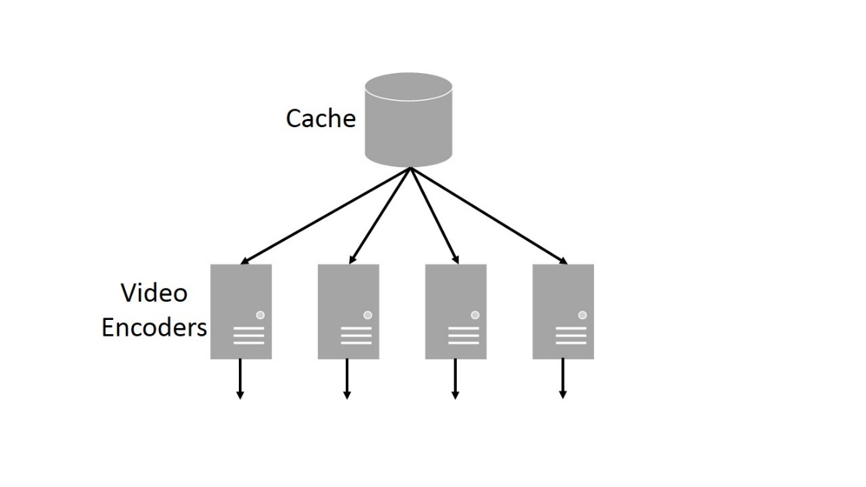
iProxy: Evaluation
Scalability
Star shape architecture:
Video Length | 587 s
200 kbps | 13 s
400 kbps | 14 s
600 kbps | 14 s
800 kbps | 14 s
1000 kbps | 15 s
Notes:
Scalability is another issue for dynamic video encoding. We measure the time needed to encode 587 second video. The time is around 13 to 15 seconds. It means one node can serve 39 clients at the same time. If we want to further enhance the scalability, we can use a star shape structure, including multiple video encoders and they share one cache.

Slide 34
iProxy: Frequency domain data
Information bound references (IBR)
Video identification module
IBR
Fingerprint to identify videos
Frequency domain data
DCT transform
Liner bit rate adapter module
Dynamic video encoder
Notes:
Both of two module rely on frequency domain data. When a video comes in, it is sent to DCT transform. This is usually the first step of video encoding. The raw video frames are transferred to frequency domain data. This frequency domain data is inputted to video identification module to retrieve video’s fingerprint called information-bound references. Frequency domain data is also sent to liner bit rate adapter module. The module dynamically encode video for clients.

Slide 35
