Slide 1
E-MOS: Efficient Energy Management Policies in Operating Systems
Vinay Gangadhar, Clint Lestourgeon, Jay Yang, Varun Dattatreya
CS736: Advanced Operating Systems
Spring 2015

Slide 2
System Power Management
Computing Platforms → Power Management (PM) problem
Mobile and Embedded Devices
Desktop Systems
Server Environment
Takeaway
Better Control on System Power Consumption
Policy decisions favoring Energy Efficient Computing
But wait!! → Who has the control ?
Notes:
Power management in computing systems is an important prevalent problem
In mobile domain, its mostly the battery reosurce to conserve
Desktops → CPU overheating problem
Servers → Cost you pay for cooling systems and computation resources for demand

Slide 3
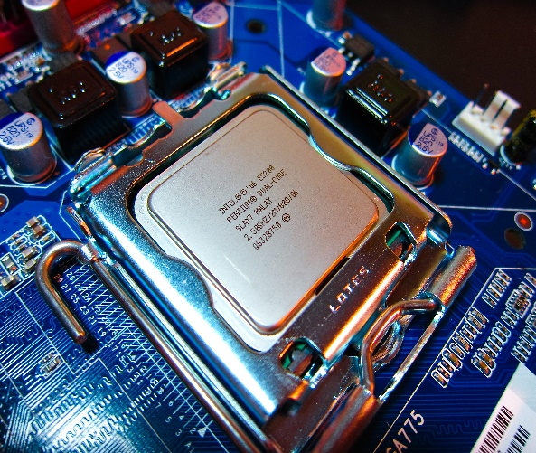
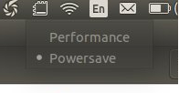
Levels of Power Management
Coarse
Control
Fine
KERNEL POWER GOVERNORS
P-STATE
DRIVERS
HARDWARE
Workload Awareness
High
Low
Notes:
Run the workload to completion at the maximum performance setting and then transition into a low-power mode
Assumes that the highest energy savings can be achieved by running at the lowest performance setting

Slide 4
Our Project
Evaluate existing Linux PM mechanisms
Application-aware energy efficient policy decisions → E-MOS model
Evaluate E-MOS using User-Space power governors

Slide 5
Outline
Introduction
Linux Power Governors
Case Study
Application Categorization & Analysis
E-MOS Model
Evaluation & Results
Lessons Learnt & Conclusion

Slide 6
Linux Power Governors
CPUFreq
Intel P-State
Governors
Governors
Ondemand
Conservative
PowerSave
PowerSave
Performance
Performance
Userspace
Architecture
Independent
CPUFreq module
Core frequency setting
Architecture
Dependent
Intel P-State driver
Core frequency setting
Notes:
Run the workload to completion at the maximum performance setting and then transition into a low-power mode
Assumes that the highest energy savings can be achieved by running at the lowest performance setting
OS PM uses ACPI interface to communicate with CPUFreq driver
C-States are Processor power states
P-states are performance states for a particular operating point → Freq, Voltage

Slide 7
Power Governors Contd.

Slide 8
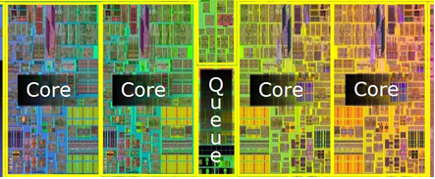
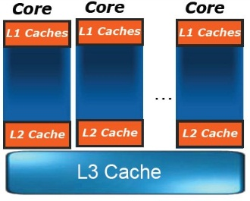
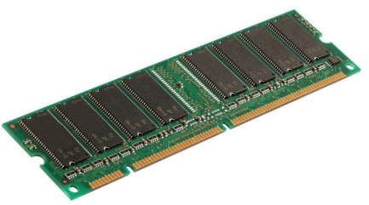
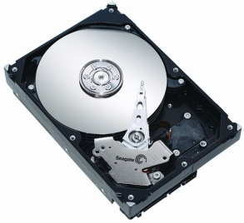
Applications
Compute Intensive → CPU Core
Cache Sensitive →
Memory Intensive→
I/O Intensive →
Takeaway
Cannot apply same policies to all workloads !!
Need Application-aware energy management policy decisions
Notes:
Each of these applications demand different CPU and memory demands

Slide 9
Imperfect Scaling Case study
Expectation: High CPU usage → Performance should scale with CPU frequency
Problem: Cache misses
Memory is fast
But not fast enough
Existing Solutions
Better Programming skills
Modern Computer Architecture improvements
Notes:
For the programmers part, note that cache misses are already considered harmful, so usually programmers avoid them anyways

Slide 10
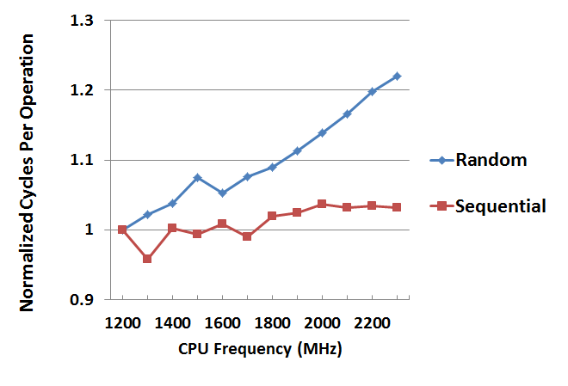
Imperfect Scaling Case study
Notes:
For the programmers part, note that cache misses are already considered harmful, so usually programmers avoid them anyways

Slide 11
Application Categorization
PIN Based Modeling
SPEC2K6 → Compute
SPLASH2 → Compute + Cache
MICRO-BENCH → Cache + Memory
Notes:
Could not model the I/O operations

Slide 12
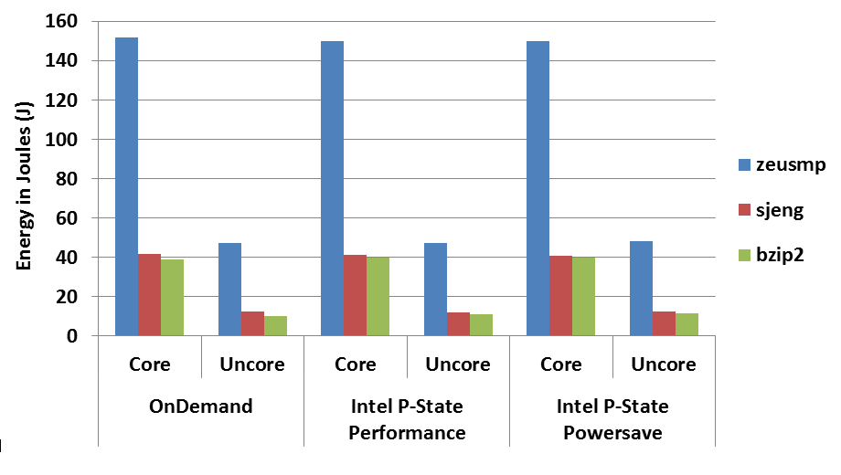
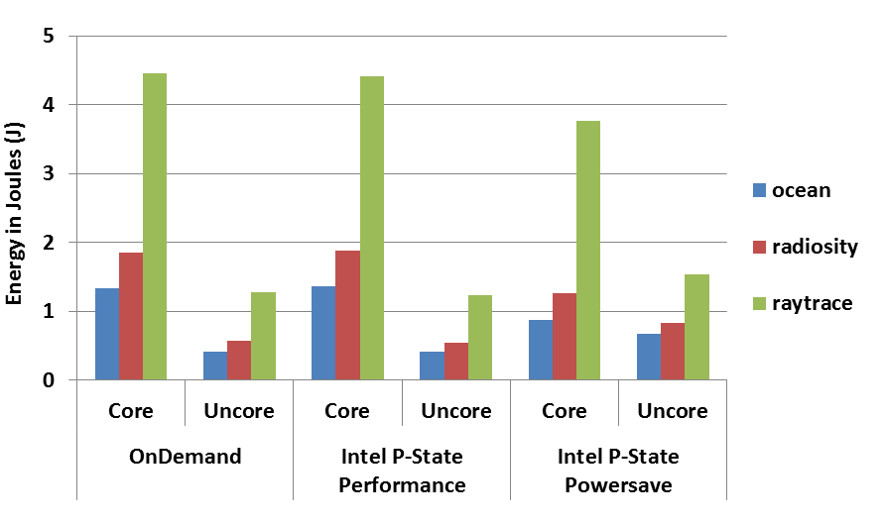
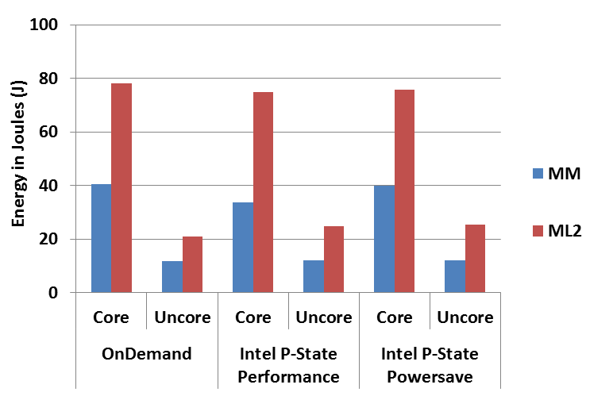
Power Governors’ Analysis
SPEC2K6 – Compute Intensive
SPLASH2 – Cache Sensitive
MICRO-BENCH – Memory Intensive
Notes:
- All governors are optimized for compute workloads and they mainly aim for ‘race to halt condition’
- But this doesn’t work for cache sensitive and memory intensive workloads as it simply wastes the energy of core

Slide 13
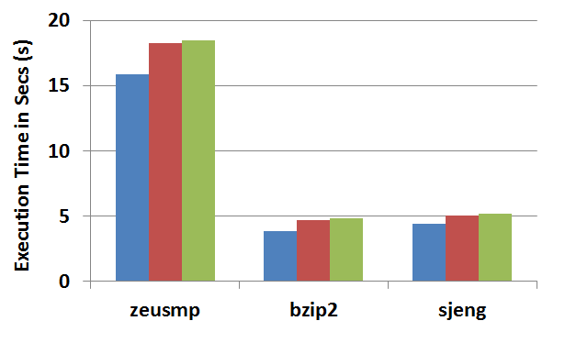
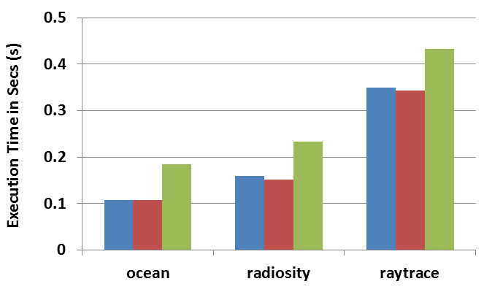
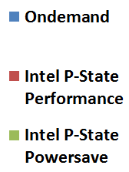
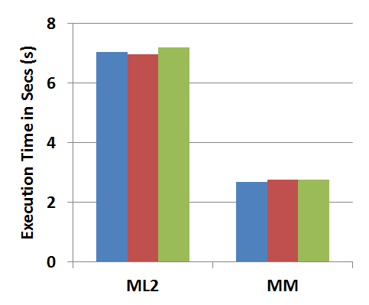
Power Governors’ Analysis
SPEC2K6 – Compute Intensive
SPLASH2 – Cache Sensitive
Takeaway – Default power governors
Don’t provide better energy efficiency → Optimized only for Compute workloads!!
Don’t rely on application characteristics to make better policy decisions
OS can relinquish freedom to User space for better energy management
MICRO-BENCH – Memory Intensive
Notes:
- All governors are optimized for compute workloads and they mainly aim for ‘race to halt condition’
- But this doesn’t work for cache sensitive and memory intensive workloads as it simply wastes the energy of core

Slide 14
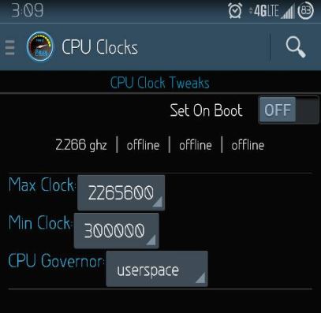
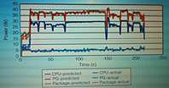
E-MOS Analytical Model
RAPL – Running Average Power Limit
Perf – Linux utility for performance measurements
CPUPower – Utility for frequency measurement
Profiled Application Information
RAPL + Perf + CPUPower
Application-aware Energy Policy
E-MOS Analytical Model
Reduce Freq.
by 5%, 10%, …, 25% steps
Increase Freq.
by 5%, 10%, …, 25% steps
-
+
User-Space Power Governor
Energy Estimates for CPU cores
Notes:
RAPL – interface to monitor SOC power consumption (sysfs layout)
-- Based on the estimates, user can then use a spectrum of scaled frequency for better energy efficiency

Slide 15
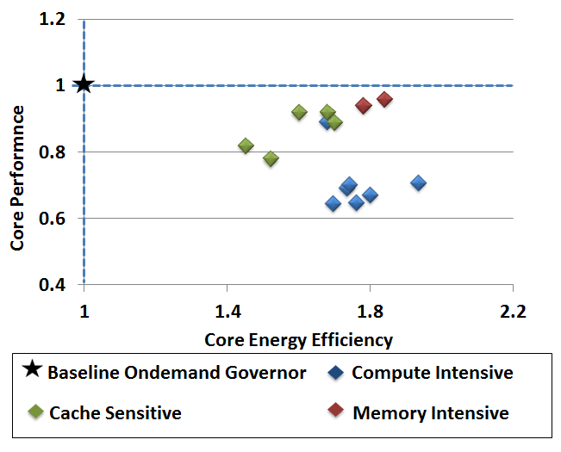
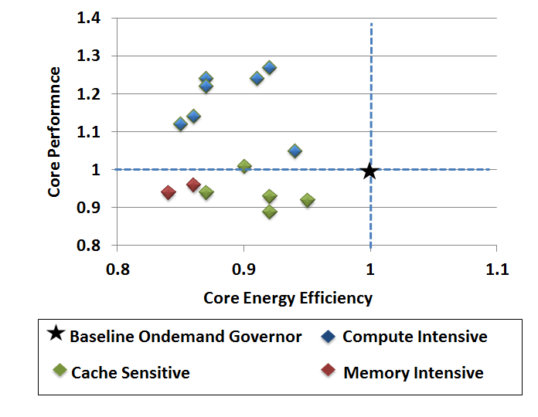
E-MOS Decision Table Example
Reduce Core Freq. by 25%
Increase Core Freq. by 25%
Application | Objective | CPU Freq. | DRAM Freq.
Compute Intensive | Energy | Maintain/Increase | Decrease
 | Performance | Increase | Maintain
Cache Sensitive | Energy | Decrease | Decrease
 | Performance | Maintain | Increase
Memory Intensive | Energy | Decrease | Maintain/Increase
 | Performance | Maintain | Increase
Notes:
DRAM frequency scaling needs BIOS settings modifications. But modern RAPL interface to provide some way to limit power of DRAM but not frequency
And we test each application with possible scalable frequencies and test how energy efficient it is compared to Ondemand governor

Slide 16
Evaluation
Platform:
Kernel: Linux 3.14
CPU: Intel core i7 3630M
Scaling frequencies (Ghz): 0.8, 1.2, 1.5, 1.8, 2.1, 2.4, 3.4 (turbo)
Energy & timing measurement:
Perf (RAPL interface) – Power and Performance measurements
CPUPower – Frequency Setting

Slide 17
Results - 1
Compute Intensive workloads -- SPEK2K6
E-MOS Frequency Setting chosen → 1.8Ghz to 2.4Ghz
With 2.4Ghz → 1.44x (44%) Energy Efficiency with Performance loss of 3%
Notes:
-- It should be flexible enough to accommodate research studies of various types

Slide 18
Results - 2
Compute Intensive + Cache Sensitive workloads -- SPLASH2
E-MOS Frequency Setting chosen → 1.8Ghz to 2.1Ghz
With 1.8Ghz → 1.61x (61%) Energy Efficiency with Performance loss of 9%
Notes:
- For cache sensitive, you want to decrease the frequency but not to extent that the perf gets affected too much because of slowing down of core

Slide 19
Results - 3
Memory Intensive workloads -- MICRO-BENCH
E-MOS Frequency Setting chosen → 1.2Ghz to 1.8Ghz
With 1.2Ghz → 2x (200%) Energy Efficiency with Performance loss of 13%
Notes:
- Interesting that the performance remains the same even with reducing the frequency

Slide 20
Lessons Learnt
Power estimation is challenging but the tools are getting better
Performance benchmarks may not be the best way to evaluate power management
Based on our results, P-state drivers may not be as awesome as Intel would have you believe
Intel’s most useful P-state documentation is a Google+ post !!

Slide 21
Conclusion
Application-aware energy management → Energy as a first class resource
EMOS achieves upto 2x energy efficiency with performance loss of 13%
Power governors can take advantage of reducing CPU frequency for Memory bound applications
User-space power governors with more runtime library support can be more efficient than Ondemand

Slide 22
Back Up Slides
Notes:
-- It should be flexible enough to accommodate research studies of various types

Slide 23
Power Governors – Optimized for Compute workloads
Energy = Power X Time
Benchmarks:
SPEC CPU2006, Splash2, Micro benchmarks

Slide 24
ACPI Interface
Applications
OS Power Management
ACPI
Software drivers
Hardware: CPU, BIOS etc.

Slide 25
Problem with Power Governors
Power management tends to be simplistic
Most policies use “race to halt” approach
Run the workload to completion at the maximum performance setting and then transition into a low-power mode
Assumes that the highest energy savings can be achieved by running at the lowest performance setting
Either statically scale the CPU frequency or provide limited CPU capability to define energy requirements of an application
Use only CPU usage as source of information
What about memory bound applications?
Do not provide a fine-grained control and management over the energy utilized by the applications

