Slide 1
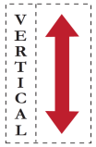
Pushing the Limits of Accelerator Efficiency While Retaining Programmability
Tony Nowatzki*, Vinay Gangadhar*, Karu Sankaralingam*, Greg Wright⁺
*Vertical Research Group
University of Wisconsin – Madison
⁺Qualcomm
Notes:
Which explores how far the efficiency limits of accelerators can be pushed while still having the programmability feature

Slide 2
Executive Summary
5 common principles of architectural specialization
A programmable architecture (LSSD) embodying the specialization principles
LSSD compared to single domain specific accelerator (DSA)
Performance: Matches DSA
Area: Overhead of at most 4x
Power: Overhead of at most 4x
LSSD power overhead inconsequential with system-level energy efficiency tradeoffs
Notes:
We mainly propose 5 important principles of specialization common to many DSAs and how they are exploited
A programmable arch. LSSD composed of uarch mechanisms embodying the common specialization principles.
I will show that LSSD can be provisioned to match the performance of DSAs with little overheads
Economic and energy tradeoffs of DSAs compared to LSSD

Slide 3
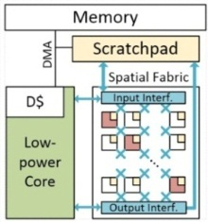
Outline
Introduction and Motivation
Principles of architectural specialization
Embodiment of principles in DSAs
Architecture for programmable specialization (LSSD)
Evaluation of LSSD with 4 DSAs (Performance, power & area)
System-level energy efficiency tradeoffs with LSSD and DSA
Concurrency
Computation
Communication
Data Reuse
Coordination
Energy
Speedup
Core
Accel.
$
System Bus
Memory

Slide 4
Era of Specialization
Traditional Multicore
DSAs
Cache
Cache
Reg Expr.
AI
Neural Approx.
Scan
Graph Traversal
Application domain specialization
Linear Algebra
Core
Core
Core
Core
Core
Core
Deep Neural
Stencil
Sort
Performance and/or energy gains from multicore chips is challenging
Specialization of application domains with custom hardware units
Domain Specific Acceleration
Domain Specific Accelerators (DSAs):
+ High Efficiency
- No Generality
- Obsoletion Prone
10 – 100x
Performance/Power
or
Performance/Area
Not general purpose programmable
Notes:
With no benefits from device scaling, extracting performance and energy efficiency from multicore chips has become challenging in last few years
Industry and academia is relying on specializing each individual application domain using custom hardware engines to do the domain specific logic
And getting 10-1000x performance
- DSAs – hardware engines capable of performing computations in one domain with high perf and energy efficiency

Slide 5
Our Goal: Programmable Specialization
Specialization benefits of DSAs in a Programmable Architecture
Programmable architecture
matching the efficiency of DSAs

Slide 6
Key Insight: Commonality in DSAs’ Specialization Principles
Host System
DSAs
Cache
Reg Expr.
AI
Neural Approx.
Scan
Graph Traversal
Linear Algebra
Core
Core
Core
Deep Neural
Stencil
Sort
Most DSAs employ 5 common Specialization Principles
Concurrency
Computation
Communication
Data Reuse
Coordination
S
S
+
FU
S
S
FU
Notes:
To understand the sources of efficiency and specialization benefits in DSAs,
We mainly investigated 4 relevant application domains and their recent DSA proposals
Key insight we derived out of this study was → Most of the DSAs employ 5 common spec. principles.

Slide 7
Solution: Architecture for Programmable Specialization
Idea 1: Specialization principles can be exploited in a general way
Idea 2: Composition of known uArch. mechanisms embodying the specialization principles
Low power core
Spatial fabric
Scratchpad
DMA
Programmable Architecture (LSSD)
LSSD as a programmable hardware template
to map one or many application domains
Deep Neural
Stencil, Sort, Scan, AI
Domain provisioned LSSD
Balanced LSSD
*Figures not to scale
Notes:
Using that insight, the key solution we propose in this work are:
Programmable specialization can be achieved In a general way instead of domain specific way
- As architects we can come up with a programmable arch with known simple uarch. Mechanisms embodying these principles
- we call this arch as LSSD named after --
LSSD can be used as a programmable hardware template employing the specialization principles to map one of many appl. Domains and get the beneifts of specialziation.
Composition of known programmable and configurable uarch mechanisms
And also show that this power overhead becomes insignificant when considering energy efficiency tradeoffs in a system level implementation involving LSSD

Slide 8
Outline
Introduction and Motivation
Principles of architectural specialization
Embodiment of principles in DSAs
Architecture for programmable specialization (LSSD)
Evaluation of LSSD with 4 DSAs (Performance, power & area)
System-level energy efficiency tradeoffs with LSSD and DSA
Concurrency
Computation
Communication
Data Reuse
Coordination
Energy
Speedup
Core
Accel.
$
System Bus
Memory

Slide 9
Principles of Architectural Specialization
Match hardware concurrency to that of algorithm
Problem-specific computation units
Explicit communication as opposed to implicit communication
Customized structures for data reuse
Hardware coordination using simple low-power control logic
Concurrency
Computation
Communication
Data Reuse
Coordination
S
S
+
FU
S
S
FU
Notes:
We mainly propose 5 important principles of specialization common to many DSAs and how they are exploited
A programmable arch. LSSD composed of uarch mechanisms embodying the common specialization principles.
I will show that LSSD can be provisioned to match the performance of DSAs with little overheads
Economic and energy tradeoffs of DSAs compared to LSSD

Slide 10
5 Specialization Principles
Concurrency
Computation
Communication
Data Reuse
Coordination
S
S
+
FU
S
S
FU
How do DSAs embody these principles in a domain specific way ?
Reg Expr.
AI
Neural Approx.
Neural Approx.
NPU
Deep Neural
DianNao
Scan
Graph Traversal
Linear Algebra
Stencil
Convolution
Engine
Q100
Deep Neural
Stencil
Database
Sort

Slide 11
Principles in DSAs
NPU – Neural Proc. Unit
General Purpose Processor
Match hardware concurrency to that of algorithm
Problem-specific computation units
Explicit communication as opposed to implicit communication
Customized structures for data reuse
Hardware coordination using simple low-power control logic
Bus Sched
In Fifo
Out Fifo
PE
PE
High Level
Organization
PE
PE
PE
PE
PE
PE
Weight Buf.
Fifo
Processing Engine
Mult-Add
Cont-roller
Acc Reg.
Sigmoid
Out Buf.
Concurrency
Computation
Communication
Data Reuse
Coordination

Slide 12
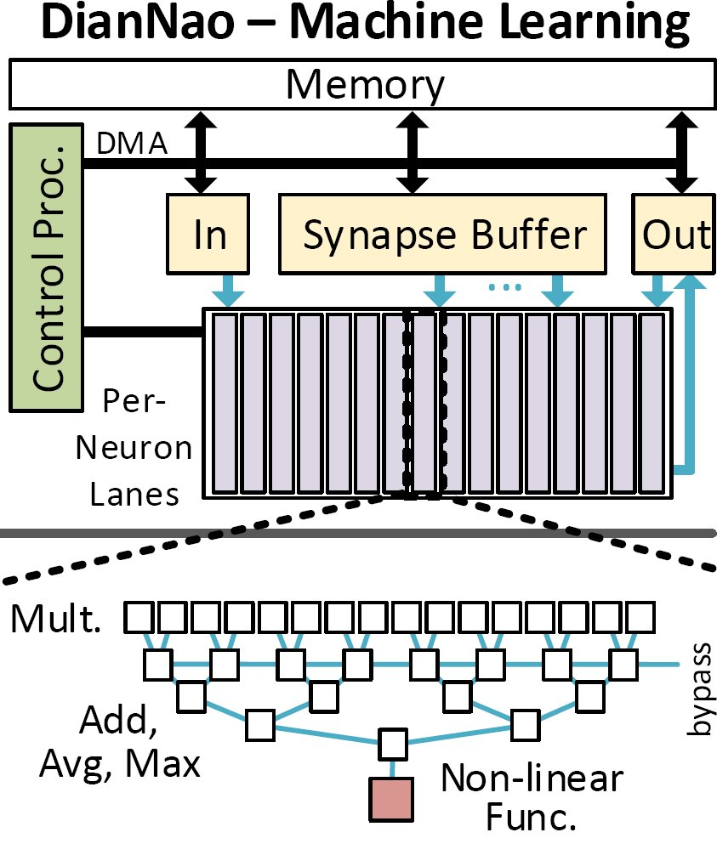
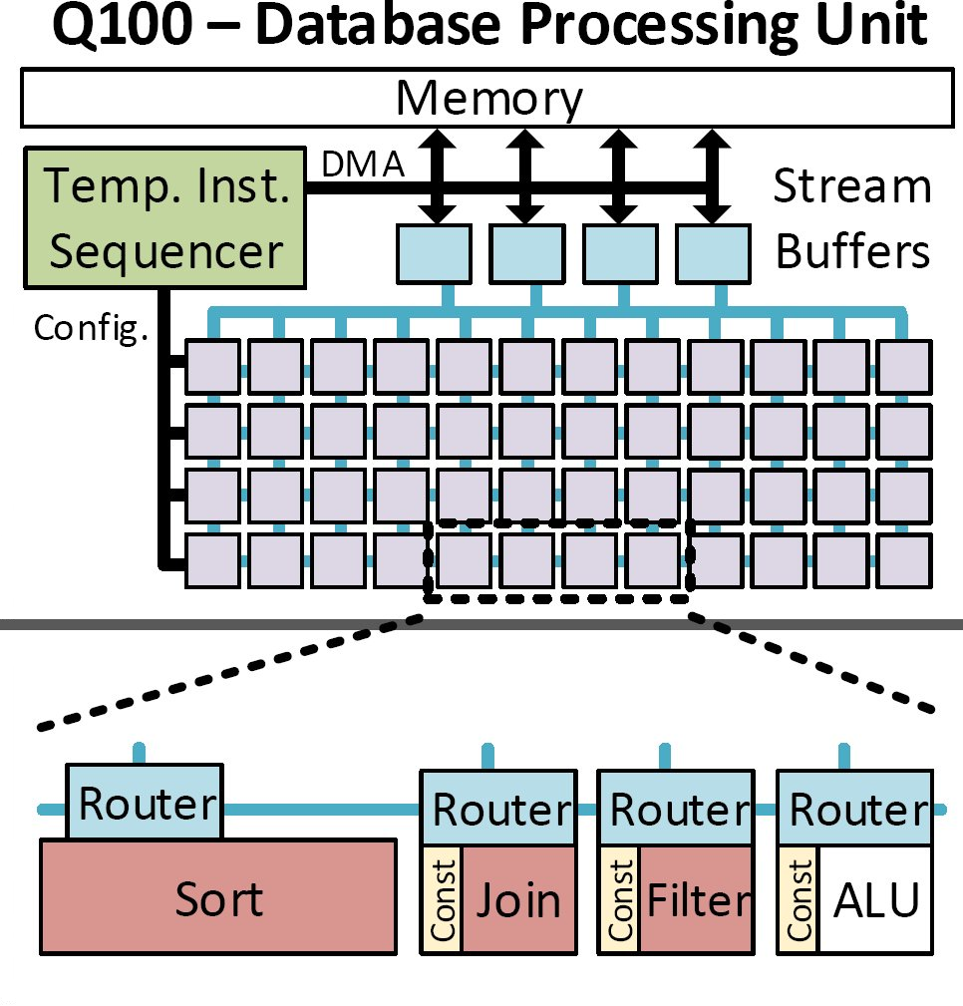
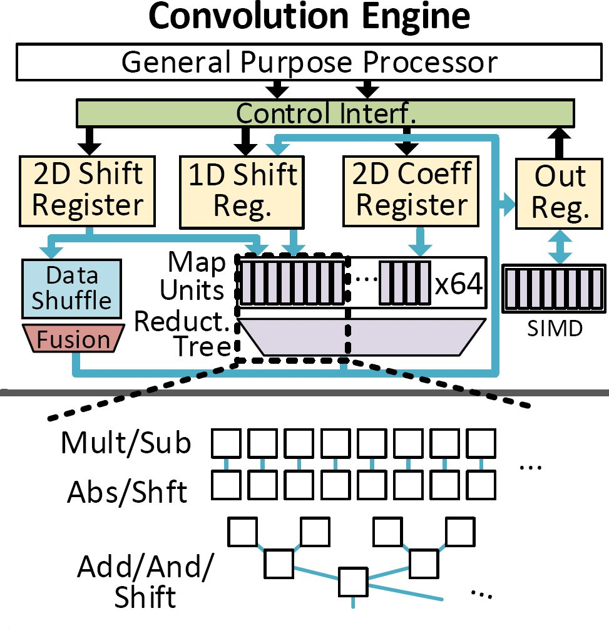
Principles in DSAs
High Level
Organization
Most DSAs employ 5 common
Specialization Principles
Processing Units
Concurrency
Computation
Communication
Data Reuse
Coordination

Slide 13
Outline
Introduction and Motivation
Principles of architectural specialization
Embodiment of principles in DSAs
Architecture for programmable specialization (LSSD)
Evaluation of LSSD with 4 DSAs (Performance, power & area)
System-level energy efficiency tradeoffs with LSSD and DSA
Concurrency
Computation
Communication
Data Reuse
Coordination
Energy
Speedup
Core
Accel.
$
System Bus
Memory

Slide 14
Implementation of Principles in a General Way
Composition of simple micro-architectural mechanisms
Concurrency: Multiple tiles (Tile – hardware for coarse grain unit of work)
Computation: Special FUs in spatial fabric
Communication: Dataflow + spatial fabric
Data Reuse: Scratchpad (SRAMs)
Coordination: Low power simple core
Each Tile
Concurrency
Computation
Communication
Data Reuse
Coordination

Slide 15
LSSD Programmable Architecture
Memory
Memory
Memory
Memory
D$
Low-power Core
(LX3)
DMA
Scratchpad
D$
Low-power Core
(LX3)
D$
Low-power Core
(LX3)
DMA
Scratchpad
DMA
Scratchpad
Input Interface
Input Interface
Input Interface
. . .
FU
FU
Spatial Fabric
Spatial Fabric
S
Spatial Fabric
. . .
. . .
. . .
FU
FU
S – Switch
Output Interface
Output Interface
Output Interface
Low power core | Spatial fabric | Scratchpad | DMA → LSSD
Concurrency
Computation
Communication
Data Reuse
Coordination

Slide 16
Instantiating LSSD
Programmable hardware template for specialization
LSSD
Provisioned for
one single application domain
Provisioned for
multiple application domains
Neural Approx.
LSSDN
Deep Neural
Stencil
Neural Approx.
Database
LSSDBalanced
or
LSSDB
Stencil
LSSDC
Deep Neural
LSSDD
Database
LSSDQ
Design point selection, Synthesis & Programming: More details in the paper…..
*Figures not to scale

Slide 17
Outline
Introduction and Motivation
Principles of architectural specialization
Embodiment of principles in DSAs
Architecture for programmable specialization (LSSD)
Evaluation of LSSD with 4 DSAs (Performance, power & area)
System-level energy efficiency tradeoffs with LSSD and DSA
Concurrency
Computation
Communication
Data Reuse
Coordination
Energy
Speedup
Core
Accel.
$
System Bus
Memory

Slide 18
Methodology
Modeling framework for LSSD
Perf: Trace driven simulator + application specific modeling
Power & Area: Synthesized modules, CACTI and McPAT
Compared to four DSAs (published perf., area & power)
Four parameterized LSSDs
Provisioned to match performance of DSAs
Other tradeoffs possible (power, area, energy etc. )
One combined balanced LSSD
LSSDN
LSSDC
LSSDD
LSSDQ
LSSDB
1 Tile 1 Tile 8 Tiles 4 Tiles
8 Tiles
NPU
Conv.
NPU
Conv.
DianNao
Q100
DianNao
Q100
Notes:
An analytical model → trace driven simulator with application specific modeling to capture compiler and LSSD program role
Framework has multiple execution stages depending on application
We contacted authors to get detailed cycle level counts and area/power information
LSSDn and LSSDc required one tile of LSSD

Slide 19
Performance Analysis (1)
LSSD_{N} vs. NPU
N
Baseline – 4 wide OOO core (Intel 3770K)
Notes:
Core + Sig → 1.7x
SIMD → 7x
CGRA → 9x
Reuse → 11.5x

Slide 20
Performance Analysis (2)
LSSD_{c} vs. Conv.
(1 Tile)
LSSD_{D} vs. DianNao
(8 Tiles)
Domain Provisioned LSSDs
Performance: LSSD able to match DSA
Main contributor to speedup: Concurrency
C
D
LSSD_{Q} vs. Q100
(4 Tiles)
Q
Baseline – 4 wide OOO core (Intel 3770K)

Slide 21
Domain Provisioned LSSDs
LSSD area & power compared to a single DSA ?

Slide 22
Area Analysis
Domain Provisioned LSSDs
3.8x
Domain provisioned LSSD overhead
1x – 4x worse in Area
1.7x
1.2x
0.5x
LSSDN
NPU
LSSDC
Conv.
LSSDD
LSSDQ
Q100
DianNao
*Detailed area breakdown in paper
Notes:
For NPU, same area as DSA. 1.6x more power
For Conv, 1.3x more area and 4.1x more power (Conv – 10bit datapath width)
LSSD alone is around 40x lower area/power than OOO

Slide 23
Power Analysis
Domain Provisioned LSSDs
4.1x
3.6x
Domain provisioned LSSD overhead
2x – 4x worse in Power
2x
0.6x
LSSDN
NPU
LSSDC
Conv.
LSSDD
LSSDQ
Q100
DianNao
*Detailed power breakdown in paper

Slide 24
Balance LSSD design
Area and power of LSSDBalanced design, when multiple domains mapped ?

Slide 25
LSSDBalanced Analysis
Area
Power
2.5x
Balance LSSD design overheads
Area efficient than multiple DSAs
2.5x worse in Power than multiple DSAs
0.6x
LSSDB
LSSDB
Multi-DSA
Multi-DSA

Slide 26
Outline
Introduction and Motivation
Principles of architectural specialization
Embodiment of principles in DSAs
Architecture for programmable specialization (LSSD)
Evaluation of LSSD with 4 DSAs (Performance, power & area)
System-level energy efficiency tradeoffs with LSSD and DSA
Concurrency
Computation
Communication
Data Reuse
Coordination
Energy
Speedup
Core
Accel.
$
System Bus
Memory

Slide 27
LSSD’s power overhead of
2x - 4x matter in a system with accelerator?
In what scenarios you want to build
DSA over LSSD?

Slide 28
Energy Efficiency Tradeoffs
System with accelerator
Pcore: 5W
OOO Core
Accel.
(LSSD or DSA)
Pacc: 0.1 – 5W
Core power
Accel. power
t: execution time
Caches
S: accelerator’s speedup
U: accelerator utilization
Psys: 5W
System power
System Bus
Memory
Overall energy of the computation executed on system
E =
Pacc * (U/S) * t
+
Psys * (1 – U + U/S) * t
+
Pcore * (1 - U) * t
Accel. energy
System energy
Core energy
*Power numbers are example representation

Slide 29
Energy Efficiency Gains of
LSSD & DSA over OOO core
Speeduplssd = Speedupdsa (Speedup w.r.t OOO)
Pdsa ≈ 0.0W
500mW Power overhead
Plssd = 0.5W
At higher speedups (S → ∞), energy efficiency gains ‘capped’ due to large system power
Baseline – 4 wide OOO core

Slide 30
LSSD’s power overhead of
2x - 4x matter in a system with accelerator?
When Psys >> Plssd, 2x - 4x power overheads of LSSD become inconsequential

Slide 31
Energy Efficiency Gains of
DSA over LSSD
Speeduplssd = Speedupdsa (Speedup w.r.t OOO)
${Eff}_{{dsa}/{lssd}}$ = (1 / DSA energy) / (1 / LSSD energy)
= LSSD energy / DSA energy
${Eff}_{{dsa}/{lssd}}$is no more than 10% even at 100% utilization
At higher speedups, benefits of DSA less than 5% on energy efficiency
At lower speedups, DSA’s energy efficiency gains 6 - 10% over LSSD
Baseline – LSSD

Slide 32
In what scenarios you want to build
DSA over LSSD?
Only when application speedups are small &
small energy efficiency gains too important

Slide 33
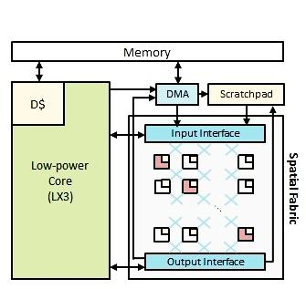
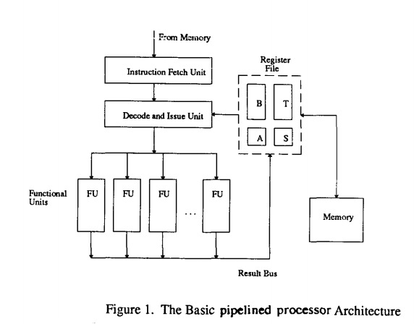
Conclusion
5 common principles for architectural specialization
Programmable architecture (LSSD) composed of simple uArch. mechanisms embodying the principles
LSSD competitive with DSA performance and overheads of only up to 4x in area and power
Power overhead inconsequential when system-level energy tradeoffs considered
LSSD as a baseline for future accelerator research
Programmable Architecture $LSSD$
5 stage pipelined processor (ISCA’ 87)

Slide 34
Back Up Slides

Slide 35
Design-Time vs. Runtime Decisions
 | Synthesis – Time | Run – Time
Concurrency | No. of LSSD Units | Power-gating unused LSSD Units
Computation | Spatial fabric FU mix | Scheduling of spatial fabric and core
Communication | Enabling spatial datapath elements, & SRAM interface widths | Config. of spatial datapath, switches and ports, memory access pattern
Data Reuse | Scratchpad (SRAM) size | Scratchpad used as DMA/reuse buffer
Notes:
Implement the principles in general way

Slide 36
LSSD Design Point Selection
Design | Concurrency | Computation | Comm. | Data Reuse | No. of LSSD Units
LSSD_{N} | 24-tile CGRA (8 Mul, 8 Add, 1 Sigmoid) | 2k x 32b sigmoid lookup table | 32b CGRA; 256b SRAM interface | 2k x 32b weight buffer | 1
LSSD_{C} | 64-tile CGRA (32 Mul/Shift, 32 Add/logic) | Standard 16b FUs | 16b CGRA; 512b SRAM interface | 512 x 16b SRAM for inputs | 1
LSSD_{D} | 64-tile CGRA (32 Mul, 32 Add, 2 Sigmoid) | Piecewise linear sigmoid unit | 32b CGRA; 512b SRAM interface | 2k x 16b SRAMs for inputs | 8
LSSD_{Q} | 32-tile CGRA (16 ALU, 4 Agg, 4 Join) | Join + Filter units | 64b CGRA; 256b SRAM interface | SRAMs for buffering | 4
LSSD_{B} | 32-tile CGRA (Combination of above) | Combination of above FUs | 64b CGRA; 512b SRAM interface | 4KB SRAM | 8

Slide 37
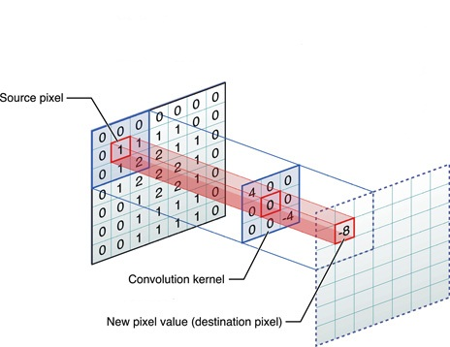
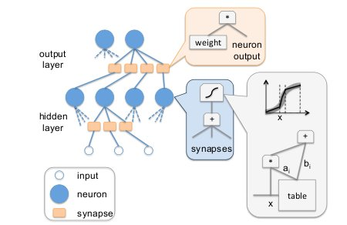
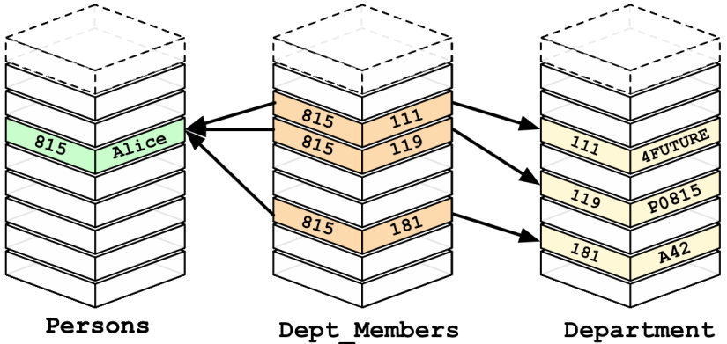
Accelerator Workloads
Neural Approx.
Convolution
DNN
Database Streaming
1. Ample Parallelism 2. Regular Memory
3. Large Datapath 4. Computation Heavy

Slide 38
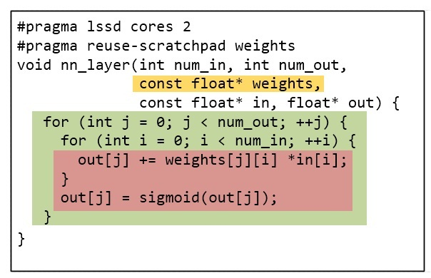
LSSD in Practice
1.
Design Synthesis
2.
Programming
Performance
Requirements
H/W
Constraints
Perf.
App. 1: ...
App. 2: ...
App. 3: ...
Area goal: ...
Power goal: ...
Designer
FU Types
No. of FUs
Spatial fabric size
No. of LSSD tiles
For each application:
Write Control Program
(C Prog. + Annotations)
Write Datapath Program
(spatial scheduling compiler framework)
Design
decisions
Synthesis
LSSD

Slide 39
Programming LSSD
Pragmas
Insert data transfer
LSSD
#pragma lssd cores 2
#pragma reuse-scratchpad weights
void nn_layer(int num_in, int num_out,
const float* weights,
const float* in,
const float* out )
{
for (int j = 0; j < num_out; ++j)
{
for (int i = 0; i < num_in; ++i)
{
out[j] += weights[j][i] *in[i];
}
out[j] = sigmoid(out[j]);
}
}
Memory
D$
Low-power Core
DMA
Scratchpad
Input Interface
x
x
x
x
x
x
x
x
Spatial Fabric
+
+
+
+
+
+
+
Ʃ
Output Interface
Loop Parallelize, Insert Communication,
Modulo Schedule
Resize Computation (Unroll), Extract Computation Subgraph, Spatial Schedule

Slide 40
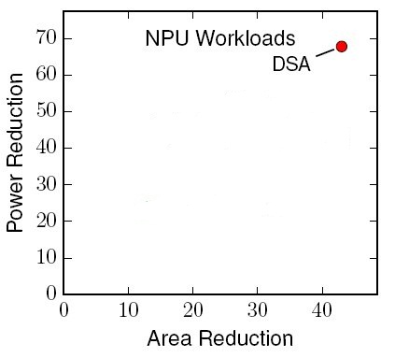
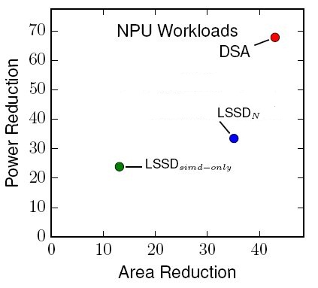
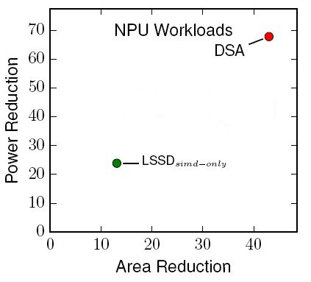
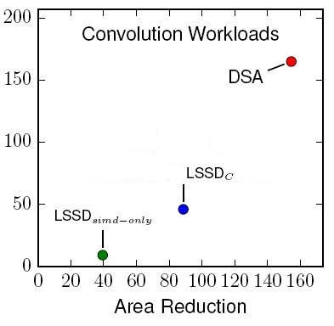
Power & Area Analysis (1)
LSSD_{N}
LSSD_{C}
1.2x more Area than DSA
2x more Power than DSA
1.7x more Area than DSA
3.6x more Power than DSA
Notes:
For NPU, same area as DSA. 1.6x more power
For Conv, 1.3x more area and 4.1x more power (Conv – 10bit datapath width)
LSSD alone is around 40x lower area/power than OOO

Slide 41
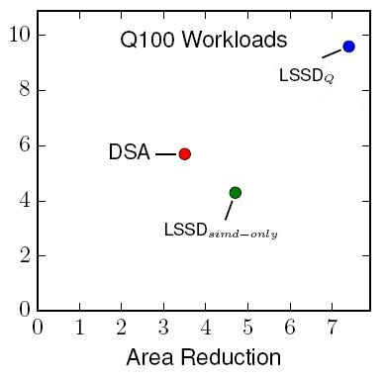
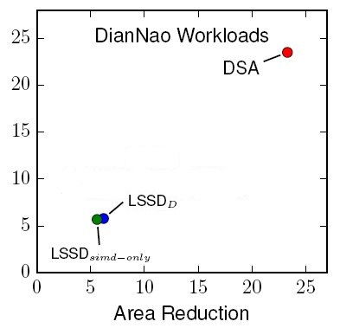
Power & Area Analysis (2)
LSSD_{D}
LSSD_{Q}
3.8x more Area than DSA
4.1x more Power than DSA
0.5x more Area than DSA
0.6x more Power than DSA
Notes:
For Q100, we are better in area by 0.2x and 0.3x better in power
For DianNao, we are 2.6x worse in area and 2.4x in power
LSSD is around 6x to 90x lower area and 5x to 40x lower power than OOO

Slide 42
LSSD Area & Power Numbers
 |  | Area (mm²) | Power (mW)
Neural Approx. | LSSD_{N} | 0.37 | 149
 | NPU | 0.30 | 74
Stencil | LSSD_{C} | 0.15 | 108
 | Conv. Engine | 0.08 | 30
Deep Neural. | LSSD_{D} | 2.11 | 867
 | DianNao | 0.56 | 213
Database Streaming | LSSD_{Q} | 1.78 | 519
 | Q100 | 3.69 | 870
 | LSSD_{Balanced} | 2.74 | 352
*Intel Ivybridge 3770K CPU 1 core Area – 12.9mm² | Power – 4.95W
*Intel Ivybridge 3770K iGPU 1 execution lane Area – 5.75mm²
+AMD Kaveri APU Tahiti based GPU 1CU Area – 5.02mm²
*Source: http://www.anandtech.com/show/5771/the-intel-ivy-bridge-core-i7-3770k-review/3
+Estimate from die-photo analysis and block diagrams from wccftech.com

Slide 43
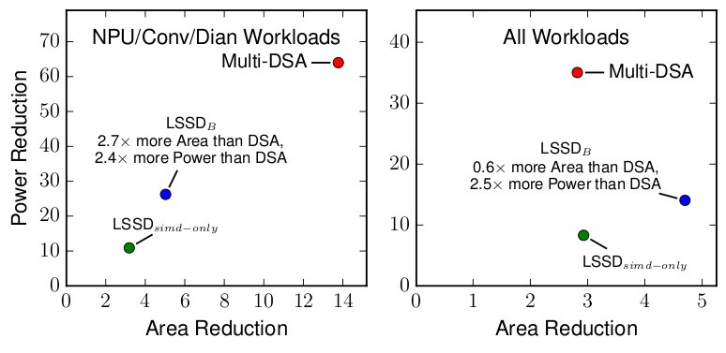
Power & Area Analysis (3)
LSSD_{B} → Balanced LSSD design
2.7x more Area than DSAs
2.4x more Power than DSAs
0.6x more Area than DSA
2.5x more Power than DSA

Slide 44
Energy Efficiency Gains of
DianNao over LSSD
SpeedupLSSD = SpeedupDianNao (Speedup w.r.t OOO)

Slide 45
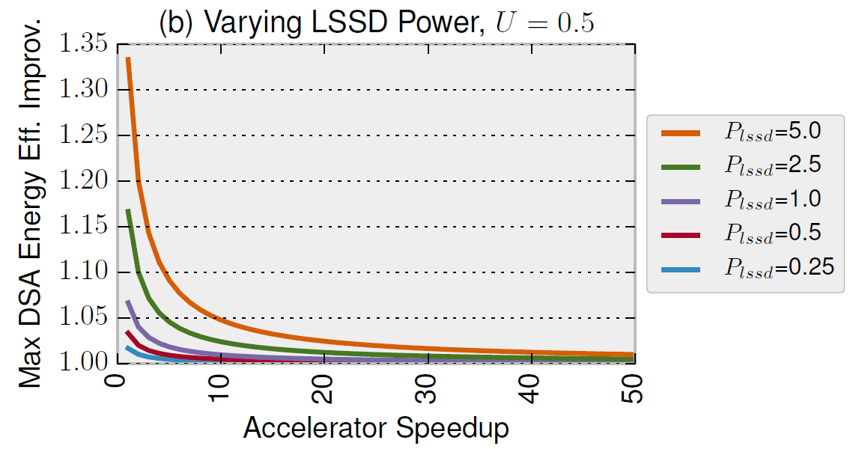
Does Accelerator power matter?
At Speedups > 10x, DSA eff. is around 5%, when accelerator power == core power
At smaller speedups, makes a bigger difference, up to 35%

