Slide 1
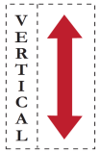
MIAOW: An Open Source RTL Implementation of a GPGPU
Vinay Gangadhar, Raghu Balasubramaniam, Mario Drumond, Ziliang Guo, Jai Menon, Cherin Joseph, Robin Prakash, Sharath Prasad, Pradip Vallathol, Karu Sankaralingam
www.miaowgpu.org
Vertical Research Group
University of Wisconsin - Madison

Slide 2
MIAOW Open Source GPGPU
MIAOW - Many-core Integrated Accelerator Of Wisconsin
AMD Southern Islands ISA-based GPGPU
Transformative for Academic GPU research
Contribution to Industry
MIAOW as a Research tool –
RTL codebase, Verification and Simulation toolchain
Support for workloads
Notes:
First publicly available open source GPGPU - MIAOW
Embodies its principles that it can be transformative for GPU research in Academia with RTL implementation
We also envision that this research tool could be of help to industry in applying new research ideas and exploring the uarch impact

Slide 3
Outline
Open Source GPGPU
Micro-Architecture
Realism
Research Flexibility
Conclusion

Slide 4
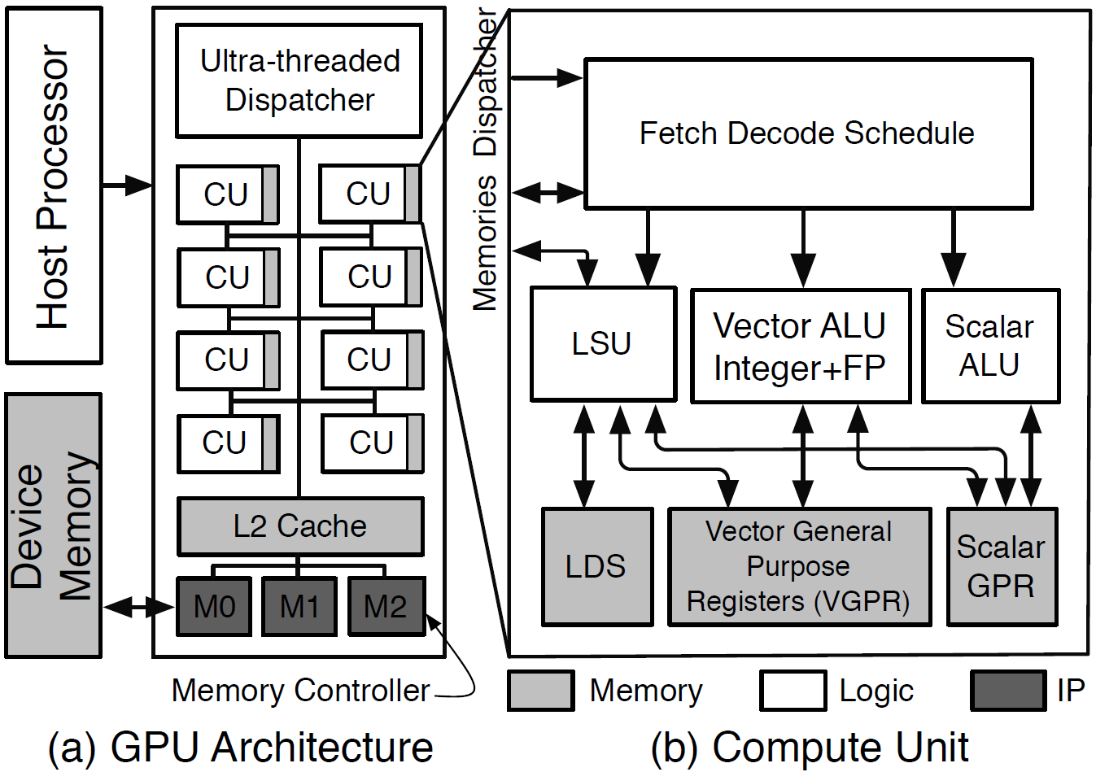
MIAOW Overview
MIAOW has 32 Compute Units (CUs)

Slide 5
Hardware Organization
Compute Unit
In-order + Vector core
Single Issue
40
16-wide vector ALUs
LSU – Memory operations
Wavefronts
Notes:
-- Hybrid of an in-order + vector core all fed by single instruction supply with MT support

Slide 6
ISA Summary
95 instructions – AMD Southern Islands ISA
No Graphics support
support
Notes:
The instructions selected are based on application profiling , operations in datapath and practically implementable by a small design team
Program control – predication and branch instructions
32 bit data support

Slide 7
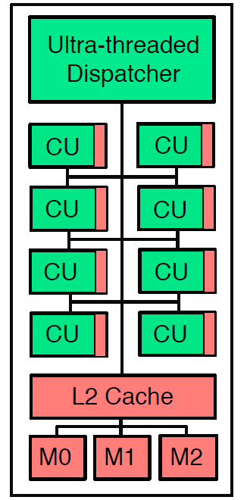
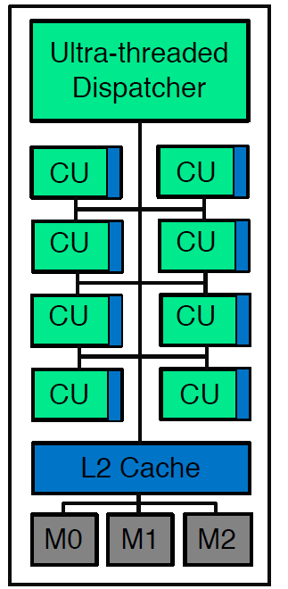
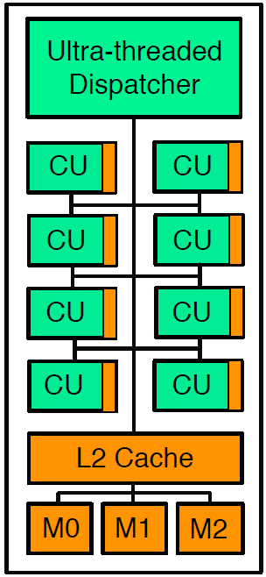
MIAOW Design Approach
(a) Full ASIC Design
(b) Mapped to FPGA
(c) Hybrid Design
Low Flexibility,
High Cost,
High Realism
Medium Flexibility,
Low Cost,
Long Design Time,
Medium Realism
High Flexibility,
Low Cost,
Short Design Time,
Flexible Realism
Notes:
Spectrum of Implementation strategizies and tradeoffs MIAOW follows
Shaded portion indicates Register file and SRAM storage
FPGA has resource constraints

Slide 8
Outline
Open Source GPGPU
Micro-Architecture
Realism
Research Flexibility
Conclusion

Slide 9
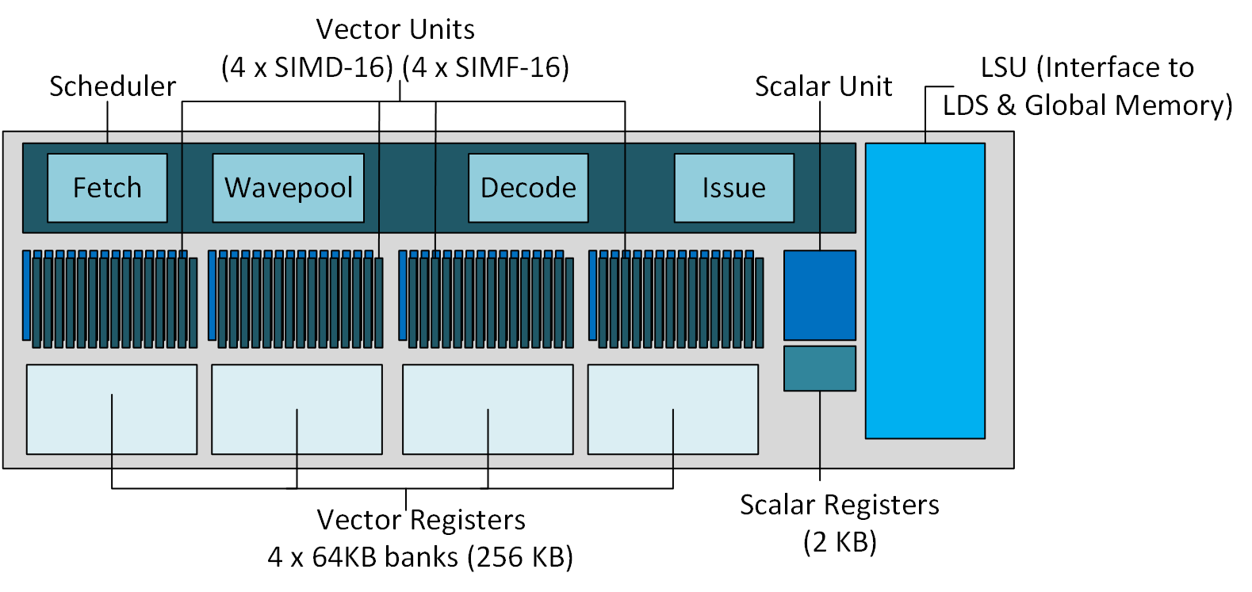
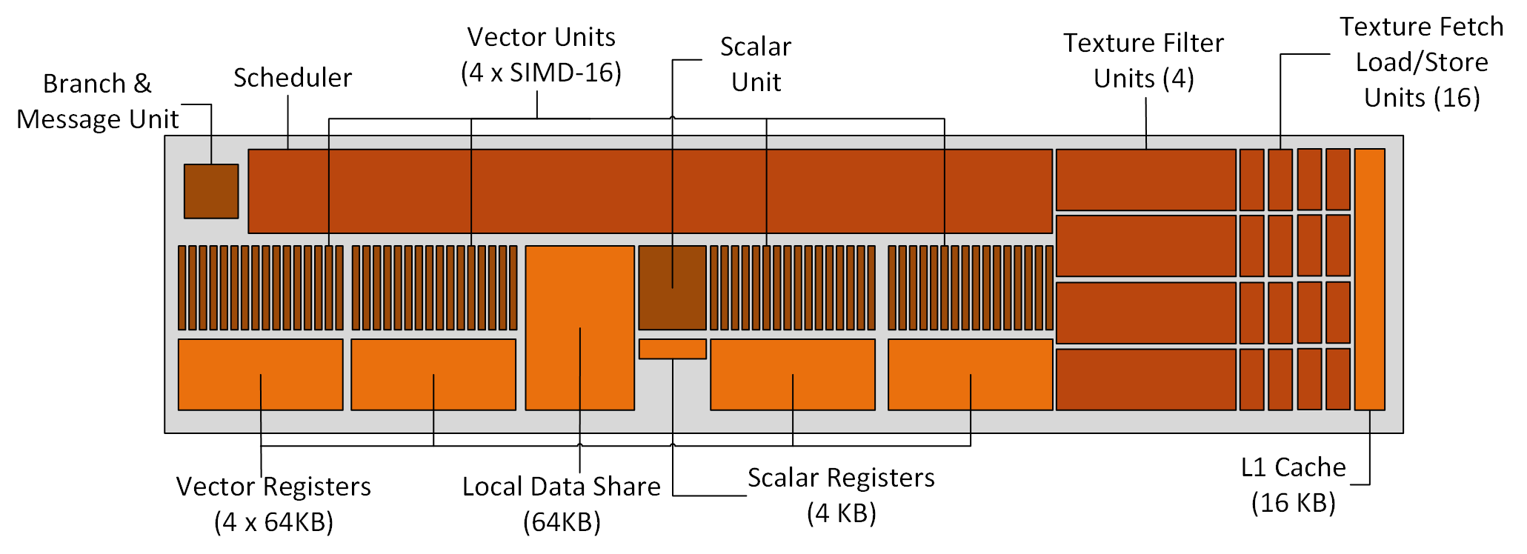
MIAOW Realism
MIAOW
No graphics and
texture support
in MIAOW
Kaveri
Notes:
-- MIAOW should be a realistic implementation of a GPU resembling principles and implementation of industry GPU
-- Area and Power estimation done to assure that our design decisions reflect that

Slide 10
Realism – Software Compatibility
Runs unmodified OpenCL programs
All OpenCL benchmarks
Many Rodinia benchmarks
Easily extendable to add any missing instruction from ISA

Slide 11
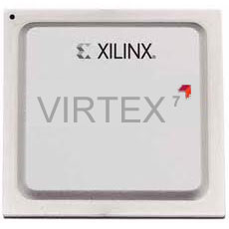
Realism – FPGA Synthesis
Xilinx Virtex 7 based
Maps 1 CU
Explores feasibility of Design
Benchmark prototyping – Ongoing work
Notes:
- ASIC Chip not built yet, but we do have a synthesized version of FPGA
Has embedded microblaze soft core processor connected to Compute unit via AXI interface
300K LUTs and 1K Block RAMs

Slide 12
Outline
Open Source GPGPU
Micro-Architecture
Realism
Research Flexibility
Conclusion

Slide 13
Research Flexibility
Direction | Research Idea | MIAOW enabled findings
New Directions | Circuit-Failure Prediction (Aged SDMR) | Implemented entirely in µarch Works elegantly in GPUs Small area, power overheads
 | Timing Speculation (TS) | Quantifies error-rate on GPU
Direction | Research Idea | MIAOW enabled findings
Validation of Simulator studies | Transient Fault Injection | RTL Level Fault Injection More Gray area than CPUs Silent data corruption seen
Direction | Research Idea | MIAOW enabled findings
Traditional µarch | Thread-block compaction (TBC) | Implemented TBC in RTL Significant design complexity Increase in Critical Path length
Ultra-threaded Dispatcher modified
Micro-architecture impacted
Compute Units modified
Micro-architectural Gates + Delay elements impacted
Compute Units + Storage modified
Delay elements impacted
Notes:
Physical design perspective to traditional uarch
It should be flexible enough to accommodate research studies of various types
Compare the implementation to simulator studies

Slide 14
Research Flexibility
Direction | Research Idea | MIAOW enabled findings
Traditional µarch | Thread-block compaction (TBC) | Implemented TBC in RTL Significant design complexity Increase in Critical Path length
New Directions | Circuit-Failure Prediction (Aged SDMR) | Implemented entirely in µarch Works elegantly in GPUs Small area, power overheads
 | Timing Speculation (TS) | Quantifies error-rate on GPU
Validation of Simulator studies | Transient Fault Injection | RTL Level Fault Injection Silent data corruption seen
Notes:
Physical design perspective to traditional uarch
It should be flexible enough to accommodate research studies of various types
Compare the implementation to simulator studies

Slide 15
Conclusion
MIAOW provides transformative capability for GPU research
More community support → First Open Source Silicon GPU Chip
Can it help kick-start an Open Source hardware movement?
Are Open Source hardware chips feasible?
www.miaowgpu.org
Notes:
-- It should be flexible enough to accommodate research studies of various types

Slide 16
Back Up Slides
Notes:
-- It should be flexible enough to accommodate research studies of various types

Slide 17
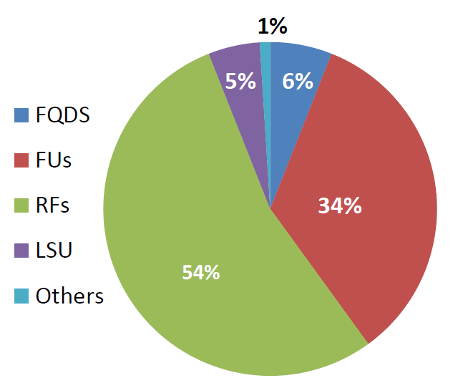
Area Estimates
Total Area: 15 mm²
SRAM based RF: 9mm²

Slide 18
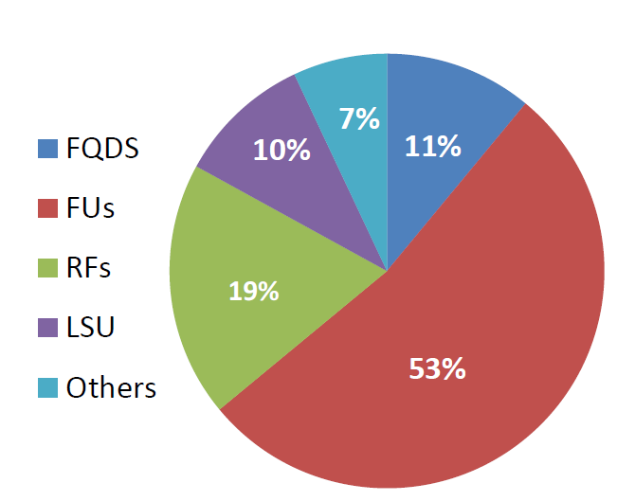
Power Estimates
Total Power: 1.1 W

Slide 19
Performance Estimates
Compared to NVIDIA Fermi 1-SM GPU
CPI close on 3 benchmarks
CPI | DMin | DMax | BinS | BSort | MatT | PSum | Red | SLA
Scalar | 1 | 3 | 3 | 3 | 3 | 3 | 3 | 3
Vector | 1 | 6 | 5.4 | 2.1 | 3.1 | 5.5 | 5.4 | 5.5
Memory | 1 | 100 | 14.1 | 3.8 | 4.6 | 6.0 | 6.8 | 5.5
Overall | 1 | 100 | 5.1 | 1.2 | 1.7 | 3.6 | 4.4 | 3.0
NVIDIA | 1 | - | 20.5 | 1.9 | 2.1 | 8 | 4.7 | 7.5

Slide 20
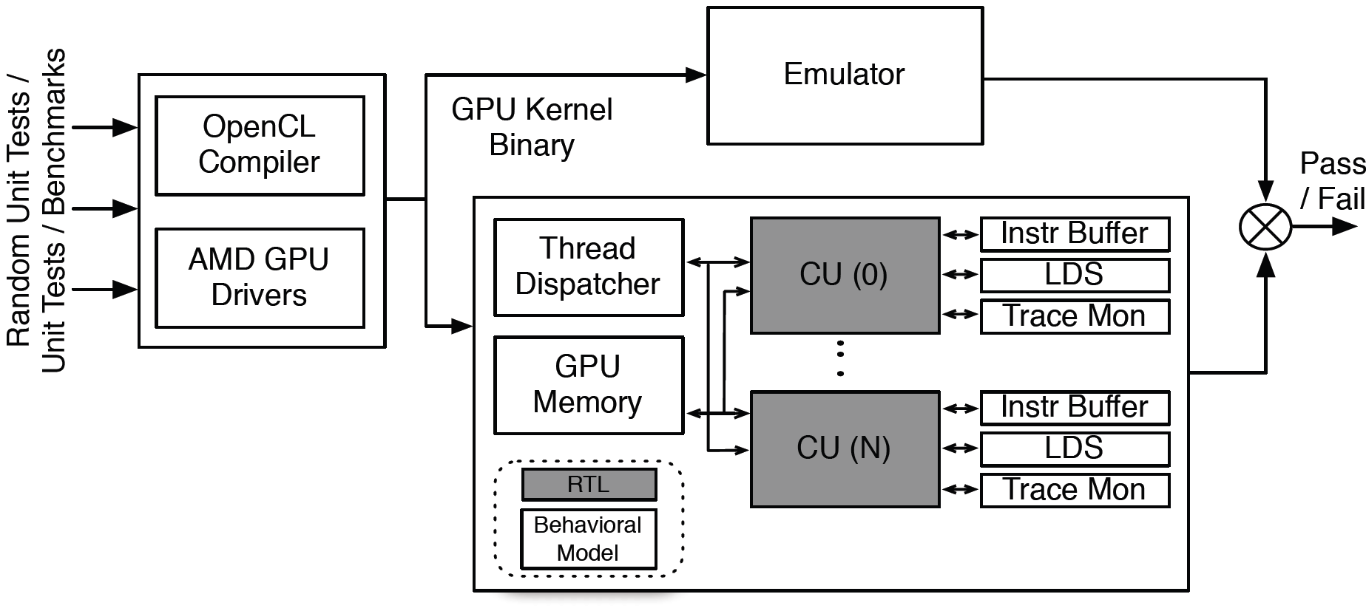
Verification Methodology
Emulator – Multi2sim Heterogeneous Simulator

