Slide 1
Distributed Computing in Practice: The Condor Experience CS739 11/4/2013
Todd Tannenbaum
Center for High Throughput Computing
Department of Computer Sciences
University of Wisconsin-Madison

Slide 2
The Condor High Throughput Computing System
“Condor is a high-throughput distributed computing system. Like other batch systems, Condor provides a job management mechanism, scheduling policy, priority scheme, resource monitoring, and resource management….
While similar to other conventional batch systems, Condor's novel architecture allows it to perform well in environments where other batch systems are weak: high-throughput computing and opportunistic computing.”

Slide 3
MultiCore
Cyber Infrastructure
SaaS
HDFS
WorkFlows
Workforce
HTPC
IaaS
Grids
eResearch
HPC
Cyber Security
100Gb
SLA
Virtual Machines
QoS
Web Services
eScience
Open Source
HTC
Map-Reduce
Clouds
Master-Worker
High Availability
Green Computing
GPUs
3

Slide 4
Definitional Criteria for a Distributed Processing System
P.H. Enslow and T. G. Saponas “”Distributed and Decentralized Control in Fully Distributed Processing Systems” Technical Report, 1981
Multiplicity of resources
Component interconnection
Unity of control
System transparency
Component autonomy

Slide 5
A thinker's guide to the most important trends of the new decade
In Defense of Failure By Megan McArdle Thursday, Mar. 11, 2010
“The goal shouldn't be to eliminate failure; it should be to build a system resilient enough to withstand it”
“The real secret of our success is that we learn from the past, and then we forget it. Unfortunately, we're dangerously close to forgetting the most important lessons of our own history: how to fail gracefully and how to get back on our feet with equal grace.”

Slide 6
Claims for “benefits” provided by Distributed Processing Systems
P.H. Enslow, “What is a Distributed Data Processing System?” Computer, January 1978
High Availability and Reliability
High System Performance
Ease of Modular and Incremental Growth
Automatic Load and Resource Sharing
Good Response to Temporary Overloads
Easy Expansion in Capacity and/or Function

Slide 7
High Throughput Computing (HTC)
High Throughput Computing
Goal: Provide large amounts of fault tolerant computational power over prolonged periods of time by effectively utilizing all resources
High Performance Computing (HPC) vs HTC
FLOPS vs FLOPY
FLOPY != FLOPS * (Num of seconds in a year)

Slide 8
Opportunistic Computing
Opportunistic Computing
Ability to use resources whenever they are available, without requiring one hundred percent availability.
Very attractive due to realities of distributed ownership
[Related: Volunteer Computing]

Slide 9
Philosophy of Flexibility
Let communities grow naturally.
Build structures that permit but do not require cooperation.
Relationships, obligations, and schemata will develop according to user necessity
Leave the owner in control.
Plan without being picky.
Better to be flexible than fast!
Lend and borrow.

Slide 10
Todd’s Helpful Tips
Architect in terms of responsibility instead of expected functionality
Delegate like Ronald Reagan. How?
Plan for Failure!
Leases everywhere, 2PC, belt and suspenders, …
Never underestimate the value of code that has withstood the test of time in the field
Always keep end-to-end picture in mind when deciding upon layer functionality

Slide 11
End to end thinking
Code reuse creates tensions…
Example: Network layer uses checksums to ensure correctness

Slide 12
The Condor Kernel
Step 1: User submits a job

Slide 13
How are jobs described?
ClassAds and Matchmaking
Name-value pairs
Values can be literal data or expressions
Expression can refer to match candidate
Requirements and Rank are treated special

Slide 14
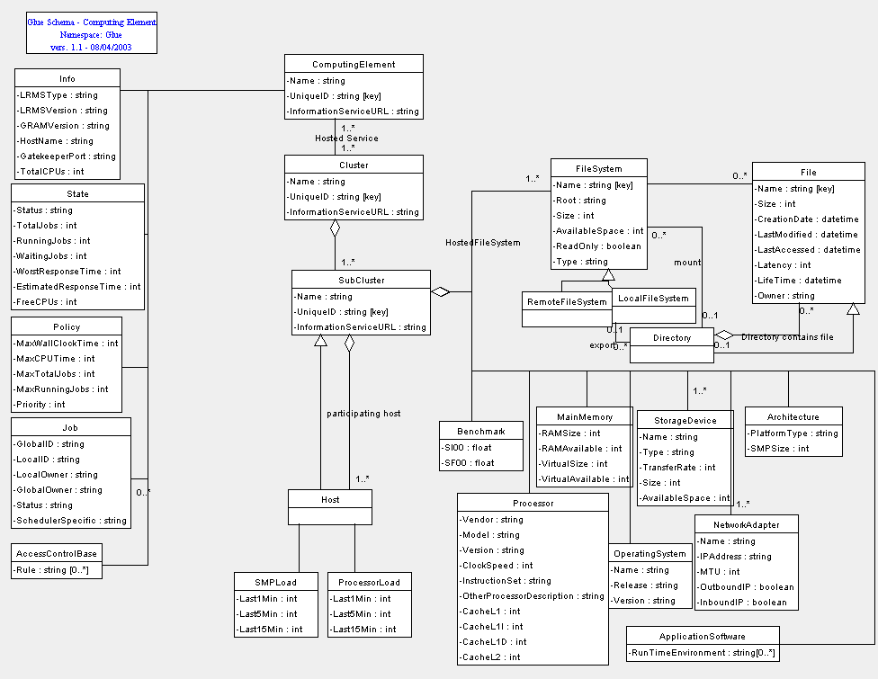
Interesting ClassAd Properties
Semi-structured data
No fixed schema
“Let communities grow naturally…”
Use three-value logic
Expressions evaluate to True, False, or Undefined
Bilateral

Slide 15
Plan for Failure, Lend and borrow
Begin Transaction
105 Owner Todd
105 Cmd /bin/hi
…
End Transaction
Begin Transaction
106 Owner Fred
106 Cmd /bin/bye
What if schedd crashes during job submission?
ARIES-style recovery log
2 phase commit
Prepare
schedd
Job ID 106
Commit 106

Slide 16
The Condor Kernel
Step 2: Matchmaking

Slide 17
Matchmaking Protocol
Each component (A, M, R) service is independent and has a distinct responsibility
Centralized Matchmaker is very light weight: after Match step, it is not involved
Claims can be reused, delegated, …
Advertise
Match
Claim

Slide 18
Federation via Direct Flocking
Federation many years later was easy because of clearly defined roles of services

Slide 19
Globus and GRAM
GRAM = Grid Resource Access and Management
“Defacto-standard” protocol for submission to a site scheduler
Problems
Dropped many end-to-end features
Like exit codes!
Couples resource allocation and job execution
Early binding of a specific job to a specific queue

Slide 24
Solution: Late-binding via GlideIn

Slide 25
Split Execution Environments
Standard Universe
Process Checkpoint/Restart
Remote I/O
Java Universe

Slide 26
Process Checkpointing
Condor’s process checkpointing mechanism saves the entire state of a process into a checkpoint file
Memory, CPU, I/O, etc.
The process can then be restarted from right where it left off
Typically no changes to your job’s source code needed—however, your job must be relinked with Condor’s Standard Universe support library

Slide 27
Relinking Your Job for Standard Universe
To do this, just place “condor_compile” in front of the command you normally use to link your job:
% condor_compile gcc -o myjob myjob.c
- OR -
% condor_compile f77 -o myjob filea.f fileb.f

Slide 28
When will Condor checkpoint your job?
Periodically, if desired (for fault tolerance)
When your job is preempted by a higher priority job
Preempt/Resume scheduling – powerful!
When your job is vacated because the execution machine becomes busy

Slide 29
Remote System Calls
I/O system calls are trapped and sent back to submit machine
Allows transparent migration across administrative domains
Checkpoint on machine A, restart on B
No source code changes required
Language independent
Opportunities for application steering

Slide 30
The Condor Kernel

Slide 31
Remote I/O
condor_schedd
condor_startd
condor_shadow
condor_starter
Job
I/O
Lib
File

Slide 32
Java Universe Job
universe = java
executable = Main.class
jar_files = MyLibrary.jar
input = infile
output = outfile
arguments = Main 1 2 3
queue

Slide 33
Why not use Vanilla Universe for Java jobs?
Java Universe provides more than just inserting “java” at the start of the execute line
Knows which machines have a JVM installed
Knows the location, version, and performance of JVM on each machine
Can differentiate JVM exit code from program exit code
Can report Java exceptions

Slide 34
DAGMan
Directed Acyclic Graph Manager
DAGMan allows you to specify the dependencies between your Condor jobs, so it can manage them automatically for you.
(e.g., “Don’t run job “B” until job “A” has completed successfully.”)
Notes:
In the simplest case…

Slide 35
What is a DAG?
A DAG is the data structure used by DAGMan to represent these dependencies.
Each job is a “node” in the DAG.
Each node can have any number of “parent” or “children” nodes – as long as there are no loops!
Job A
Job B
Job C
Job D
Notes:
a DAG is the best data structure to represent a workflow of jobs with dependencies
children may not run until their parents have finished – this is why the graph is a directed graph … there’s a direction to the flow of work
In this example, called a “diamond” dag, job A must run first; when it finishes, jobs B and C can run together; when they are both finished, D can run; when D is finished the DAG is finished
Loops, where two jobs are both descended from one another, are prohibited because they would lead to deadlock – in a loop, neither node could run until the other finished, and so neither would start – this restriction is what makes the graph acyclic

Slide 36
Defining a DAG
A DAG is defined by a .dag file, listing each of its nodes and their dependencies:
# diamond.dag
Job A a.sub
Job B b.sub
Job C c.sub
Job D d.sub
Parent A Child B C
Parent B C Child D
each node will run the Condor job specified by its accompanying Condor submit file
Job A
Job B
Job C
Job D
Notes:
This is all it takes to specify the example “diamond” dag.
DAGMan will output the log file for each job to determine what to do next.

Slide 37
Security
CEDAR
Job Sandboxing

Slide 38
Questions?

